Slide 1
Wildlife Habitat Programs
It’s Easier Than You Think
How to Gain Certification Through the WHC

Slide 2
Disclaimer
Me (Jodi)
Expert

Slide 3
Our Native Species Depend on Private Land
And Responsible Land Stewardship
In the U.S., 80 percent of the habitat that species listed under the Endangered Species Act depend on exists on private lands. Therefore, leadership by business, across all scales of land holdings, is essential to species protection and recovery.
Arkansas is home to 37 threatened and endangered (T&E) species that range from mammals and birds to insects, amphibians, mussels, and plants.
An estimated 82 percent of the total land base in Arkansas is privately owned. Surveys show that although many Arkansas landowners would like to do more for wildlife on their property, many do not know what to do. This is particularly the case for landowners with less than 40 acres whose landholdings are located on the fringe of cities or rural communities (U of A, Department of Agriculture).
Interior Least Tern

Slide 4
What is the Wildlife Habitat Council?
Mission: The Wildlife Habitat Council promotes and certifies habitat conservation and management on corporate lands through partnerships and education.
Vision: At WHC, we believe that every act of conservation matters. Whether it’s a small pollinator garden or a complex wetlands restoration, each and every conservation action contributes to the collective positive outcome for the environment.
Values: The Wildlife Habitat Council has an open, true, driven and bold team, and believe that every act of conservation matters.

Slide 5
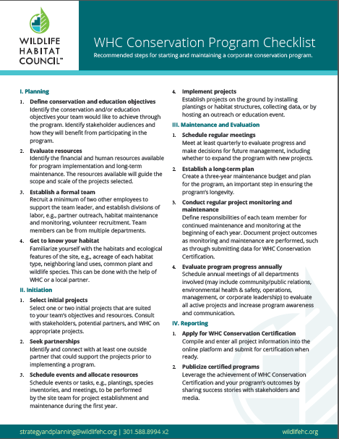
Requirements for WHC Conservation Certification
Applications must have at least one qualifying project*
Qualifying projects: 1. Are locally appropriate 2. Exceed regulatory requirements 3. Provide conservation or education value 4. Have documented measurable outcomes

Slide 6
How to Plan Your Project
Steps Provided by the WHC
Planning
Define objectives
What does your company want to achieve?
What are your employees interested in?
Start small, allow room for growth, consider sustainability
Evaluated resources and establish team
What is your available monetary and time budget?
Who will commit to the project?
What other programs exist in the region?
Know your habitat
What type of habitat/ecological features exists on your property?
Is there room for improvement?
What species utilize your property?

Slide 8
Initiate Your Project
Initiation
Select project(s)
Seek partnerships
Start local
Look for partners with similar goals
Some partners can provide funding
Schedule events/allocate resources
Develop 3-year budget and schedule
Educate yourself on important deadlines
One person cannot do it all
Implement projects

Slide 9
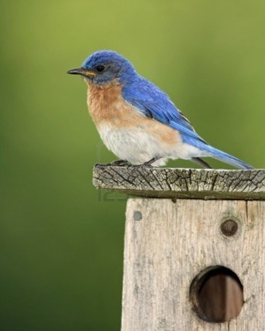
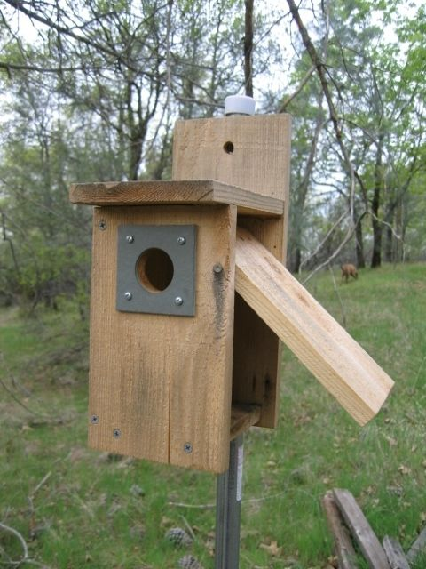
Program Implementation and Reporting
Maintenance and Evaluation
Regular meetings/evaluations
Routine maintenance
Items such as spring and fall seeding,
birdhouse cleaning, mowing
Routine monitoring
Documentation
Photography
Report results
WHC-Conservation Certification
Other programs

Slide 10
Types of WHC Programs
26 Possible Themes
Habitat, ex.
Grassland, wetland, forest, landscaping
Species, ex.
Avian, mammals, fish
Education and Awareness
Tours, events, formal learning
Other Options
Green infrastructure, remediation
Pollinator Project

Slide 11
WHC Programs
No minimum acreage requirements
You can have one or more programs
You set your own monitoring requirements and goals
Application submitted online
Certification good for 2 years
Certification fee $1,000
WHC staff available to help (different levels)

Slide 12
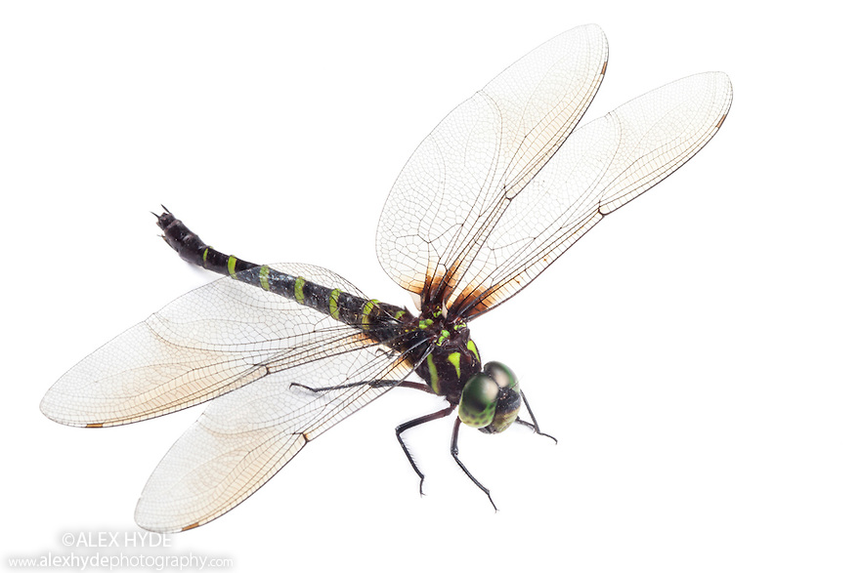
Waste Management Example:
How We Set Ourselves Up to Fail
OR
How We Learned From Our Mistakes

Slide 13
2009 Eco-Vista Landfill WHC Project
Wildlife at Work

Slide 14
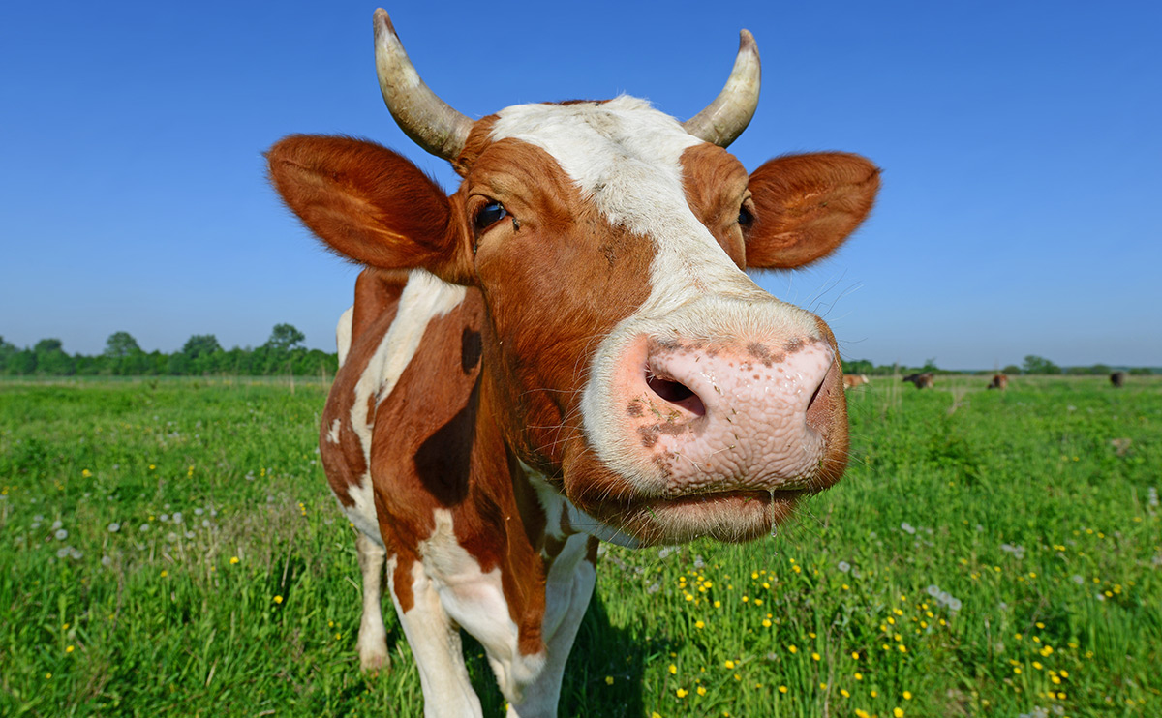
Components of 2009 WHC Plan
Prairie Unit
75 acres of prairie unit improvement/conservation area in 6 phases
$7,000 total - Quail Unlimited grant with matching funds by WM to plant native grasses in 2009
Changes in management
Neighbors cows grazed land
Future borrow area makes this plan unsustainable
Employees weren’t interested in this area

Slide 15
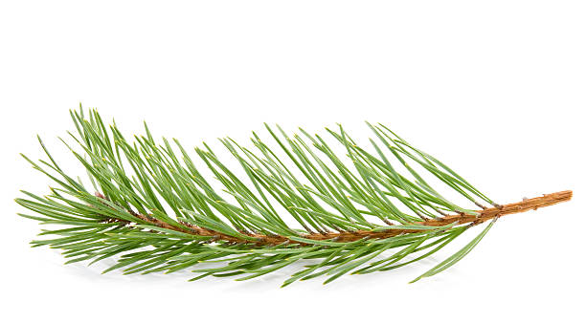
Components of 2009 WHC Plan
Woodland Unit/Bluebird Trail
85 acres of hardwood/pine forest improvement/conservation in 2 phases
Since 2009, 4 prescribe burn event conducted on approximately 40 acres for timber stand improvement – Phase 1
Wildlife walking trail cut through Phase 2
Outdoor classroom built in Phase 1
Bluebird boxes erected along the trail and monitored annually
Project is sustainable because it was planned in areas not affected by landfill expansion activities
Project successful because employees liked working in the woods
Outdoor classroom never used because it is not accessible

Slide 16
Components of 2009 WHC Plan
Butterfly Garden/Fish Pond
Small area at site entrance planted with native wildflowers for a butterfly garden
Easy project with highly visible results, adds aesthetic value
Someone forgot to tell the temps not to mow this area
Small pond near scalehouse designated as wildlife area and automatic fish feeders installed
Another easy project with highly visible results, adds aesthetic value BUT…
Next landfill expansion is planned right over pond and scalehouse area

Slide 17
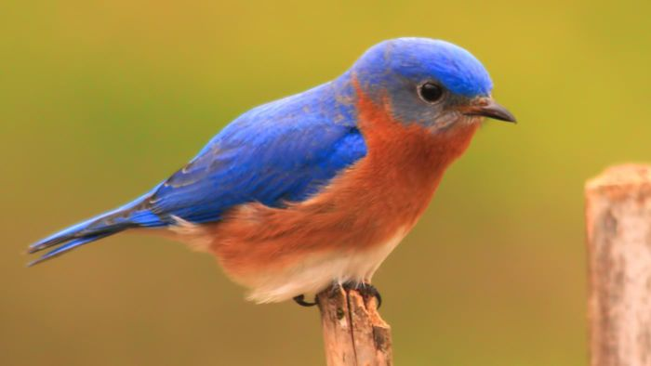
Revised Program
Eco-Vista Landfill
Bluebird trail
Monitor bluebird boxes
Performed by site personnel
Woodland unit
Prescribed burn
Performed by contractor
Wildlife Inventory
Record wildlife seen on site
Performed by site personnel

Slide 18
5 Key Takeaways
For A Successful Program
A great Wildlife Habitat Program does not necessarily require lots of time and money
Consider comprehensive site plan when designing your Wildlife Habitat Program
Employee participation and interest is crucial
Teaming with local groups who have similar interests can be a great asset
If you don’t document it, it didn’t happen

