Slide 1

Environmental Mitigation Trust
Volkswagen Settlement
ADEQ
Office of Air Quality
Notes:
Image Notes: https://pixabay.com/en/car-volkswagen-vw-shine-reflection-932734/
CC0 Public DomainEditorial use only
No attribution required
Learn more

Slide 2

Overview
Volkswagen Partial Settlement
Environmental Mitigation Trust
Arkansas Environmental Mitigation Plan

Slide 3
Volkswagen Partial Settlement

Slide 4
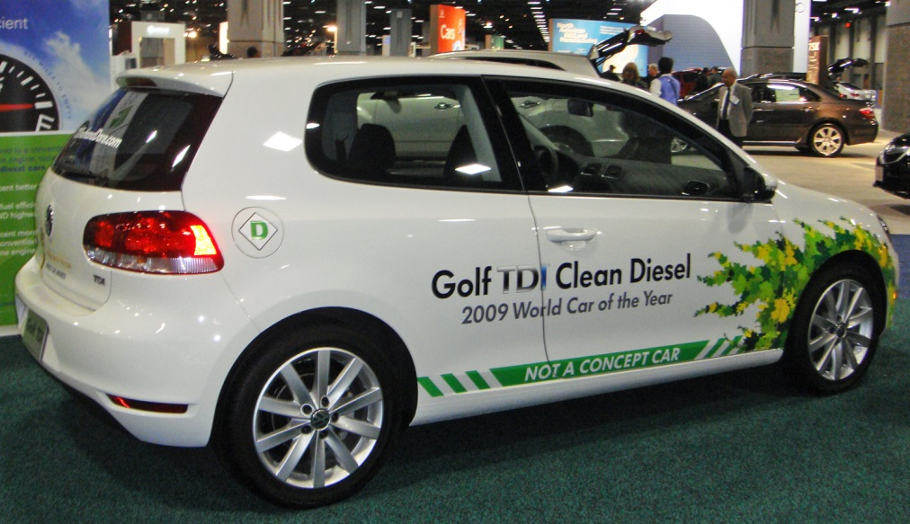
Allegations against Volkswagen
September 18, 2015 – EPA issued a Notice of Violation of the Clean Air Act to Volkswagen for the alleged sale of ~ 500,000 turbocharged direct Injection diesel (TDI) vehicles equipped with emission control defeat devices.
Vehicles subject to the Notice of Violation and subsequent litigation emitted up to forty times more nitrogen oxides than allowed under applicable emission standards.

Slide 5
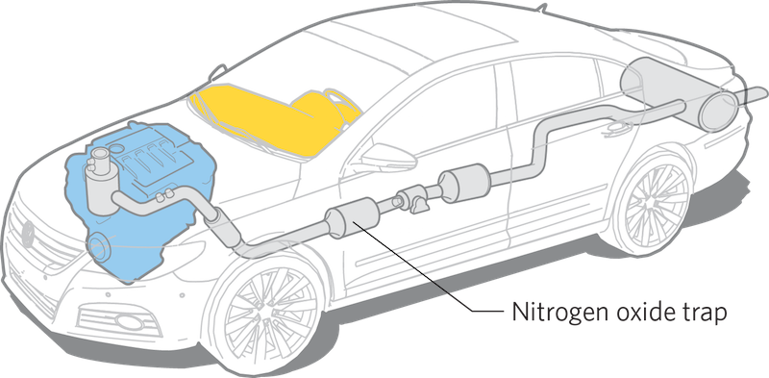
Use of the Defeat Device
Volkswagen installed software that turned off pollution controls except during EPA testing, which
both vastly
increased
the
emissions of
nitrogen oxides
and also enhanced vehicle performance.

Slide 6


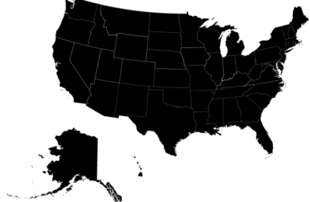
First Partial Consent Decree
October 25, 2016 – Volkswagen enters into the first of three consent decrees to partially settle Clean Air Act violation allegations. The first consent decree consists of three major parts:
  Volkswagen must buy back, terminate leases, or provide approved emissions modifications for subject 2.0 L vehicles;
  Volkswagen must invest $2 billion over ten years in projects that increase the use of zero emission vehicles; and
  Volkswagen must pay $2.7 billion to an Environmental Mitigation Trust for states to fund projects to reduce emissions of nitrogen oxides.

Slide 7
Second and Third Partial Consent Decrees
December 20, 2016 – Volkswagen enters into a second partial consent decree addressing 3.0 L subject vehicles. The second consent decree consists of two major parts:
  Volkswagen must buy back, terminate leases, or provide approved emission modifications for subject 3.0 L vehicles; and
  Volkswagen must pay an additional $225,000,000 into the Environmental Mitigation Trust.
January 11, 2017– Volkswagen enters into a third partial consent decree addressing Volkswagen’s liability under the Clean Air Act for civil penalties and injunctive relief to prevent similar future violations.
  In total, Volkswagen must pay$14.7 billion in settlement
    fees

Slide 8
Other Consequences
In 2015, a Harvard study concluded that fifty-nine premature deaths occurred as a result of the scandal and that this number could increase to 120.
On January 11, 2017, VW pled guilty to three criminal felony counts and to pay $2.8 billion in a fine. In addition The court appointed a monitor to oversee the parent company.
  VW also agreed to pay $1.5 billion in civil penalties in connection with the importation and sale of these cars as well as Customs and Border Protection claims for customs fraud.
On May 3, 2018, Martin Winterkorn, the former chairman of the board of Volkswagen AG was charged with conspiracy and wire fraud in connection with the what the Department of Justice (DOJ) described as the “long-running scheme to cheat U.S. diesel vehicle emissions requirements.”
  As of May 3, 2018, nine VW executives have been charged in connection with their roles in the scandal. Two have pled guilty.
  Four Audi executives were charged on January 17, 2019.

Slide 9
Environmental Mitigation Trust

Slide 10
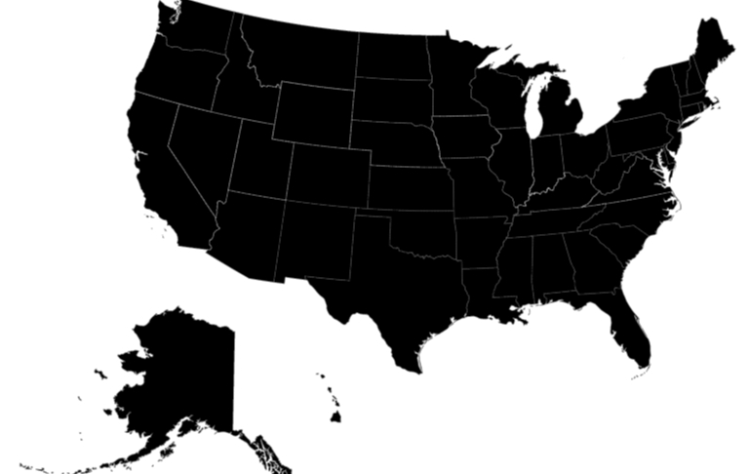
Environmental Mitigation Trust
Volkswagen will pay $2.7 billion to be used to establish an Environmental Mitigation Trust.
  The Trust will be administered by Wilmington Trust.
  States and territories will use trust funds to invest in transportation projects that will reduce emissions of nitrogen oxides.
  States must develop and submit a Beneficiary Mitigation Plan that summarizes how funds from the Environmental Mitigation Trust will be used.

Slide 11
Beneficiary Mitigation Plan
Projects that can be included in a Beneficiary Mitigation Plan are limited to a framework of ten Eligible Mitigation Actions.
The Beneficiary Mitigation Plan must include the following:
  The goal for use of the funds allocated under the trust;
  Eligible mitigation actions selected and the percentage of funds to be used for each action;
  A description of how the beneficiary will consider the beneficial impact of the actions in areas that bear a disproportionate share of air pollution; and
  A general description of emissions benefits.
States and territories can adjust their Beneficiary Mitigation Plans at any time, but changes must be submitted to and approved by the Trustee.

Slide 12
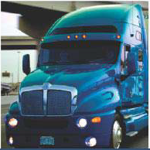
Eligible Mitigation Action 1
Eligible Large Trucks
  Engine model year 1992–2009 Class 8 local freight or drayage trucks
  Eligible large trucks may be repowered or replaced with any new diesel, alternative fueled, or all-electric engine/vehicle
  Scrappage of old equipment/vehicle is required
Project Type | Percentage Funded through Trust
 | Government-owned | Other
Repower with new diesel or alternative-fueled vehicle | Up to 100% | Up to 40%
Replace vehicle with new diesel or alternative-fueled vehicle | Up to 100% | Up to 25% (50% for drayage trucks)
Repower with all-electric engine, including infrastructure | Up to 100% | Up to 75%
Replace with all-electric vehicle, including infrastructure | Up to 100% | Up to 75%

Slide 13
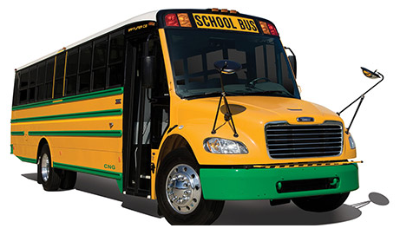
Eligible Mitigation Action 2
Eligible Buses
  Engine model year 2009 and older Class 4–8 school buses, shuttle buses, or transit buses
  Eligible buses may be repowered or replaced with any new diesel, alternative fueled, or all-electric engine/vehicle
  Scrappage of old equipment/vehicle is required
Project Type | Percentage Funded through Trust
 | Government-owned | Other
Repower with new diesel or alternative-fueled vehicle | Up to 100% | Up to 40%
Replace vehicle with new diesel or alternative-fueled vehicle | Up to 100% | Up to 25%
Repower with all-electric engine, including infrastructure | Up to 100% | Up to 75%
Replace with all-electric vehicle, including infrastructure | Up to 100% | Up to 75%

Slide 14
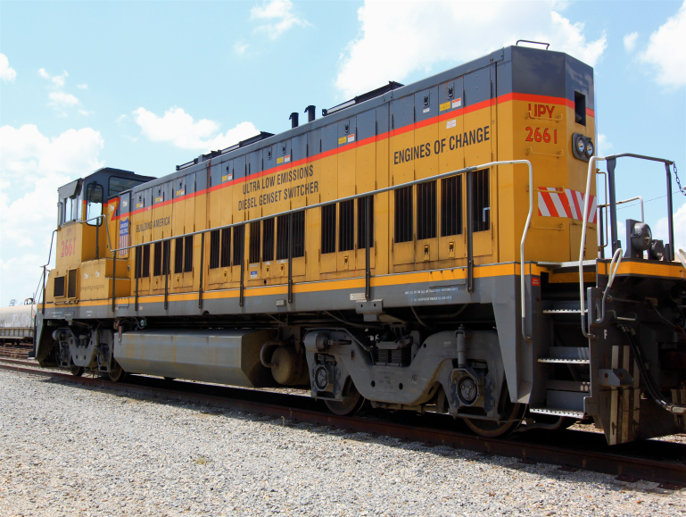
Eligible Mitigation Action 3
Eligible Freight Switchers
  Pre-Tier 4 switcher locomotives that operate 1000 hours or more per year
  Eligible switchers may be repowered or replaced with any new diesel, alternative fueled, or all-electric engine/vehicle
  Scrappage of old equipment/vehicle is required
Project Type | Percentage Funded through Trust
 | Government-owned | Other
Repower with new diesel or alternative-fueled vehicle | Up to 100% | Up to 40%
Replace vehicle with new diesel or alternative-fueled vehicle | Up to 100% | Up to 25%
Repower with all-electric engine, including infrastructure | Up to 100% | Up to 75%
Replace with all-electric vehicle, including infrastructure | Up to 100% | Up to 75%

Slide 15
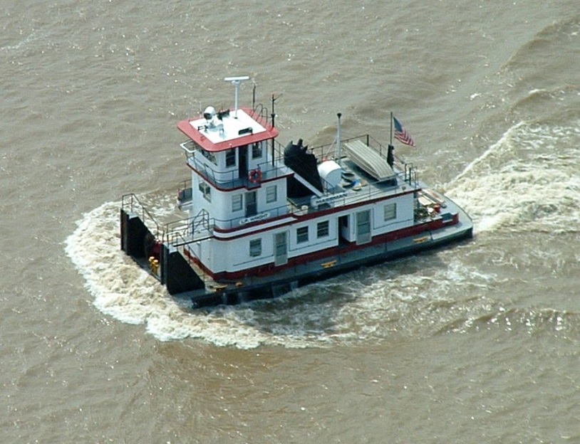
Eligible Mitigation Action 4
Eligible Ferries/Tugs
  Ferries and/or tugs with unregulated, Tier 1, or Tier 2 marine engines
  Eligible ferries and tugs may be repowered with any Tier 3 or Tier 4 new diesel, alternative fueled, or all-electric engine or may be upgraded with an EPA-certified remanufacture system or an EPA-verified engine upgrade
  Scrappage of old equipment is required
Project Type | Percentage Funded through Trust
 | Government-owned | Other
Repower with new diesel or alternative-fueled vehicle | Up to 100% | Up to 40%
Repower with all-electric engine, including infrastructure | Up to 100% | Up to 75%

Slide 16
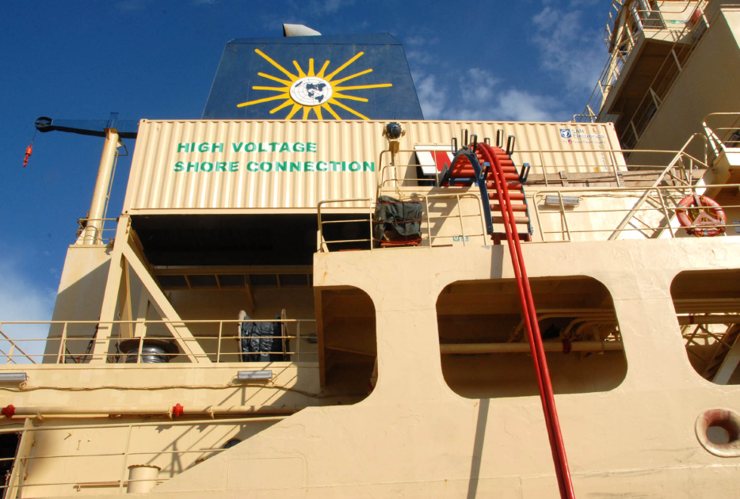
Eligible Mitigation Action 5
Eligible Ocean Going Vessels Shorepower
  Systems that enable a compatible vessel’s engines to remain off while at berth.
  Eligible components of shorepower systems include cables, cable management systems, shore power coupler systems, distribution control systems, and power distribution.
Port of San Diego Shore Power Installation (Photo: Dale Frost)
Project Type | Percentage Funded through Trust
 | Government-owned | Other
Costs Associated with Shore-Side System Components, including Installation | Up to 100% | Up to 25%

Slide 17
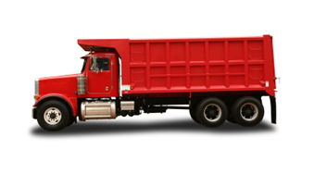
Eligible Mitigation Action 6
Eligible Medium Trucks
  Engine model year 1992–2009 Class 4–7 local freight trucks
  Eligible medium trucks may be repowered or replaced with any new diesel, alternative fueled, or all-electric engine/vehicle
  Scrappage of old equipment/vehicle is required
Project Type | Percentage Funded through Trust
 | Government-owned | Other
Repower with new diesel or alternative-fueled vehicle | Up to 100% | Up to 40%
Replace vehicle with new diesel or alternative-fueled vehicle | Up to 100% | Up to 25%
Repower with all-electric engine, including infrastructure | Up to 100% | Up to 75%
Replace with all-electric vehicle, including infrastructure | Up to 100% | Up to 75%

Slide 18
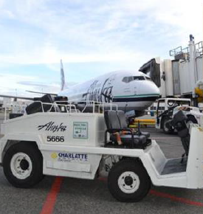
Eligible Mitigation Action 7
Eligible Airport Ground Support Equipment
  Eligible equipment includes Tier 0, Tier 1, or Tier 2 diesel-powered air support ground equipment; and uncertified, or certified to 3 g/bhp-hr or higher emissions, spark ignition engine powered air support ground equipment
  Scrappage of old equipment/vehicle required
Project Type | Percentage Funded through Trust
 | Government-owned | Other
Replace or Repower with All-Electric | Up to 100% | Up to 75%

Slide 19
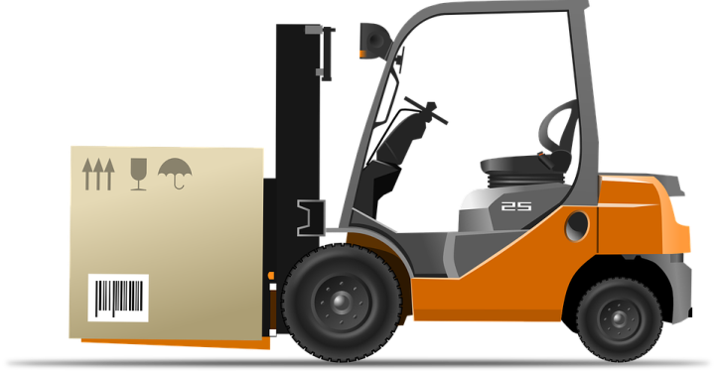
Eligible Mitigation Action 8
Eligible Forklifts and Port Cargo Handling Equipment
  Eligible forklifts includes forklifts with greater than 8000 pounds lift capacity
  Scrappage of old equipment required
Project Type | Percentage Funded through Trust
 | Government-owned | Other
Replace or Repower with All-Electric | Up to 100% | Up to 75%

Slide 20
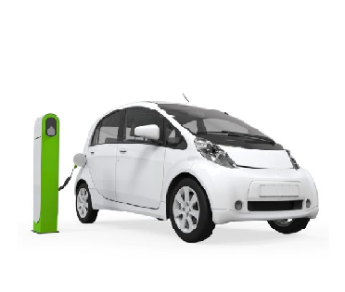
Eligible Mitigation Action 9
Eligible Light-Duty Zero Emission Vehicle Supply Equipment
  Electric vehicle supply equipment includes Level 1, Level 2, or fast charging equipment
  Hydrogen fuel cell vehicle supply capable of dispensing hydrogen at a pressure of seventy megapascals
Project Type | Percentage Funded through Trust
 | Government-Owned Property (Publically Available) | Non-Government Owned Property (Publically Available) | Workplace | Multi-Unit Dwelling
Electric Vehicle Supply Equipment | Up to 100% | Up to 80% | Up to 60% | Up to 60%
Fuel Cell Vehicle Supply Equipment (250 kg/day) | Up to 33% | Up to 33% | NA | NA
Fuel Cell Vehicle Supply Equipment (100 kg/day) | Up to 25% | Up to 25% | NA | NA

Slide 21
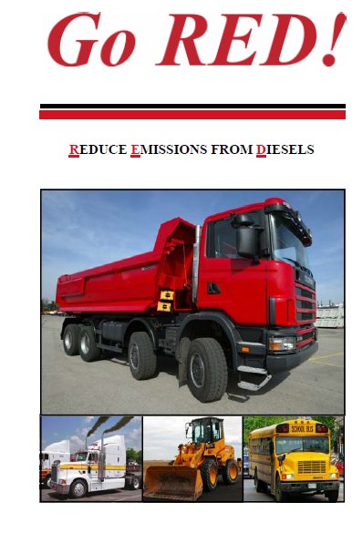
Eligible Mitigation Action 10
Diesel Emission Reduction Act (DERA) Option
  States may use Trust funds for their voluntary match or overmatch for DERA programs (such as the State Clean Diesel Grant used to fund ADEQ’s Go RED! program)
  Allows beneficiaries to use Trust Funds for actions not specified in Eligible Mitigation Actions 1–9

Slide 22
Arkansas Mitigation Plan

Slide 23


Arkansas Allocation Under the Trust
Arkansas is to receive approximately $14.6 million to fund projects that fall within the framework of the ten eligible mitigation actions.
  Up to $4.8 million can be spent in first year
  Up to $9.7 million can be spent in the first two years
ADEQ will be the lead agency for developing and implementing programs to fund Eligible Mitigation Actions.
  Office of Energy and Office of Air Quality developing the plan in collaboration with the Governor’s Office and other State agencies

Slide 24
Beneficiary Mitigation Plan
On June 28, 2018, ADEQ submitted its Beneficiary Mitigation plan to the Trustee.
This plan describes four new programs that ADEQ intends to implement to reduce emissions using funding from the Volkswagen Settlement.

Slide 25
Arkansas Bus Compressed Natural Gas (ABC) Pilot Program
ADEQ would use settlement funding to reimburse up to seventy-five percent of the purchase price of low NOx CNG buses.
The program would fund the purchase of up to twenty buses at each of three school districts in Arkansas.
Preference would be given to districts located in areas where the installation of CNG infrastructure would contribute to establishment of alternative fuel corridors.
Applicants must demonstrate that CNG fueling infrastructure will be in place to service vehicles funded by the pilot project by the time funds are awarded.

Slide 26
Arkansas Clean Fuels Grant
The Arkansas Clean Fuels grant is a statewide grant program intended to reduce NOx emissions by repowering or replacing Class 4–8, model years 1992–2009 diesel vehicles with low NOx CNG, propane(LPG), liquefied natural gas (LNG), or Electric Vehicles.
This grant program could be used to target school districts that fall outside of the pilot areas and to assist other entities with converting their fleets to CNG, LPG, LNG or all -electric technologies.
Funding would be awarded on a competitive basis and project proposals would be scored based on whether the project would benefit one of the priority areas and the cost effectiveness in dollars per ton of NOx reduced.
Applicants must demonstrate that fueling/charging infrastructure will be in place to service vehicles funded by the project by the time funds are awarded.

Slide 27
Light-Duty Electric Vehicle Infrastructure Rebate Program
The Arkansas Energy Office (AEO), which has recently moved under the umbrella of ADEQ, would oversee funding for implementation of a rebate program for EV charging stations.
The integration of the AEO into ADEQ has improved coordination between the Office of Air Quality and AEO and enhanced the implementation of VW programs.
This program would provide funding up to the maximum amount allowed under the consent decree of fifteen percent ($2,197,156)

Slide 28
Diesel Emissions Reduction Act (DERA)
This Plan allocates funds toward supplementing state funding sources for the State voluntary match under the State Clean Diesel Grant.
ADEQ has utilized funding under the State Clean Diesel Grant to administer the Reduce Emissions from Diesels (Go RED!) funding assistance program.
Go RED! is a competitive funding assistance program that assists Arkansas-based public, private, and nonprofit entities in reducing diesel emissions in the State through exhaust control, engine upgrade, idling reduction, and engine/vehicle replacement projects.

Slide 29
State Agency Fleet Emission Reduction Grant (SAFER)
A small percentage (eight percent) of funds would be used to enable State Agency classes 4–8 medium- and heavy-duty vehicles to be replaced or repowered with any fuel allowable under the VW settlement.

Slide 30
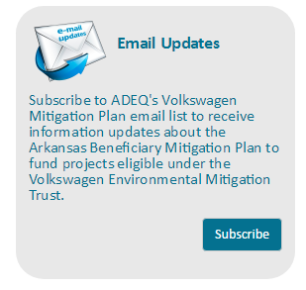
Next Steps and More information
ADEQ has set up a webpage to provide information to the public on plan development and implementation
https://www.adeq.state.ar.us/air/planning/vw.aspx.
The public can also sign up for email updates.
ADEQ is currently finalizing the details and documentation of the programs and will begin implementation this year.

Slide 31

Another Scandal? Another Approach?
On January 10, 2019, Fiat Chrysler agreed to pay $800 million to settle charges that its diesel vehicles sold in the United States had software that allowed it to violate emissions rules. This is a fraction of the $14.7 billion that Volkswagen is obligated to pay under its settlement.
  Fiat Chrysler will do the following:
    Pay about $400 million in civil penalties and fines to various federal agencies and the State of California;
    Implement a program to mitigate excess pollution from these vehicles by improving the efficiency of 200,000 aftermarket catalytic converters sold for use on light-duty vehicles by July 1, 2020; and
    Implement a repair program for more than 100,000 noncompliant diesel vehicles.
Fiat Chrysler has not admitted to guilt or any wrongdoing under the settlement.

Slide 32
Questions
Stuart Spencer
Associate Director
Office of Air Quality, ADEQ
spencer@adeq.state.ar.us

