Slide 1
Stormwater Construction Permit(s): An Overview
Arkansas Bar Association
2025 Mid-Year Bar Conference

Slide 2
Outline
Overview
Applicability
Key terms and provisions
Seeking Coverage
Common mistakes (enforcement items)

Slide 3
Overview and Applicability
A DEQ issued “Construction General Permit” authorizes stormwater discharges from large or small construction activities that result in a total land disturbance of:
  equal to or greater than one acre, or
  less than one acre of total land area that is part of a larger common plan of development or sale if the larger common plan will ultimately disturb equal to or greater than one acre.

Slide 4
Cont’d. – “Small Construction Sites”
Construction site in which construction activities including clearing, grading, and excavating result in a land disturbance of greater that one acre and less than five acres.
Includes the disturbance of less than one acre of total land area that is part of a larger common plan of development or sale if the larger common plan will ultimately disturb equal to or greater than one and less than five acres.

Slide 5
Cont’d. – “Large Construction Sites”
Construction site in which construction activity including clearing, grading, and excavating result in disturbance of greater than five acres.
Includes the disturbance of less than five acres of total land area that is part of a larger common plan of development or sale if the larger common plan will ultimately disturb five acres or greater.

Slide 6
Why do I need authorization to discharge construction stormwater?
One, the federal Clean Water Act (section 301) prohibits the “discharge of any pollutant” by any person except by permit.
Two, federal regulations at 40 CFR 122.26 require authorization to discharge construction stormwater through coverage under National Pollutant Discharge Elimination System permit.
Three, Arkansas rules implementing the federal Clean Water Act adopt and incorporate these federal regulations “verbatim.”

Slide 7
Key Terms to Consider
"Commencement of Construction" is the initial disturbance of soils (or breaking ground) associated with clearing, grading, or excavating activities or other construction-related activities (e.g., stockpiling of fill material; placement of raw materials at the site).
"Construction Activity" earth-disturbing activities, such as the clearing, grading, and excavation of land, and other construction–related activities (e.g., stockpiling of fill material; placement of raw materials at the site) that could lead to the generation of pollutants.

Slide 8
Key Terms to Consider
"Construction Support Activity" a construction-related activity that specifically supports the construction activity and involves earth disturbance of pollutant-generating activities of its own, and can include, but not limited to, activities associated with concrete or asphalt batch plants, equipment staging yards, materials storage areas, excavated material disposal areas, and burrow areas.

Slide 9
Key Terms to Consider
"Larger Common Plan of Development or Sale" is a contiguous (sharing a boundary or edge; adjacent; touching) area where multiple and distinct construction activities may be taking place at different times on different schedules under one plan. Such a plan might consist of many small projects (e.g. a common plan of development for a residential subdivision might lay out the streets, house lots, and areas for parks, schools and commercial development that the developer plans to build or sell to others for development). All these areas would remain part of the common plan of development or sale. The following items can be used as guidance for deciding what might or might not be considered a “Common Plan of Development or Sale.” The ‘‘plan’’ in a common plan of development or sale is broadly defined as any announcement or piece of documentation (including a sign, public notice or hearing, sales pitch, advertisement, drawing, permit application, zoning request, computer design, etc.) or physical demarcation (including boundary signs, lot stakes, surveyor markings, etc.) indicating construction activities may occur on a specific plot. The applicant shall still meet the definition of operator in order to be required to get permit coverage, regardless of the acreage that is personally disturbed.

Slide 10
Getting your Construction General Permit
All construction general permit forms and information are available on DEQ’s website:
https://www.adeq.state.ar.us/water/permits/npdes/stormwater/
The notice of intent and applicable signatures and authorizations must be submitted through DEQ’s SEEK system:
https://seek.ee.arkansas.gov/ext/ncore/external/home

Slide 11
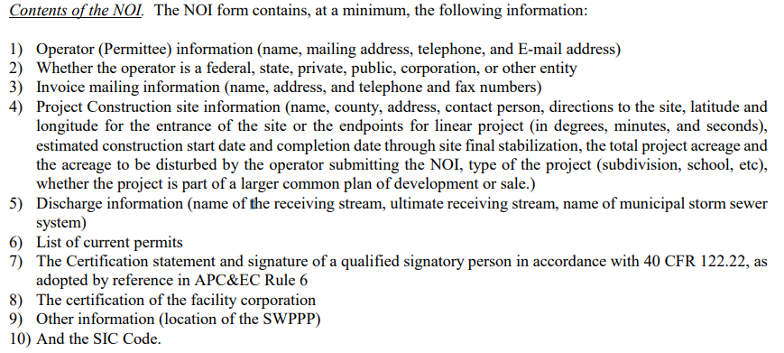
Notice of Intent

Slide 12
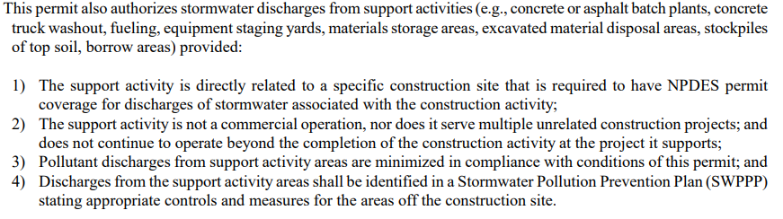
Some things included in the general permit ...

Slide 13
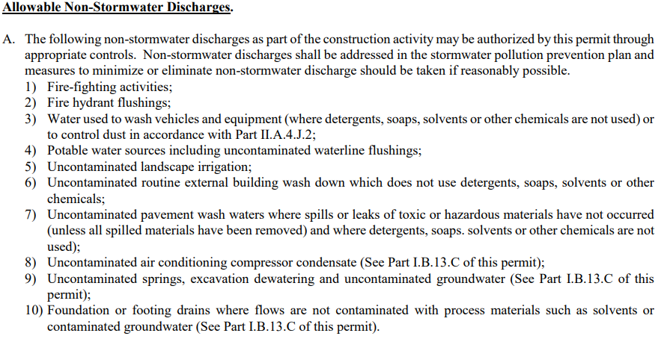
Some things allowed by the general permit …

Slide 14
Some things excluded (unless specifically authorized) from the general permit …
Post construction discharge
Non-stormwater discharges (other than identified in the prior slide) mixed with stormwater
Discharges to streams with a TMDL
Discharges into “impaired” waterbody segments
Discharges to Extraordinary Resource Waters, Natural and Scenic Waterways, or Ecologically Sensitive Waterbodies

Slide 15
Permit Compliance
Technical:
Erosion and sediment controls
Soil stabilization
Pollution Prevention Measures (e.g., minimize exposure, minimize spills and leaks, implement BMPs)
Administrative:
SWPPP, SWPPP, SWPPP
Inspections
Retention of Records
Certifications

Slide 16
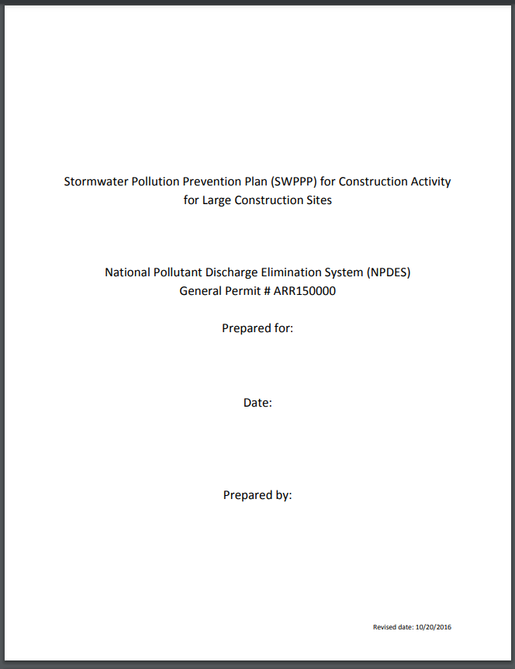
SWPPP or SW3

Slide 17
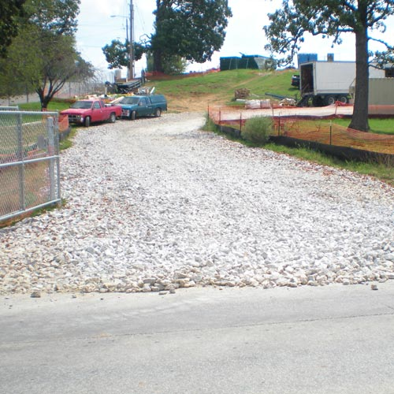
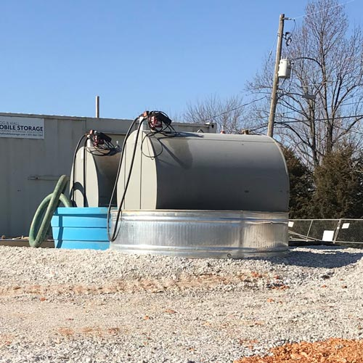
BMP Examples

Slide 18
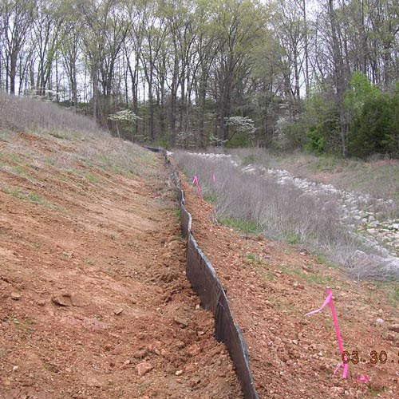
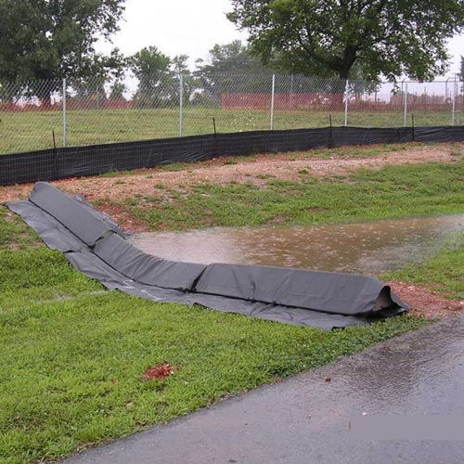
More BMPs

Slide 19
Common Mistakes
Failure to obtain coverage
Failure to post the Notice of Coverage
Failure to update the SWPPP
Failure to conduct inspections
Failure to retain inspection reports
Failure to maintain BMPs
Sediment leaving the site

Slide 20
Questions?
Jordan Wimpy
Mitchell, Williams, Selig, Gates & Woodyard, P.L.L.C
Phone: (501) 688-8872
Email: jwimpy@mwlaw.com

