Slide 1


Environmental Issues Impacting Utilities
SEMO-NEARK Annual Meeting
Walter G Wright
wwright@mwlaw.com

Slide 2

We will briefly identify and update a number of Arkansas/Missouri and federal environmental issues that may be of interest to municipal utilities operating power, wastewater, and water facilities.

Slide 3
Arkansas Environmental, Energy and Water Law Blog http://www.mitchellwilliamslaw.com/blog
Three posts five days a week

Slide 4
92nd Arkansas
General Assembly
  SELECTED ISSUES
  State Government Reorganization
    Department of Energy and Environment
      ADEQ
      PSC
      Tank Advisory Committee
      State Geologist
    Department of Agriculture Includes ANRC
    Transfer of Liquid Animal Waste permitting from ADEQ to ANRC?
    Solid Waste Facility Licensing Revisions? (What is a “Materials Recycling Facility?)
    Tires
    Bella Vista Fire/Dump Funding (transfer of funds?) (POA has now taken over)

Slide 5
92nd Arkansas
General Assembly (cont.)
  SELECTED ISSUES (cont.)
    Solar Energy
      AB 1636
        Allows schools to participate in Arkansas Energy Performance Contracting
        Contracts can go to 25 years
      SB 145
        Allows third party purchasing allowing a resident or business to host a solar energy system
        Solar size limit from 300 KW to 1000 KW

Slide 6
Missouri Legislation
    GRANTS FOR UTILITY PROJECTS (Section 640.620) - Grants in aid are made available by the DNR to assist in financing certain utility projects, with such grants being limited to $1,400 per connection. This act instead limits such grants to $3,000 per connection.
    MISSOURI CLEAN WATER LAW (Section 644.059) - This act exempts agricultural storm water discharges and return flows from irrigated agriculture from clean water permitting requirements, and prevents such discharges and flows from being considered unlawful unless they have entered waters of the state rendering them harmful, detrimental, or injurious to public health, safety, or welfare, or to industrial or agricultural uses, or to wild animals, birds, or fish. Nothing in this act shall supersede current law relating to concentrated animal feeding operations.

Slide 7
  Water Quality Issues

Slide 8
Clean Water Act - Reminder
A Clean Water Act NPDES permit must be acquired if five jurisdictional elements are met:
a person
adds a
pollutant
to navigable waters (waters of the United States)
from a point source
The absence of any one of these jurisdictional definitions eliminates Clean Water Act NPDES permitting requirements.

Slide 9
The scope of the term “waters of the United States” from a Clean Water Act standpoint has been the subject of debate, regulatory activity, litigation, and confusion for many years. Its importance is magnified by the fact it is also relevant to non-NPDES programs.
Not just relevant to NPDES program
404 wetland
311 oil spill
SPCC requirements

Slide 10
WOTUS
  Key Definition - Waters of the United States
  Continuing debate over appropriate scope
  Obama Definition Rule Revoked
  Trump Rule Proposed
  Will be decided by the U.S. Supreme Court

Slide 11
Does a Discharge to Groundwater Require an NPDES Permit?
A current important Clean Water Act jurisdictional issue is whether, and to what extent, a discharge of pollutants into groundwater can potentially trigger National Pollution Discharge Elimination (“NPDES”) permitting requirements.
Is groundwater potentially a water of the United States?
With limited exceptions groundwater has not been identified as a water of the United States.

Slide 12
Groundwater Issue (cont.)
Recent Federal Appellate Court Decisions
U.S. Supreme Court Review
U.S. EPA Activity
  Solicitation of view on the issue
  Interpretive statement issued on April 15th
Reminder about broader state jurisdiction (including Arkansas)

Slide 13
Possible Impacts?
Why Important
Areas where close connection between groundwater and surface water
Aquifer close to ground surface and some can be highly transmissive
Some activities can lead to seepage into offsite surface waters (pipeline ruptures)
Effect on improvements, ponds, etc. (fly ash ponds)
Regardless of EPA/states’ positions citizen suits by groups are a certainty until issue resolved by the U.S. Supreme Court

Slide 14
Why has this become a hot issue?
The 9th Circuit Court of Appeals in Maui ruled that discharges from a point source to groundwater can in certain circumstances be subject to the Clean Water Act.

Slide 15
The basis for environmental groups arguing in Maui for triggering jurisdiction was the migration of the pollutants released into the groundwater to hydrologically connect to surface water (i.e., the Pacific Ocean).
The Court in Maui held that the Clean Water Act does not require that the point source convey the pollutants directly to the navigable waters (waters of the United States).

Slide 16
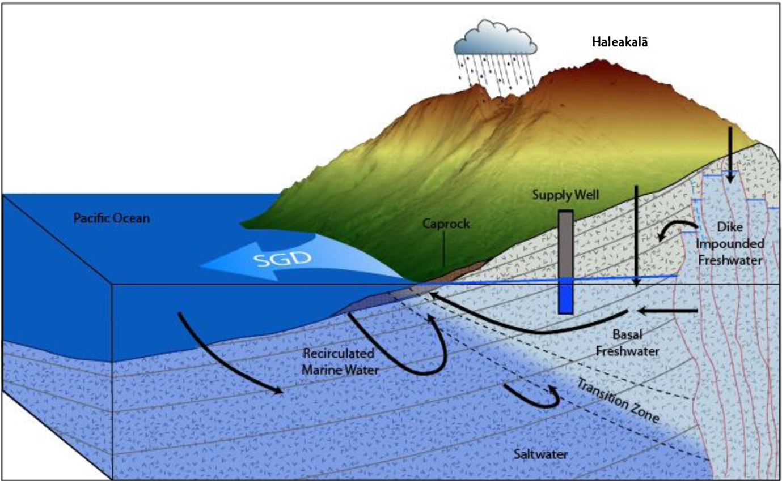
Groundwater Injection
(County of Maui)

Slide 17
Underground Injection Well?
Hawai’i Wildlife Fund v. Cnty. of Maui, 886 F.3d 737 (9th Cir., Feb. 1, 2018 ), petition for cert. filed, No. _____ (U.S. Aug. 27, 2018)
Issue – Does discharge of municipal wastewater via injection well to groundwater that ultimately affects navigable surface waters require an NPDES permit.
Application – NPDES permitting includes circumstances where pollutants reach navigable waters by means other than a point source, such as groundwater.
Test – (1) Discharge from a point source; (2) pollutants “fairly traceable” to a navigable water; (3) pollutants reach navigable water at “more than de minimis” levels

Slide 18
Does a Discharge to Groundwater Require a Clean Water Act NPDES Permit?: U.S. Environmental Protection Agency Issues April 15th Interpretive Statement
EPA issued on April 15th what it describes as an “Interpretive Statement” addressing the application of the Clean Water Act permitting requirements to discharges to groundwater.
EPA stated it issued its April 15th Statement due to the uncertainty generated by conflicting federal court decisions and the “prior lack of clear agency guidance” regarding whether NPDES permits are required for releases of pollutants to groundwater.

Slide 19
Does a Discharge to Groundwater Require a Clean Water Act NPDES Permit?: U.S. Environmental Protection Agency Issues April 15th Interpretive Statement (cont.)
EPA concluded in the Statement that the Clean Water Act is:
. . .best read as excluding all releases of pollutants from a point source to groundwater from NPDES program coverage and liability under section 301 of the Clean Water Act, regardless of a hydrologic connection between the groundwater and a jurisdictional surface water.
Note: EPA’S view will be subject to a Supreme Court decision.
Interim – Environmental organizations and others will file actions based on their view of the issue.

Slide 20
The State Issue (including Arkansas)
Arkansas Delegated NPDES Program
Assume Arkansas Will Follow EPA Interpretation Regarding Effect on NPDES Permitting Until Definitive U.S. Supreme Court Ruling?
However!
Arkansas has much broader state statutory jurisdiction under Arkansas Water and Air Pollution Act –
  “Waters of the State” much broader reach
  Used to authorize ADEQ regulation of various “no discharge” programs
  Assume same for Missouri

Slide 21
Other Clean Water Act Issues
  Arkansas Water Quality Trading
  Arkansas Antidegradation
  Arkansas Water Quality Standards/Minerals
  Arkansas Water Quality Standards/Nutrients
  Missouri Nutrients
  .

Slide 22
Antidegradation
  Arkansas
  Waters exceeding Water Quality Standards – can they be degraded as long as they still meet WQS?
  Antidegradation demonstrations may require permit modifications, 401 certifications,etc.
  Congress affirmed the principle of “antidegredation” in the CWA amendments of 1987
  Arkansas Antidegredation Policy stated in Regulation No. 2, 2.201-2.204
  EPA revised federal WQS regulations in 2015, which included revisions to antidegredation requirements:
    Identification of high quality waters;
    Analysis of alternatives; and
    Antidegredation implementation methods
    ADEQ Antidegredation Workgroup met in the Summer o 2018 to review ADEQ proposals for updating antidegredation policy

Slide 23
Minerals
  Arkansas
  Not Much to Report:
    Ecoregion Values for Minerals remain in place with continued disagreement over their use as “criteria”
    Minerals issues continue to be addressed with establishment of site specific criteria, where appropriate
    ADEQ said to be working on a long-term (10-year) strategy to develop mineral criteria
    Significant cost issue for a number of POTWS

Slide 24
Nutrients (Phosphorous and Nitrogen)
  Arkansas
  Difficulty establishing standards/non-point sources significant contributors
  2015: Act No. 335 authorized nutrient water quality trading programs (i.e. water quality credits and offsets) as a means of complying with nutrient effluent permit limits
  2018: Northwest Arkansas Nutrient Trading Research and Advisory Group (NANTRAG) petitioned the Commission to initiate rulemaking on proposed Reg. 37 – Arkansas Nutrient Water Quality Trading Regulation:
    Petition to Initiate granted in January 2018
    2 Public Hearings
    2 Rounds of Public Comment
    Should be back to the Commission for final review in 2019

Slide 25
Nutrients (cont.)
  Missouri
  Missouri Lakes Numeric Nutrient Criteria: U.S. Environmental Protection Agency Approval
  EPA in a December 14, 2018, letter approved Clean Water Act Numeric Nutrient Criteria for Missouri Lakes.
  The Missouri Department of Natural Resources included these provisions in a Water Quality Standards package submitted to EPA for review in a letter dated April 13, 2018.

Slide 26
Nutrients (cont.)
  The Missouri DNR Lake Numeric Nutrient Criteria approved by EPA include:
  MO’s Approved Plan
  Ecoregion Chlorophyll Criteria (μg/l)
  Plains 30.0
  Ozark Border 22.0
  Ozark Highlands 15.0
  The approved plan identifies about 35 percent of monitored Missouri Lakes (34 lakes total) as impaired with approximately 33 percent requiring additional evaluation to determine if there is an impairment.

Slide 27
Triennial Review
  ADEQ is currently facilitating the Reg. 2 Triennial Review Stakeholder Process:
      2-4 stakeholder workgroup sessions
      Workgroup Summary
      Petition to Initiate Rulemaking
      ADEQ has established a clear objective to reach final EPA approval of a “clean” Reg. 2. Proposed Revisions are limited to:
        Grammatical Corrections
        Addressing the issues that EPA disapproved or took no action on in last triennial review

Slide 28
Des Moines Waterworks
Lawsuit – Alleging three drainage districts responsible for nitrate flowing down river
Iowa legislation introduced to dismantle DMWW, dissolve the independent governing board and transfer utility to City of Des Moines – includes urbandale and West Des Moines boards.
  Stated purpose of forcing regionalization of the water utility
Terrible precedent for utilities that are governed by independent boards

Slide 29
What are PFAS?
Large group of chemicals (2000 and counting) have been identified in the environment
Water repellant and stain resistant properties
Used since the 1940s in consumer and industrial products
Sources of contamination vary but include manufacturing and industrial sites, municipal waste sites, fire training areas, etc.
Traditionally unregulated, but:
  Changing at federal level (EPA Draft recommendation for Groundwater Cleanup) and especially state level
  No Arkansas activity yet
  Federal legislation would require EPA to set a Safe Drinking Water Act MCL

Slide 30
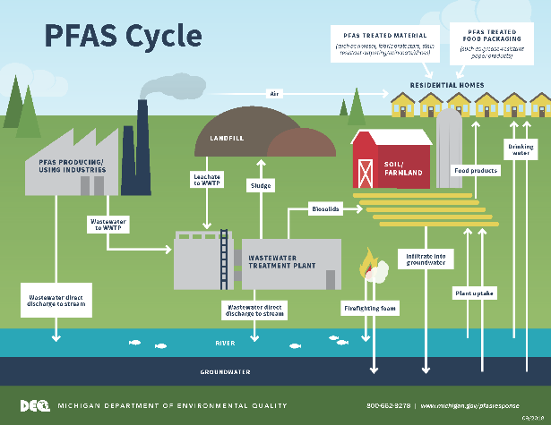

Slide 31
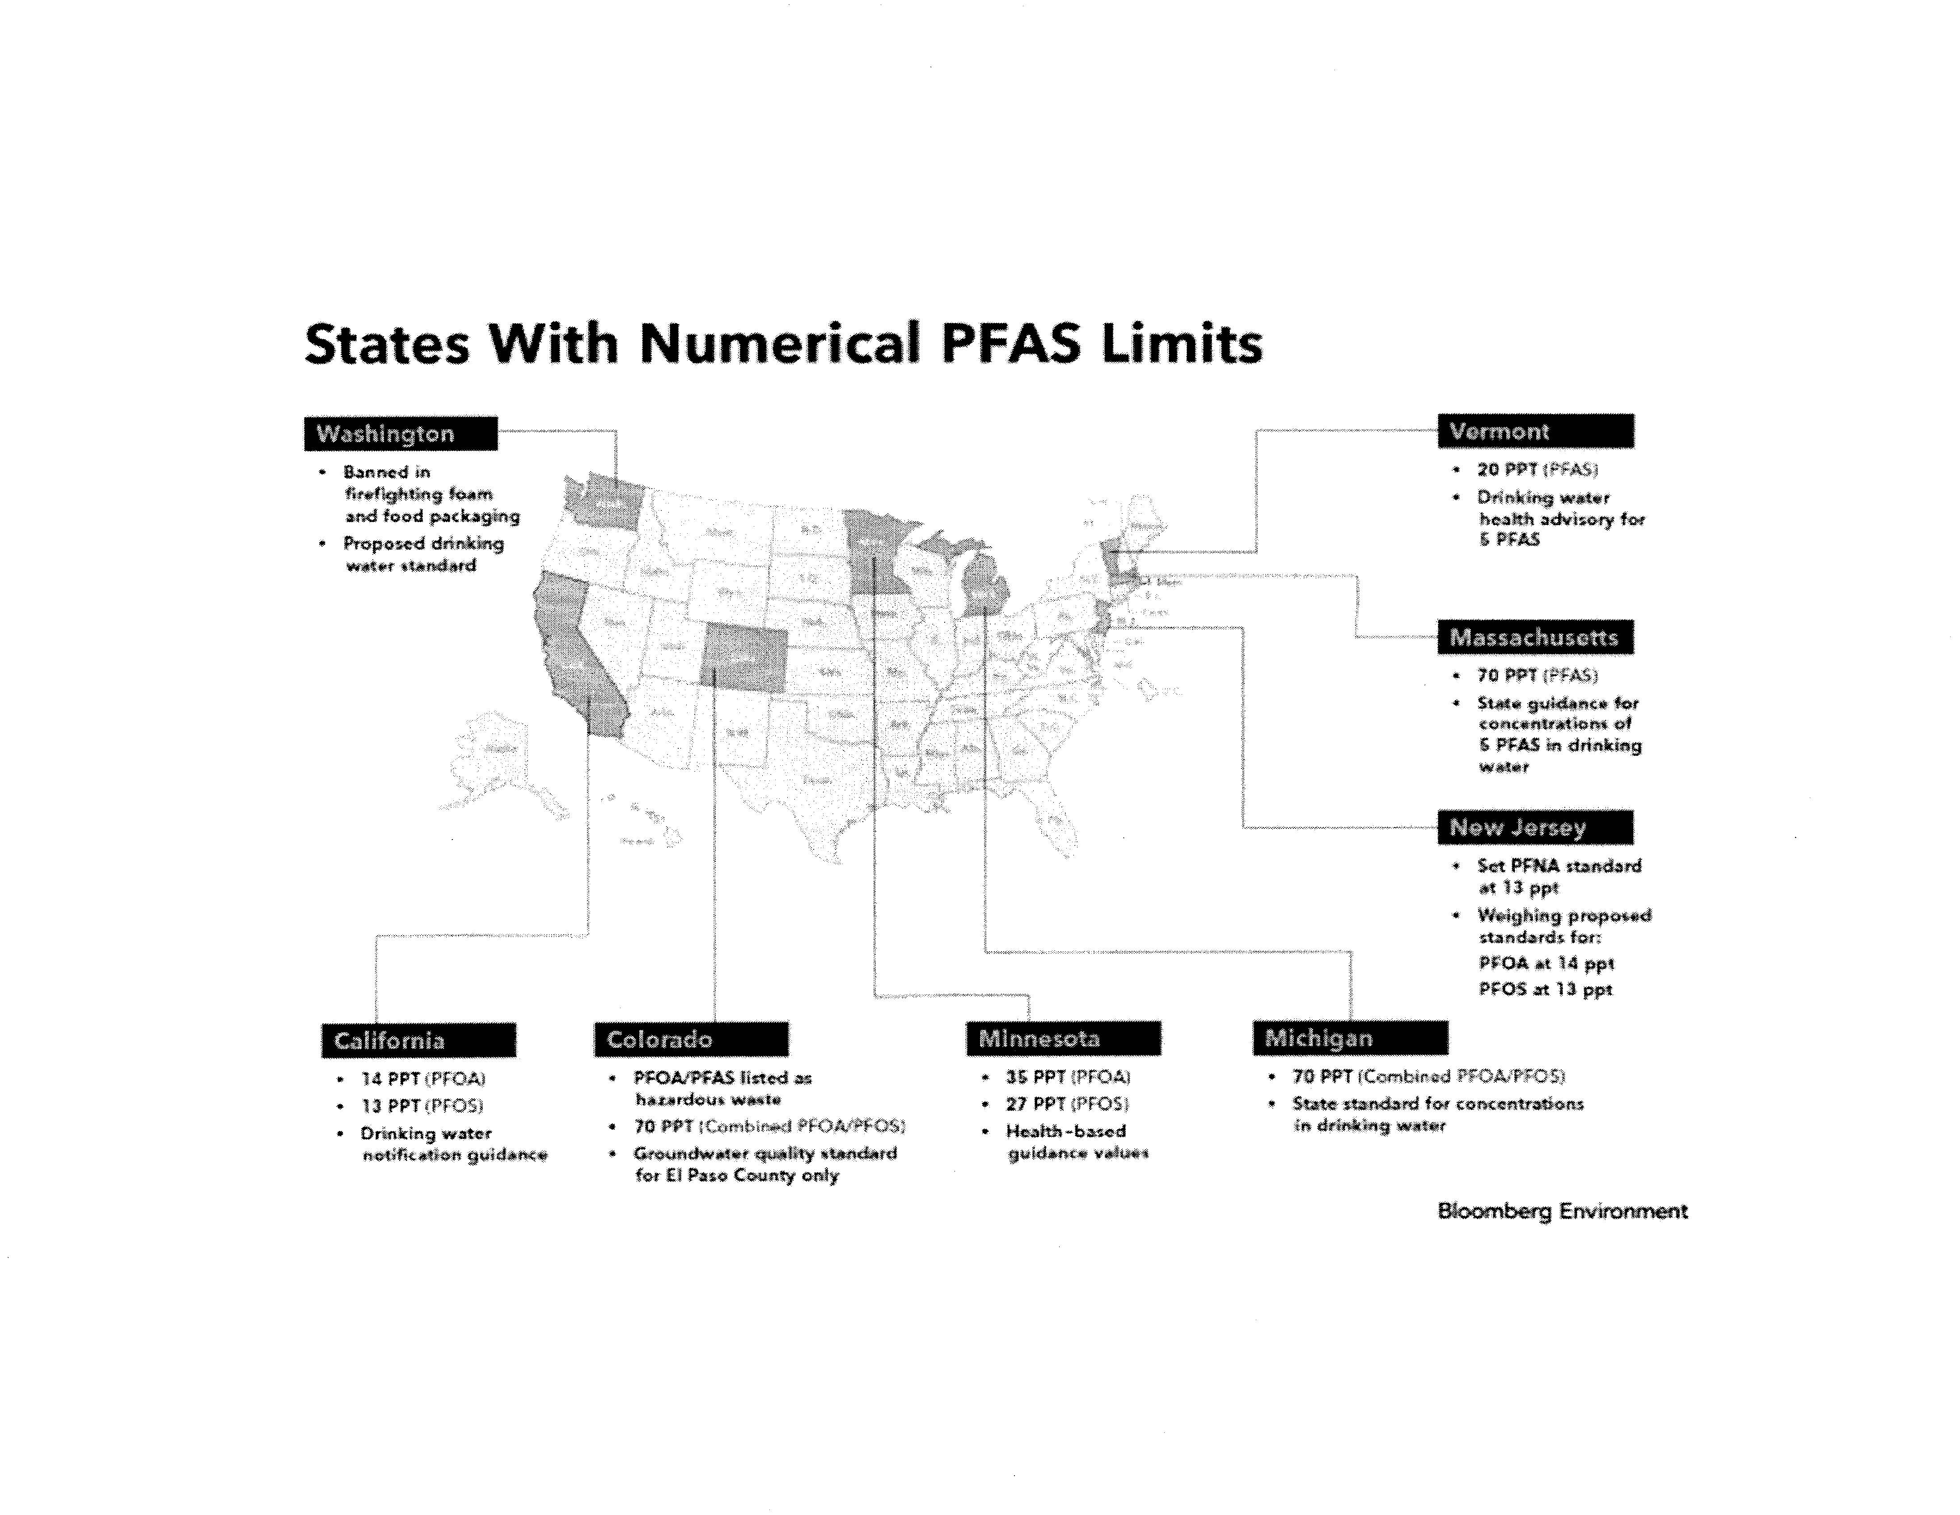

Slide 32
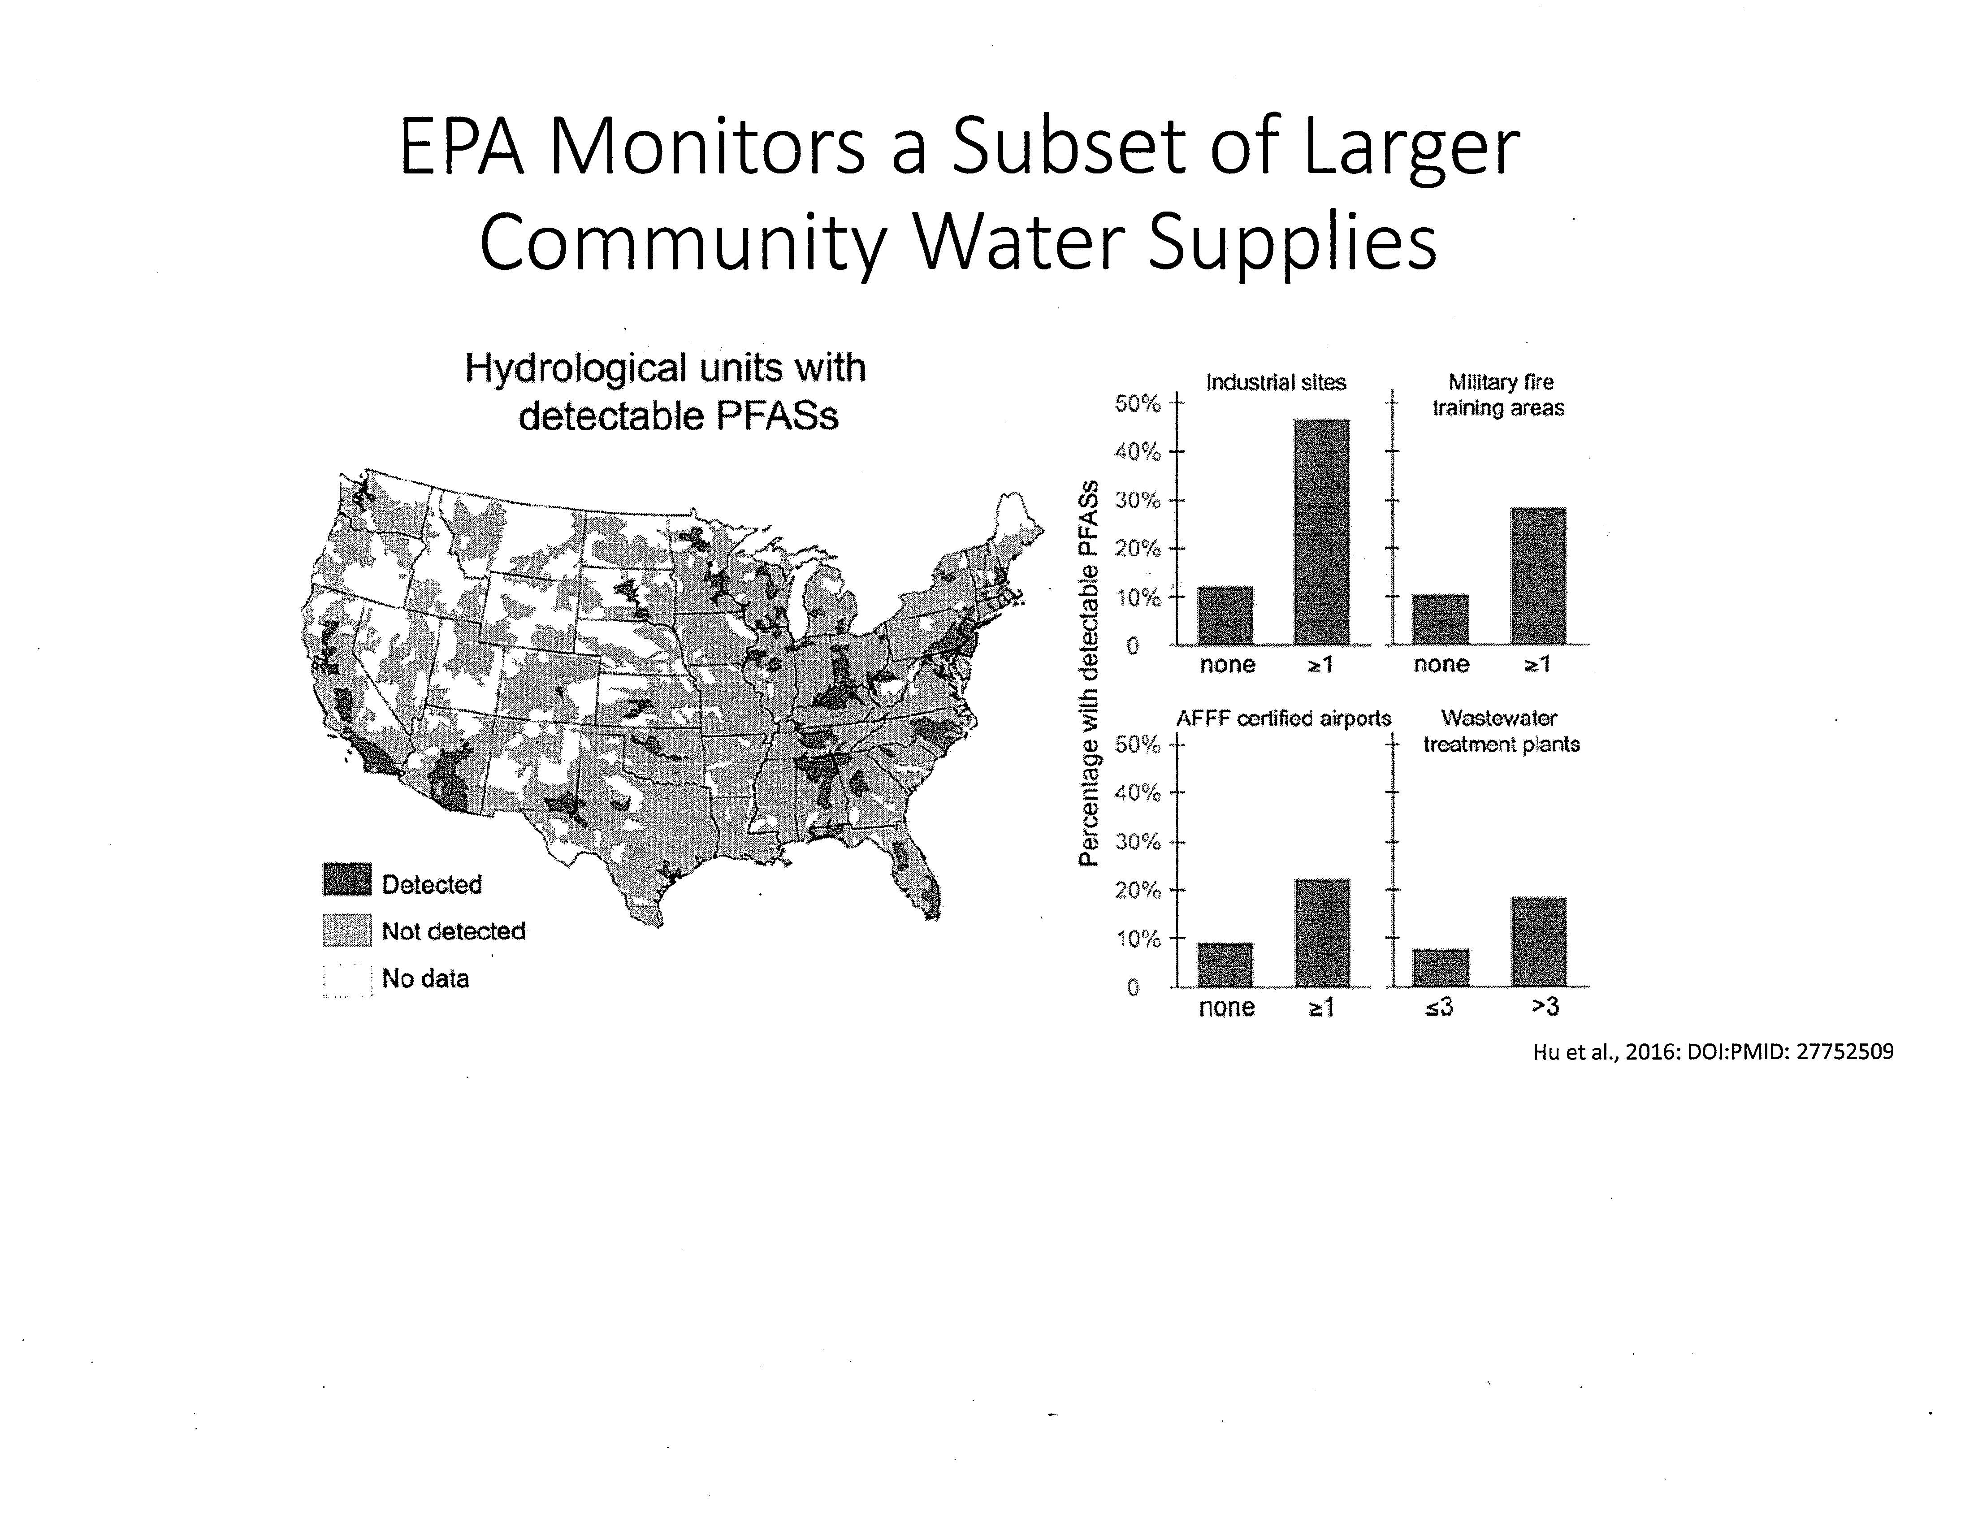

Slide 33
Wastewater and Public Water Supply Sampling
PFAS (CONT.)
Ambient Surface Water and Fish Sampling
Wastewater and Industrial Pretreatment
Incorporating PFAS into Investigations at Existing Site cleanups
Wastewater/Biosolids generally only contain trace amounts of PFAS (are not sources of PFAS)

Slide 34
PFAS: New Mexico Environment Department Issues Notice of Violation to United States Air Force
(Cannon Air Force Base)
The New Mexico Environment Department announced in a December 4th news release that it issued a Notice of Violation to the United States Air Force (“Air Force”) regarding PFAS and Poly-Fluoroalkyl Substances.
NMED states that the Air Force failed to properly address groundwater contamination at Cannon Air Force Base near Clovis, New Mexico.
NMED states that for approximately 40 years:
. . . Cannon Air Force Base used PFAS, a suite of hundreds of compounds, that was contained in aqueous film-forming firefighting foam (AFFF) used in training and actual firefighting events at the base. Use of PFAS in AFFF at Cannon Air Force Base has now ceased. However, PFAS remains at very high concentrations in groundwater both on and off the base
Lawsuit subsequently filed.

Slide 35
EPA Finalizes RCRA Pharmaceutical Rule Affecting Health Care Providers
EPA promulgated an addition to the Resource Conservation and Recovery Act (“RCRA”) Hazardous Waste rules on December 8, 2018.
New section addresses pharmaceuticals
The rule will impose new requirements for healthcare providers including pharmacies and long-term care providers
The rule also applies to forward and reverse distributors of pharmaceuticals
Includes an example definition of “healthcare facility“
Will give qualifying healthcare sector facilities in lieu of the obligations contained in 40 CFR §262
Relevance to POTWS?

Slide 36
RCRA Pharmaceutical Rule
Who is Covered by the Rule?
  Healthcare facilities – include (but are not limited to):
    Hospitals, including psychiatric hospitals
    Pharmacies, including
      Long-term care pharmacies
      Mail-order pharmacies
      Retail stores with pharmacies
    Health clinics
    Surgical centers
    Long-term care facilities
    Physician offices, including dental, optical & chiropractors
    Veterinary clinics and hospitals
    Drug compounding facilities
    Coroners & medical examiners

Slide 37
  Water Quantity Issues

Slide 38
Groundwater/Surface Water Ownership Issues?
Primacy of state and local determinations of what constitutes groundwater sustainability
Groundwater conservation measures for irrigation, municipal, and industrial uses
Significant activity in Arkansas and Mississippi

Slide 39
Equitable Apportionment
Mississippi v. Tennessee
Is groundwater an interstate resource subject to equitable apportionment among the states?
Facts: Extensive pumping of Sparta aquifer has resulted in declining levels of groundwater and a disparity in water pressure across the aquifer.
Since mid-2000s MS has filed several complaints challenging pumping by Memphis Light, Gas, and Water pumping.
2010 complaint alleged MLGW pumped groundwater stored only in the portion of the aquifer
underlying Mississippi.

Slide 40
Equitable Apportionment (cont.)
U.S. Supreme Court Appointed Judge to address:
Does MS have sole authority and control over groundwater stored naturally within its own borders?
Is MS entitled to “damages, injunctive, and other equitable relief” for the intentional seizure of MS groundwater by MLGW?
2019 evidentiary hearing "on the limited issue of whether the aquifer and the water constitutes an interstate resource''

Slide 41
Air/Tanks/Weed

Slide 42
Arkansas Medical Marijuana Rules
Three issues relevant to the municipal utilities associated with Arkansas’s enactment of the Medical Marijuana Amendment:
Employee issues associated with the legal use of medical marijuana
Medical marijuana cultivation and dispensary use of water and wastewater services
Significant energy consumption

Slide 43
Arkansas Medical Marijuana Amendment
The Arkansas Medical Marijuana Amendment decriminalizes from a state (Arkansas) standpoint certain use of marijuana.
Establishment of regulation of cultivators and dispensaries
Does not require “Employer to accommodate the ingestion of marijuana in a workplace or an employee working under the influence of marijuana.”
Outlines process pursuant to which an individual can become a “Qualifying Patient” who can use medical marijuana
Doctor certifies he/she has a “Qualifying Medical Condition”
Marijuana is still illegal at the federal level as a DEA Schedule I controlled substance.

Slide 44
Arkansas Amendment
Non-Discrimination Provision
Non-compliance with the Arkansas Medical Marijuana Amendment of 2016 (AMMA) can pose significant risks for an employer. It includes a non-discrimination provision directed at employers. The provision provides that:
    “An employer shall not discriminate against an applicant or employee in hiring, termination, or any term or condition of employment, or otherwise penalize an applicant or employee, based upon the applicant’s or employee’s past or present status as a qualifying patient or designated caregiver.”

Slide 45
Employer Issues/Suggestions
Create Written Job Descriptions which Designate Safety Sensitive Positions within your Organization?
The AMMA permits employers to “exclude a qualifying patient from being employed in or performing a safety sensitive position based on the employer’s good faith belief that the qualifying patient was engaged in the current use of marijuana.”
Safety sensitive position is defined as “any position designated in writing by the employer as a safety sensitive position in which a person performing the position while under the influence of marijuana may constitute a threat to health or safety.
Creating written job descriptions which designate certain jobs as “safety sensitive positions” permits employers to exclude job applicants and employees with medical marijuana registry ID cards from those positions.

Slide 46
NOTE:
  Still Illegal at Federal level as Schedule I Controlled Substance
  U.S. Department of Transportation Guidance Trumps State Law and Prohibits Use of Medical Marijuana by Haz Mat Carriers
  Companies Subject to Federal Drug Workplace Act Must Prohibit Use
  OSHA General Duty Clause? (maintain safe work place)

Slide 47
Arkansas Medical Marijuana Rules/Waste Issues
ABC regulations require that medical marijuana being disposed of (i.e., waste) be rendered “unusable.” Medical marijuana wastes and other wastes generated by the cultivation and dispensary processes were identified:
Plants (including stalks, roots/soil) and unusable marijuana liquid concentrate or extract
Solid concentrate or extract
Examples:
    Trim and solid plant material used to create an extract
    Waste solvent
    Laboratory waste
    Extract that fails to meet quality testing
    Used reactants
    Residual pesticides/fertilizers
    Cleaning solution
    Lighting ballasts

Slide 48
Medical Marijuana Cultivation Facility
  State Wastewater Requirements
  Clean Water Act/National Pollution Discharge Elimination System permits for direct discharges from cultivation/processing structures into waterbodies
  Clean Water Act/Pretreatment Requirements imposed on cultivation/processing structures discharging into municipal wastewater treatment plants
  Water/Electricity
  Consumption of water
  Consumption of electricity

Slide 49
Clean Air Act
  Combine ADEQ Regs 18, 19 and 26?
  2. EPA Guidance Issued
    PSD
    MACT Once In/Always In

Slide 50
  Arkansas Storage Tank Issues
  Arkansas Petroleum Aboveground Storage Tanks
    ADEQ Registration/Fees Now Voluntary
    Prerequisite for Storage Tank Trust Fund Eligibility
  Federal Underground Storage Tank Rule Revisions
  Note Arkansas and Mississippi tank trust funds still financially viable and important

Slide 51
  Funding/Infrastructure

Slide 52
Cooperative Federalism?
  EPA prioritizing greater control by the states
  Arkansas a vocal proponent of the approach
  Greater state responsibility but no additional federal resources
  Baseline statutes have not changed
  Environmental organizations challenging EPA decisions

Slide 53
America's Water Infrastructure Act
Bioterrorism Act of 2002 vs. AWIA of 2018
Vulnerability Assessment (VA) Risk & Resilience Assessment
(& Emergency Response Plan) (& Emergency Response Plan)*
All-Hazards
Terrorism or Intentional Act (malevolent act or natural
hazard)*
Submit VA to EPA Submit certification letter of
each requirement to EPA*
One time requirement Perform requirements every 5
years*

Slide 54
AWIA of 2018 Requirements
Risks and Resilience Assessment:
• Risks of malevolent acts or natural hazards;
• Resilience of the water system assets: physical barriers, source
water, water collection and intake, pretreatment, treatment, storage and distribution facilities, electronic, computer, or other automated systems;
• The monitoring practices of the system;
• The financial infrastructure of the system;
• The use, storage, or handling of various chemicals by the
system;
• The operation and maintenance (O&M) of the system;
• May include an evaluation of capital and operational needs
for risk and resilience management.

Slide 55
AWIA of 2018 Requirements (cont.)
Emergency Response Plan, considering:
• Strategies and resources to improve the resilience of the
system (incl. both physical and cybersecurity);
• Plans and procedures that can be implemented, and
identification of equipment that can be utilized, in the event
of a malevolent act or natural hazard;
• Actions, procedures, and equipment which can mitigate or
significantly lessen the impact of a malevolent act or natural
hazard (incl. development of alternative source water options, relocation
of water intakes, construction of flood protection barriers); and
• Strategies to aid in the detection of malevolent acts or
natural hazards that threaten the security or resilience of the
system.

Slide 56
AWIA of 2018 Requirements (cont.)
Compliance deadlines:
*Utilities must review, update and recertify every 5 years
Utility Size (Population Served, incl. consecutive) | Number of Community Water Systems in WI | Risk & Resilience Assessment | Emergency Response Plan
>100K | 7 | March 31, 2020 * | Sept. 30, 2020 *
50K - 100K | 9 | Dec. 31, 2020 * | June 30, 2021 *
3,300 - 50K | 168 | June 30, 2021 * | Dec. 30, 2021 *
<3,300 | 870 | N/A | N/A

Slide 57
AWIA of 2018 Requirements (cont.)
Other provisions of AWIA:
• Source water items that are effective immediately:
  State must promptly notify a community water system of a
release impacting source waters (spill);
  Communities have access to Emergency Planning and
Community Right-to-Know Act (EPCRA)* Tier II data for any facility within a delineated source water area
Consumer Confidence Reports have to be reported twice per
year (unsure of implementation date)
All water systems >3,300 must participate in UCMR
(unregulated contaminant monitoring rule) starting in 2022

Slide 58
Civil/Criminal Enforcement
Federal/State

Slide 59
Release Reporting/CERCLA Enforcement: U.S. Environmental Protection Agency and Waseca, Minnesota, Facility Enter into Consent Agreement
EPA and Birds Eye Foods, LLC, entered into a December 13th Consent Agreement and Final Order addressing alleged violations of the Comprehensive Environmental Response, Compensation and Liability Act and Emergency Planning and Community Right-to-Know Act.
The CAFO provides that Birds Eye violated Section 103(a) of CERCLA and Section 304(a) of EPCRA.
The alleged violations are stated to have been due, respectively, to a failure to immediately notify the National Response Center of a release which occurred at the facility between June 21 and July 19, 2013, and failing to immediately notify the Minnesota State Emergency Response Commission (“SERC”) of the same release by failing to provide a written follow-up emergency notice to the Minnesota SERC as soon as practicable after the June 21 – July 19, 2013, release occurrence.

Slide 60
Release Reporting/CERCLA Enforcement: U.S. Environmental Protection Agency and Waseca, Minnesota, Facility Enter into Consent Agreement (cont.)
Section 103 of CERCLA requires any person in charge of a facility to immediately notify the National Response Center as soon as that person has knowledge of any release of hazardous substance from the facility in an amount equal to or greater than the reportable quantity of the hazardous substance. In order for a release to be considered reportable under CERCLA, there are three criteria that must be met, which include the following. The release must:
Be into the environment
Be equal to or exceed the reportable quantity for a particular substance
Occur within a 24-hour period
The terms “environment” and “facility” are very broadly defined by CERCLA.
The CAFO assesses a civil penalty of $75,000 for the CERCLA violation and $75,000 for the EPCRA violation.

Slide 61
OSHA Enforcement: U.S. Department of Labor Cites Alabama Tank Cleaning Company for Alleged Violations
The United States Occupational Safety and Health cited American Remediation and Environmental Inc. for alleged violations related to confined space, fire and explosion hazards.
OSHA proposed $171,281 in penalties for the Chunchula, Alabama, tank cleaning company.
OSHA inspectors are alleged to have determined that AREI allowed employees to enter a tank without testing for atmospheric hazards. The company was cited for:
Allowing employees to use a non-explosion proof vacuum in a tank that transported a highly hazardous chemical;
Failing to provide appropriate personal protective clothing;
Authorizing employees to enter a permit-required confined space without a retrieval system;
Failing to ensure confined space testing and monitoring equipment was property maintained
Note – Trenching issues have been an OSHA focus

Slide 62
Criminal Enforcement/Hazardous Waste: U.S. Department of Justice References Guilty Plea of Madison Heights, Michigan, Individual/Electro-Plating Company
The United States Department of Justice issued a February 14th news release stating that Gary Alfred Sayers and his company, Electro-Plating Services Inc. pleaded guilty to a felony charge of illegal storage of Resource Conservation and Recovery Act (“RCRA”) hazardous wastes.
The alleged illegal storage is stated to have taken place at EPSI’s Madison Heights, Michigan, facility.
The RCRA hazardous waste is stated to have been utilized by EPSI in its electroplating activities. The materials are alleged to have become hazardous wastes after they no longer fulfilled their industrial purposes.
The individual is stated to have “almost never sent those wastes away for proper disposal, preferring to keep them on site indefinitely.”

Slide 63
Criminal Enforcement/Hazardous Waste: U.S. Department of Justice References Guilty Plea of Madison Heights, Michigan, Individual/Electro-Plating Company (cont.)
The alleged knowing RCRA violation is derived from the allegation that the individual knew that such storage was illegal because he also managed the company’s former Detroit facility. The news release further notes:
. . . where he kept hazardous wastes illegally until 2005 – and because the Michigan Department of Environmental Quality (MDEQ) repeatedly sent him warnings. In 2005, Sayers was charged with and pleaded guilty to illegally transporting hazardous wastes. During the ensuing years, MDEQ attempted to get Sayers and Electro-Plating Services to properly manage the amounts of hazardous wastes piling up at the Madison Heights location. MDEQ issued numerous Letters of Warning and Violation Notices to the company regarding its hazardous wastes.

Slide 64
Citizen Suit Activity
Two Types
Citizen Enforcement Against an Alleged Violator
Against EPA, Corps of Engineers, etc., for alleged failure to undertake non-discretionary duty
Environmental groups have ramped up both during Trump Administration.

Slide 65
Public Employees for Environmental Responsibility/U.S. Environmental Protection Agency Region 4 Overfile Request: Tampa, Florida, Wastewater Treatment Plant
The Public Employees for Environmental Responsibility (“PEER”) sent a February 4th Overfile Request to the Region 4 Office of the United States Environmental Protection Agency requesting action against the Howard F. Curren Advanced Wastewater Treatment Plant that serves the City of Tampa, Florida.
PEER stated that it was seeking EPA’s action because of alleged violations of the Plant’s Clean Water Act National Pollutant Discharge Elimination System permit issued by the Florida Department of Environmental Protection (under its delegated authority pursuant to the Clean Water Act).
The Request asks that EPA, pursuant to its response authority under the Clean Water Act, immediately assert primary jurisdiction over the NPDES permit and, with full public participation, take action to comprehensively assess and mitigate the imminent and substantial threat to public health and environmental harm caused by what are described as numerous violations in connection with the Plant’s wastewater discharges.
PEER alleges that the Plant has been in noncompliance for 6 of the past 12 quarters and SNC for 2 of the past 12 quarters. Referenced violations include pH and IC25 violations.

Slide 66
Environmental Reporting: Federal Court Addresses Employee First Amendment/Public Employer Retaliation Claim
A United States District Court (M.D. Fla.) addressed a Motion to Dismiss related to a First Amendment employment retaliation case. See Chustz v. City of Marco Island, 2019 WL 277705.
The Court’s January 22nd opinion discusses litigation involving an employee who alleged his termination was due to reporting environmental violations by a public employer.
Chadd Chustz (“Plaintiff”) was stated to be an environmental specialist employed by Defendant City of Marco Island.

Slide 67
Environmental Reporting: Federal Court Addresses Employee First Amendment/Public Employer Retaliation Claim (Cont.)
In May 2017 Plaintiff is stated to have encountered environmental protection violations which involved alleged false mangrove and wetland environmental reports.
Stated to have reported the violations to his immediate supervisor who failed to take action.
Plaintiff was stated to have reported the violations to the Florida Department of Environmental Protection and United States Army Corps of Engineers. Such outside disclosures were not part of Plaintiff’s ordinary job duties.
Plaintiff alleged that his supervisor both threatened to fire him and issued a written reprimand because of the outside disclosures. Further, he was given a negative performance review which explicitly mentioned the disclosures to state and federal authorities.
The City Motion to Dismiss was denied and the action was allowed to process.

Slide 68
Transactional Issues

Slide 69
PERC/Dry Cleaners: Wisconsin Appellate Court Addresses Degree of Spill or Release Constituting Breach of Lease
The Court of Appeals of Wisconsin in a September 28th opinion addressed whether a tenant breached a commercial lease because of contamination originating from its dry cleaning operation. See In Re the Writ of Restitution: RJR ML LLC. v. Keyhan Sheikholeslami, D/B/A Ognden Cleaners, 2018 WL 4621179 (Wis. Ct. App. 2018).
RJR ML LLC, alleged that Keyhan Sheikholeslami, d/b/a Ognden Cleaners breached the commercial lease:
. . . by causing or permitting the release or spill of hazardous substances… and by failing to timely remediate such releases.
The hazardous substance at issue was perchloroethylene.

Slide 70
PERC/Dry Cleaners: Wisconsin Appellate Court Addresses Degree of Spill or Release Constituting Breach of Lease (Cont.)
The Court concluded the lease contains plain and unambiguous language which:
Defines hazardous substance in a way that includes PERC;
Prohibits the Tenant from causing or permitting any hazardous substance to be spilled or released and the prohibition applies to any spill, not just high-volume spills;
Requires the Tenant to promptly take all investigatory and/or remedial action reasonably recommended for the cleanup of any contamination that was caused or materially contributed to by the Tenant; and
Provides the lease permits the Tenant to use hazardous substances for dry cleaning, but does not permit the spilling or releasing of them

Slide 71
PERC/Dry Cleaners: Wisconsin Appellate Court Addresses Degree of Spill or Release Constituting Breach of Lease (Cont.)
Tenant argued that no breach had occurred, stating:
Under the lease, merely detectable levels found in the sludge do not constitute a spill or release of a hazardous substance.
To constitute a breach of the lease, a spill or release must have a component of damage, potential injury or liability
The determination of a breach was based on an incorrect interpretation of the lease as meaning “that the Tenant breaches the lease by not removing residue even if the Tenant did not cause the purported spill or release.”

Slide 72
Landfill Lease Agreement: New Jersey Appellate Court Addresses Indemnity Provision
The Superior Court of New Jersey, Appellate Division addressed in a July 26th opinion the Town of Kearny, New Jersey’s claim for contractual indemnification against The New Jersey Sports and Exposition Authority regarding remediation costs of a local landfill.
The property at issue was a landfill on land owned by both John P. Keegan and the Town of Kearny.
The landfill became non-operational and was left uncapped and leaked heavy metals and pollutants into nearby bodies of water.

Slide 73
Landfill Lease Agreement: New Jersey Appellate Court Addresses Indemnity Provision (Cont.)
The Town of Kearny leased a landfill property to New Jersey Sports and Exposition Authority, formerly known as the New Jersey Meadowlands Commission which accepted sole financial responsibility for capping and remediating the landfill and surrounding bodies of water.
New Jersey Sports and Exposition Authority subsequently condemned Mr. Keegan’s property and recovered nearly $900,000 in a cost-recovery action under the New Jersey Spill Compensation and Control Act.
Mr. Keegan filed for contribution from the Town of Kearny.
The Town filed a third-party complaint against the New Jersey Sports and Exposition Authority arguing that its lease agreement provided the Town would bear no expenses from the remediation plan, and that the New Jersey Sports and Exposition Authority would be completely financially responsible for the project.

Slide 74
Landfill Lease Agreement: New Jersey Appellate Court Addresses Indemnity Provision (Cont.)
The Town of Kearny identified several provisions in the New Jersey Sports and Exposition Authority lease agreement that specified New Jersey Sports and Exposition Authority’s acceptance of all financial responsibility and it would bear no cost.
None of the provisions used the term “indemnity,” which is a contract law term requiring unambiguous language to ensure there is mutual assent. Indemnification agreements are interpreted in accordance with the general rules of contract interpretation.
The provisions the Town of Kearny identified were deemed ambiguous and were construed against the indemnitee.

Slide 75
ADEQ Elective Site Clean-Up Agreements
Continuing ADEQ Brownfield type
Encourage Reuse of potentially or contaminated property
If agency stated issues delineated/quantified NFA
Enforcement Covenants/Controls
Risk-based Decisions
Frequent Contaminants PCE, Petroleum
ADEQ/Shopping Center Owner 2018
ESCA

Slide 76
White County, Arkansas Facility: Arkansas Department of Environmental Quality and Kohler Co. Enter into Elective Site Clean-Up Agreement
The Arkansas Department of Environmental Quality and Kohler Co. entered into an October 23rd Elective Site Clean-Up Agreement. See LIS 17-096.
The ESCA addresses a facility located in Searcy, Arkansas.
ADEQ describes an ESCA as a means to address historic contamination on a site without penalty and with known objectives.
If contamination delineated and risk-based no further determination possible.

Slide 77
Hot Springs, Arkansas, Majestic Hotel Brownfield Site: Arkansas Department of Environmental Quality Announces Certificate of Completion/Ribbon Cutting
The Arkansas Department of Environmental Quality issued a Brownfield Certificate of Completion a City of Hot Springs, Arkansas, Brownfield which is the site of the former Majestic Hotel.
The City of Hot Springs acquired the five-acre site in September 2015. It had been condemned following a fire in 2014.
ADEQ states it provided assistance to the City of Hot Springs and enrolled it in the Arkansas Brownfield Program

