Slide 1


Environmental Legal Concerns for
P3s Projects in Arkansas
Walter G Wright
wwright@mwlaw.com

Slide 2

We will briefly identify and update a number of Arkansas and federal environmental issues that may be of interest to transportation projects.

Slide 3
Arkansas Environmental, Energy and Water Law Blog http://www.mitchellwilliamslaw.com/blog
Three posts five days a week

Slide 4
92nd Arkansas
General Assembly
  State Government Reorganization
    Department of Energy and Environment (ADEQ Director Becky Keogh named Secretary)
      Arkansas Department of Environmental Quality (“ADEQ”)
      Public Service Commission
      Storage Tank Trust Fund Advisory Committee
      State Geologist
    Department of Agriculture Includes Arkansas Natural Resources Commission (which focuses on non-point source pollution)

Slide 5
Petroleum Storage Tank
  Federal Petroleum Underground Storage Tank Rules - comprehensively revised for the first time since original promulgation in the late 1980 and affects:
    Recordkeeping
    Inspections
    Monitoring
    Etc.
    Arkansas has adopted the revisions which go into effect this fall.
  Note continuing importance of Arkansas Petroleum Storage Tank Trust Fund (and maintaining eligibility)
  Provides 1.5 million for corrective action
  Provides 1 million for third party claims
  Arkansas legislation from two sessions ago eliminated requirement for aboveground storage tanks to pay fees and be registered - but !!! – must voluntarily register and pay fees to maintain Trust Fund eligibility.
  Relevant to fleet fueling facilities, skid tanks, etc.

Slide 6
National Environmental
Policy Act
  Applies to major federal actions affecting the quality of the human environment
  Requires federal agencies to prepare a detailed Environmental Impact Statement (“EIS”) if above two elements applicable
  NEPA does not dictate substantive results (like Clean Water Act, etc.) but mandates compliance with procedural requirements (including undertaking an environmental assessment to determine if EIS is required [unless a categorical exclusion is applicable])
  Recent Arkansas examples of Transportation/NEPA issues
    I-630 widening
    I-30 project

Slide 7
Streamlining NEPA
  Trump Administration Focus
    Executive Order 13807 (outlining processes and requirements to expedite environmental review and approval of major infrastructure projects
    Includes goal of agencies completing NEPA project reviews within two years
    One Decision Federal Policy requires all federal agencies to issue project approval within certain number of days of lead agency’s Record of Decision (applicable to DOT, Corps, etc.)
    MOU requires deadlines and processes for agency coordination, communication, and dispute resolution
    Council of Environmental Quality updating regulations
    DOT rules revising NEPA regulations related to changes made by Congress in the MAP-21 and FAST Acts.

Slide 8
Concerns
  Executive Order and agency rules do not guarantee win if challenged by others
  Critical to ensure basis for concluding a procedural mechanism is satisfied is sound
  Example – River Project (is project adequately defined?)
  Careful with segmenting issues (common with linear projects)
    Does federal jurisdiction (i.e., Clean Water Act) cover only small part of project? (for example as opposed to uplands)
    Do segments/parts have independent utility?
  Is the basis for a NEPA categorical exclusion sound?
    Example – Texas repaving project

Slide 9
Clean Water Act - Update
A Clean Water Act NPDES permit must be acquired if five jurisdictional elements are met:
a person
adds a
pollutant
to navigable waters (waters of the United States)
from a point source
The absence of any one of these jurisdictional definitions eliminates Clean Water Act NPDES permitting requirements
.
The scope of the term “waters of the United States” from a Clean Water Act standpoint has been the subject of debate, regulatory activity, litigation, and confusion for many years. Its importance is magnified by the fact it is also relevant to non-NPDES programs.
Relevance to linear/construction projects?
Stormwater Construction Permits
SPCC regulations
311 Oil/Spill release
404 wetland permitting

Slide 10
WOTUS
  Key Definition - Waters of the United States
  Continuing debate over appropriate scope
  Obama Definition Rule Revoked
  Trump Rule Proposed
  Will be decided by the U.S. Supreme Court

Slide 11
Does a Discharge to Groundwater Require an NPDES Permit?
A current important Clean Water Act jurisdictional issue is whether, and to what extent, a discharge of pollutants into groundwater can potentially trigger Clean Water Act programs.
Is groundwater potentially a water of the United States?
With limited exceptions groundwater has not been identified as a water of the United States.
EPA has issued guidance limiting jurisdiction.
Maui case/will be decided by U.S. Supreme Court

Slide 12
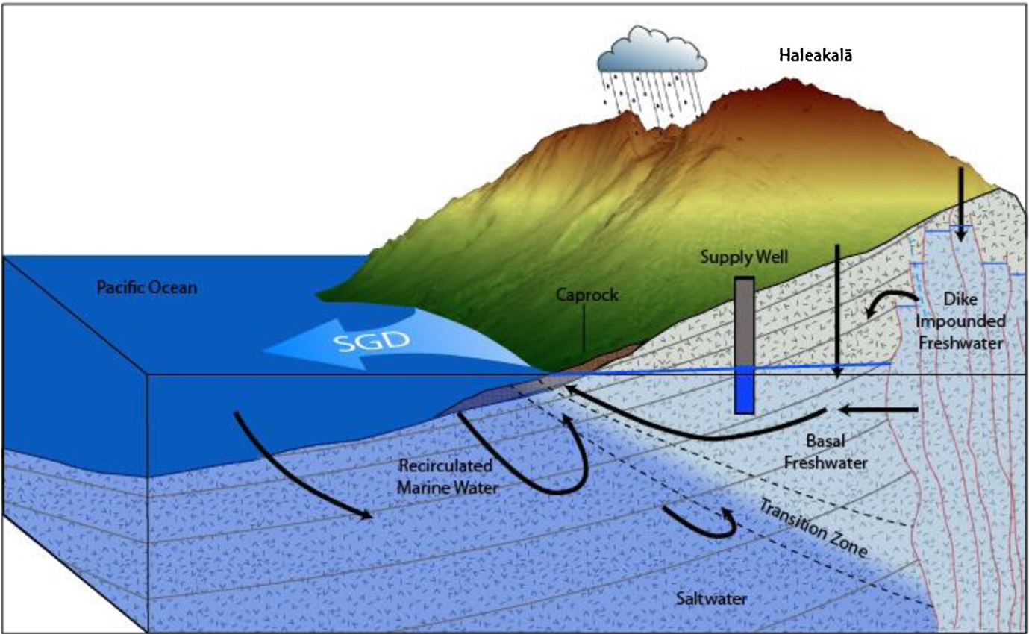
Groundwater Injection
(County of Maui)

Slide 13
Does a Discharge to Groundwater Require a Clean Water Act NPDES Permit?: U.S. Environmental Protection Agency Issues April 15th Interpretive Statement (cont.)
EPA stated in an April 15 Interpretive Statement that the Clean Water Act is:
. . .best read as excluding all releases of pollutants from a point source to groundwater from NPDES program coverage and liability under section 301 of the Clean Water Act, regardless of a hydrologic connection between the groundwater and a jurisdictional surface water.
Note: EPA’S view will be subject to the Supreme Court decision.
Interim – Environmental organizations and others will file actions based on their view of the issue.

Slide 14
Possible Impacts?
Why Important
Areas where close connection between groundwater and surface water
Aquifer close to ground surface and some can be highly transmissive
Some activities can lead to seepage into offsite surface waters (pipeline ruptures)
Effect on improvements, ponds, etc. (fly ash ponds)
Note: Arkansas statute provides broader jurisdiction by use of term “Waters of the State” (providing authority for its “nondischarge” permitting programs)

Slide 15
Wetland Mitigation
Rules Review
July 2019 EPA/corps preproposal to review and revise regulations titled “Compensatory Mitigation for Losses of Aquatic Resources” (the “Mitigation Rule”)
Standards and Regulations for Compensatory Mitigation Projects
Compensatory Mitigation refers to restoration, establishment, enhancement and/or preservation of wetlands, streams or other aquatic resources
Will address a number of topics including mitigation ratio
Note – Critical to also look at each Corps District rules which will vary.

Slide 16
Arkansas Construction
Stormwater Permit
Five-year term expires October 31, 2021
ADEQ will presumably begin considering changes in the next 6-12 months
Recently revised ADEQ Industrial Stormwater Permit reflected few substantive changes
EPA Construction Stormwater Permit modified in 2019 (applicable to non-delegates states)
  Will any of these changes be considered by ADEQ?
  Removes examples of types of parties that could be considered “operator”
  Revises three BMPs
  Clarify the roles and responsibilities of individual operators in multiple operator arrangements

Slide 17
Remember Appropriate Use of Tools Such as:
Arkansas Pollution Control and Ecology Commission Regulation No. 2 – Short Term Activity Authorization
Notification Requirements
Corps of Engineers Nationwide Permits (general permit for similar categories of activities)
Examples for linear activities:
      Maintenance(3)
      Utility lines (12)
      Bank stabilization (13)
      Linear Transportation Projects (14)
      Minor Discharges (18)
      Structural Discharges (25)
      Temporary Construction, Access and Dewatering (33)
      Discharges in Ditches (46)
    Note Preconstruction Notice Requirements
    Note NEPA procedural requirements still apply if federal action

Slide 18
Other Clean Water Act Issues
  Arkansas Water Quality Trading
  Arkansas Antidegradation
  Arkansas Water Quality Standards/Minerals
  Arkansas Water Quality Standards/Nutrients
  Regulation No. 2

Slide 19
Cooperative Federalism?
  EPA prioritizing greater control by the states
  Arkansas a vocal proponent of the approach
  Greater state responsibility but no additional federal resources
  Baseline statutes have not changed
  Environmental organizations challenging EPA decisions

Slide 20
Citizen Suit Activity
Two Types
Citizen Enforcement Against an Alleged Violator
Against EPA, Corps of Engineers, etc., for alleged failure to undertake non-discretionary duty
Environmental groups have ramped up both during Trump Administration.

Slide 21
Arkansas Medical Marijuana Rules
Relevant to the transportation facilities/contractors associated with Arkansas’s enactment of the Medical Marijuana Amendment?
Employee issues associated with the legal use of medical marijuana?

Slide 22
Arkansas Medical Marijuana Amendment
The Arkansas Medical Marijuana Amendment decriminalizes from a state (Arkansas) standpoint certain use of marijuana.
Establishment of regulation of cultivators and dispensaries
Does not require “Employer to accommodate the ingestion of marijuana in a workplace or an employee working under the influence of marijuana.”
Outlines process pursuant to which an individual can become a “Qualifying Patient” who can use medical marijuana
Doctor certifies he/she has a “Qualifying Medical Condition”
Marijuana is still illegal at the federal level as a DEA Schedule I controlled substance.

Slide 23
Arkansas Amendment
Non-Discrimination Provision
Non-compliance with the Arkansas Medical Marijuana Amendment of 2016 (AMMA) can pose significant risks for an employer. It includes a non-discrimination provision directed at employers. The provision provides that:
    “An employer shall not discriminate against an applicant or employee in hiring, termination, or any term or condition of employment, or otherwise penalize an applicant or employee, based upon the applicant’s or employee’s past or present status as a qualifying patient or designated caregiver.”

Slide 24
Employer Issues/Suggestions
Create Written Job Descriptions which Designate Safety Sensitive Positions within your Organization?
The AMMA permits employers to “exclude a qualifying patient from being employed in or performing a safety sensitive position based on the employer’s good faith belief that the qualifying patient was engaged in the current use of marijuana.”
Safety sensitive position is defined as “any position designated in writing by the employer as a safety sensitive position in which a person performing the position while under the influence of marijuana may constitute a threat to health or safety.
Creating written job descriptions which designate certain jobs as “safety sensitive positions” permits employers to exclude job applicants and employees with medical marijuana registry ID cards from those positions.

Slide 25
NOTE:
  Still Illegal at Federal level as Schedule I Controlled Substance
  U.S. Department of Transportation Guidance Trumps State Law and Prohibits Use of Medical Marijuana by Haz Mat Carriers
  Companies Subject to Federal Drug Workplace Act Must Prohibit Use
  OSHA General Duty Clause? (maintain safe work place)

