Slide 1
Program Vision
Mission driving Technology
Notes:
The program was started and is being built around the theory that missions will drive the technology we acquire. We don't want to acquire technology in hopes that one day we can use it or have the expertise to use it.

Slide 2
Program Startup
Build a Professional Environment
Notes:
The program was started from the foundation that it is Professionally organzied and operated. Begiining with the training, requirements of the RPICs, continued refinement of doucmentation and procedures.

Slide 3
The Building Blocks
Direction and Management
Lawrence Bengal – E&E Chief Technical Officer/OGC Director
Dan Pearson – E&E Chief Information Officer/Private Pilot
Original RPICs and VOs
Jeremy Ramsey – OGC GIS Technician
Chris Krou – DEQ Hazardous Waste Branch Manager
Brian Kehner – AGS GIS Technician
Training and Procedure Establishment
Training – 10 Days On-Site with Flight Safety Systems
Build Documentation and Procedures
Notes:
The original development of the program was from Larry and Dan. Larry having knowledge of the UAV technology coupled with the availability of technology would allow the use in the Oil and Gas Regulatory program. Dan being technology person along with the Private Pilot training enhanced the building of the hands-on Professional requirements to avoid the “hobby drone pilot” situation.
The original three RPICs were originally trained via a 10 day on-site training curriculum that included ground school, flight training, and a safety program overview. The three pilots have differing backgrounds and were carefully chosen based on in-person conversations and applicable backgrounds. They have their FAS Part 107 RPIC certificate.
Once training was complete, we ask that the RPICs fly as often as possible to keep current. We are constantly tweaking and modifying the documentation and procedures.

Slide 4
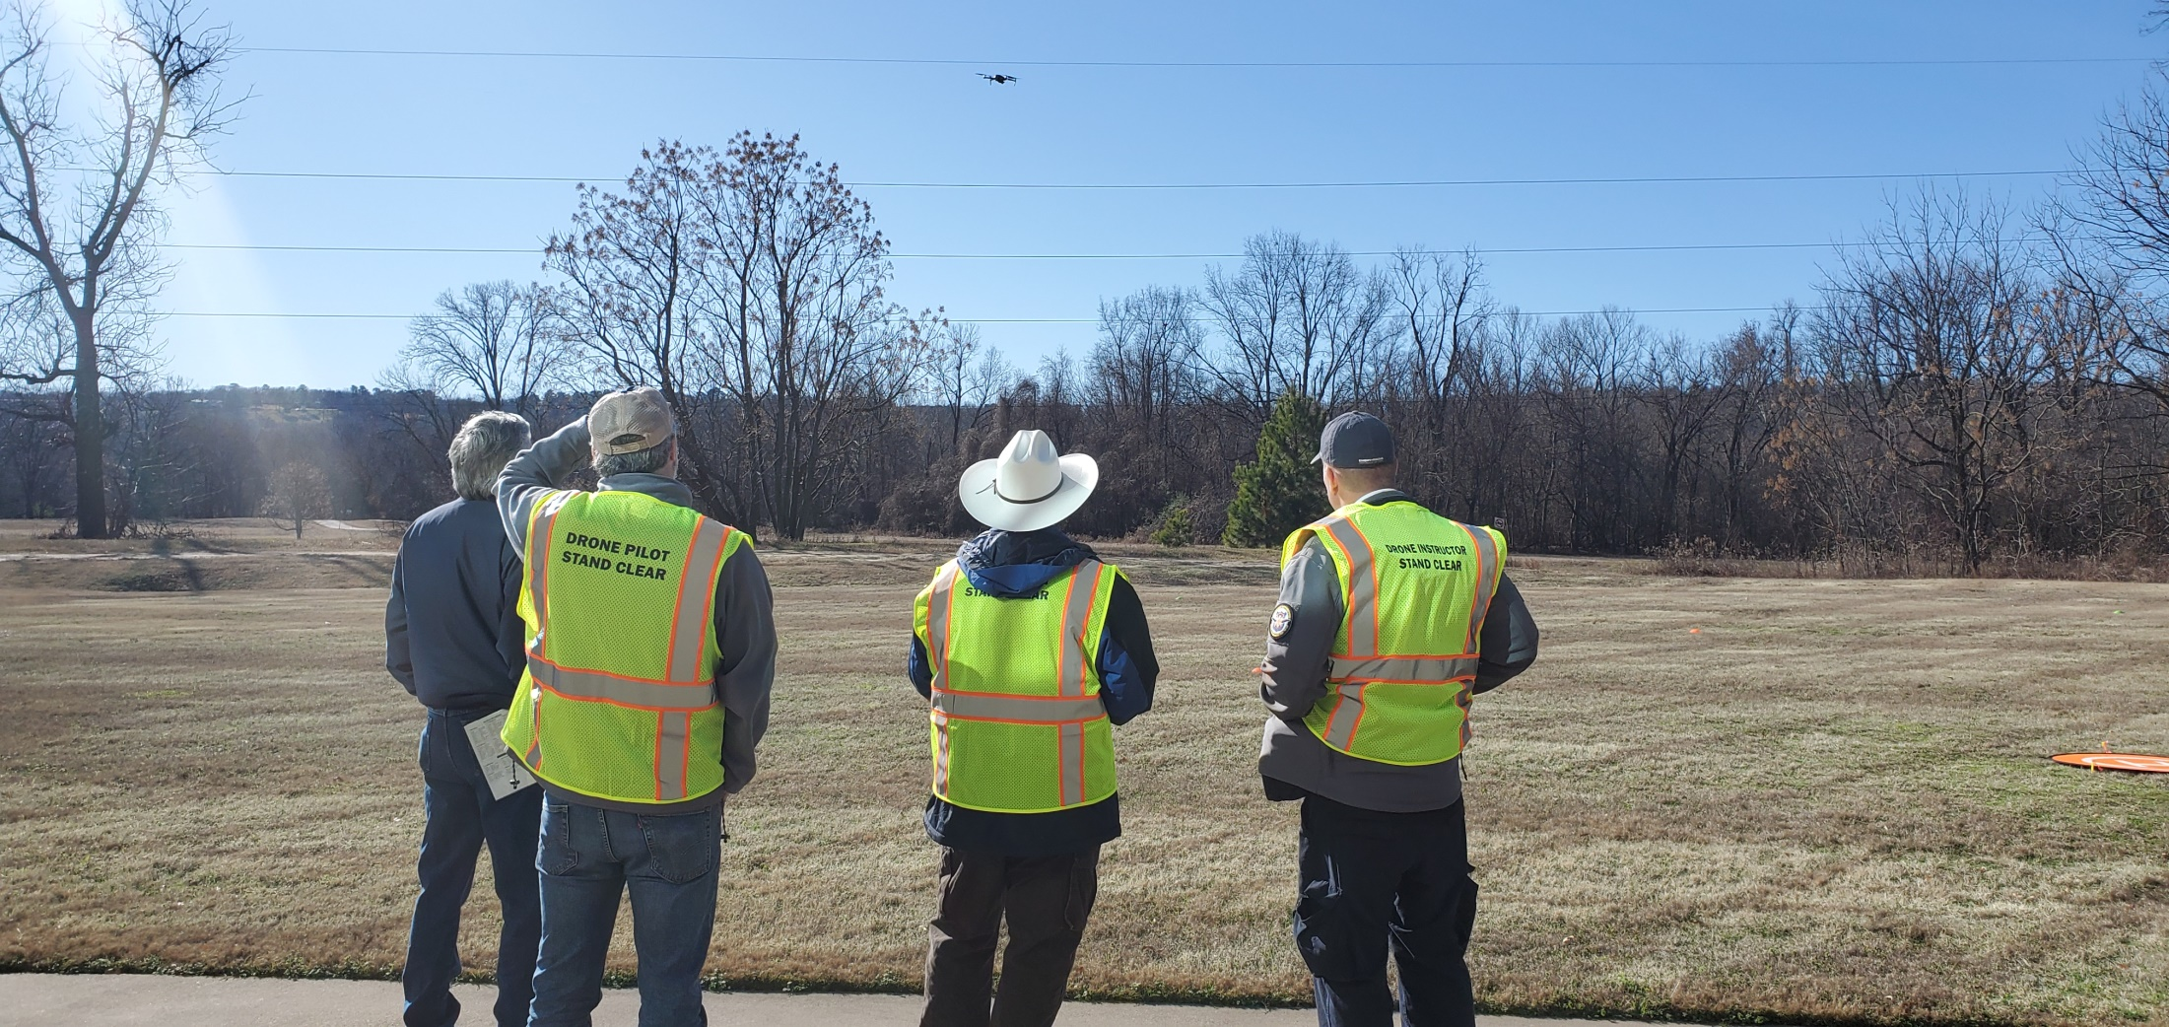
Training

Slide 5
Documentation
Policy.docx
Mission Request
Mission Checklist
Flight Log
Flight Checklist
Emergency Procedures
Pilot Application

Slide 6
Risk Management Tools
Weather RPICs check weather daily up to 7 days in advance. Wind, Rain, Visibility, Extreme Temp
sUAS-FRAT
Flight Safety APP to access Risk. Evaluates RPIC, Equipment, Flight Conditions
UAV Forecast APP that indicates if conditions for selected location is forecasted to be within the “good to fly” parameters
AIRMAP APP to show any flight restrictions for a specific area. Review of FAA Sectional.

Slide 7
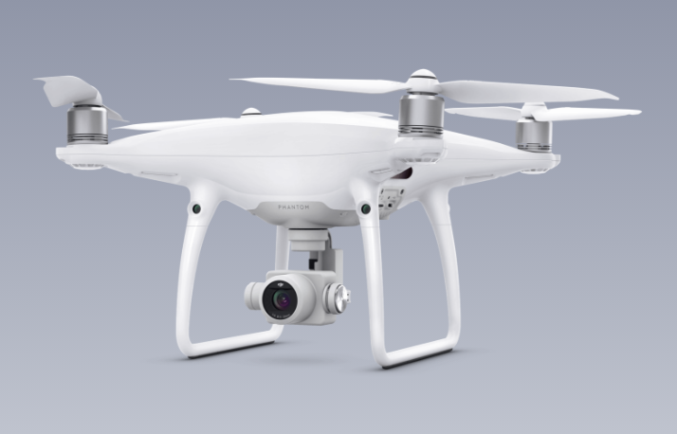
DJI Phantom 4 Pro
First UAV purchased
Photogrammetry, Video, Photo
Criteria for Selection
Familiar to RPICs, similarity to training aircraft
Very solid, capable and stabile aircraft
Technology support of the initial mission requirements
Notes:
The DJI Phantom 4 Pro was purchased immediately after the training program. It was selected because of the familiarity to the RPICs along with a recommendation from the training officer. The aircraft is very stabile in flight and provides excellent data collection through the use of photogrammetry. The ability to record photos and video has also been used to facilitate mission requests.

Slide 8
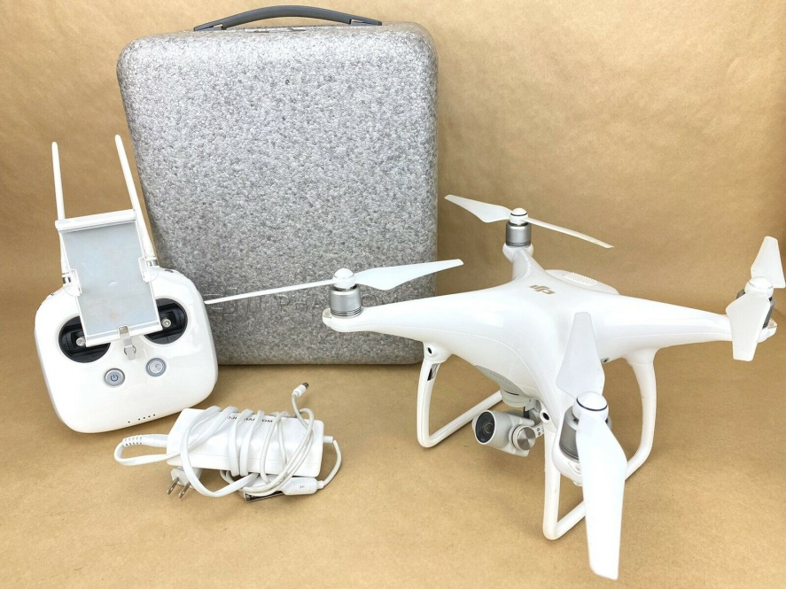
Phantom 4 Pro Missions
Algae bloom
Mining Survey
Landslide

Slide 9
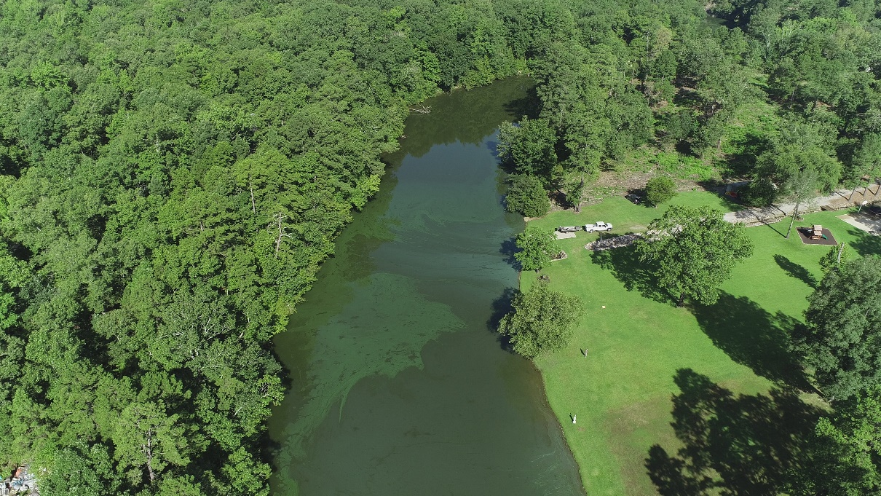
Algae Bloom
01
02
03
First Mission Planning, Logistics
Trained RPICs were prepared because of training
Lessons Learned Time of day, documentation, checklist

Slide 10
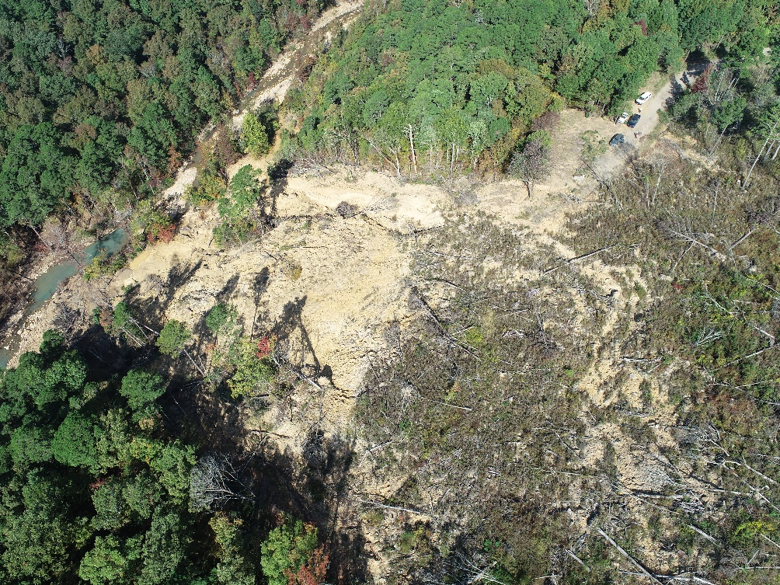
Shoal Creek Land Slide

Slide 11
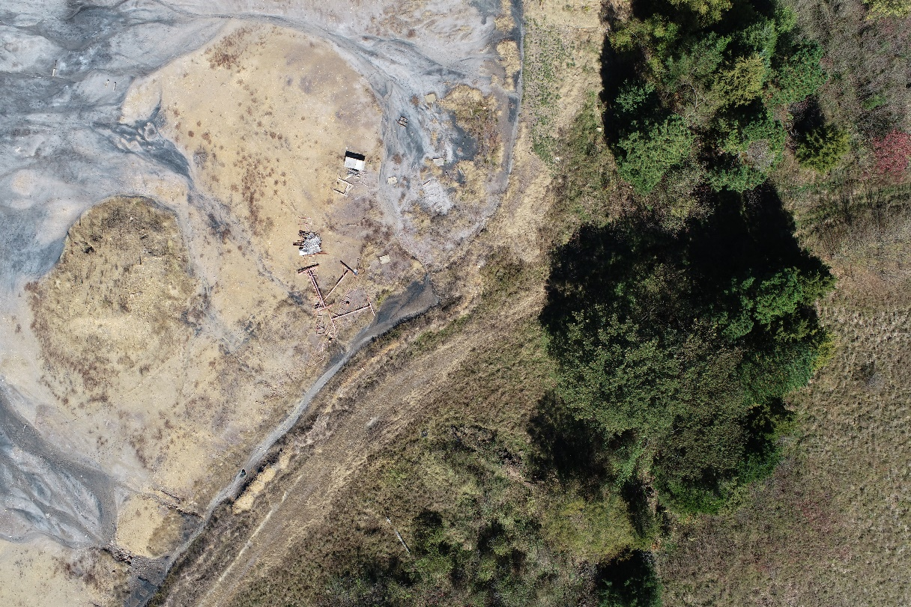
Stryton Mine Survey

Slide 12
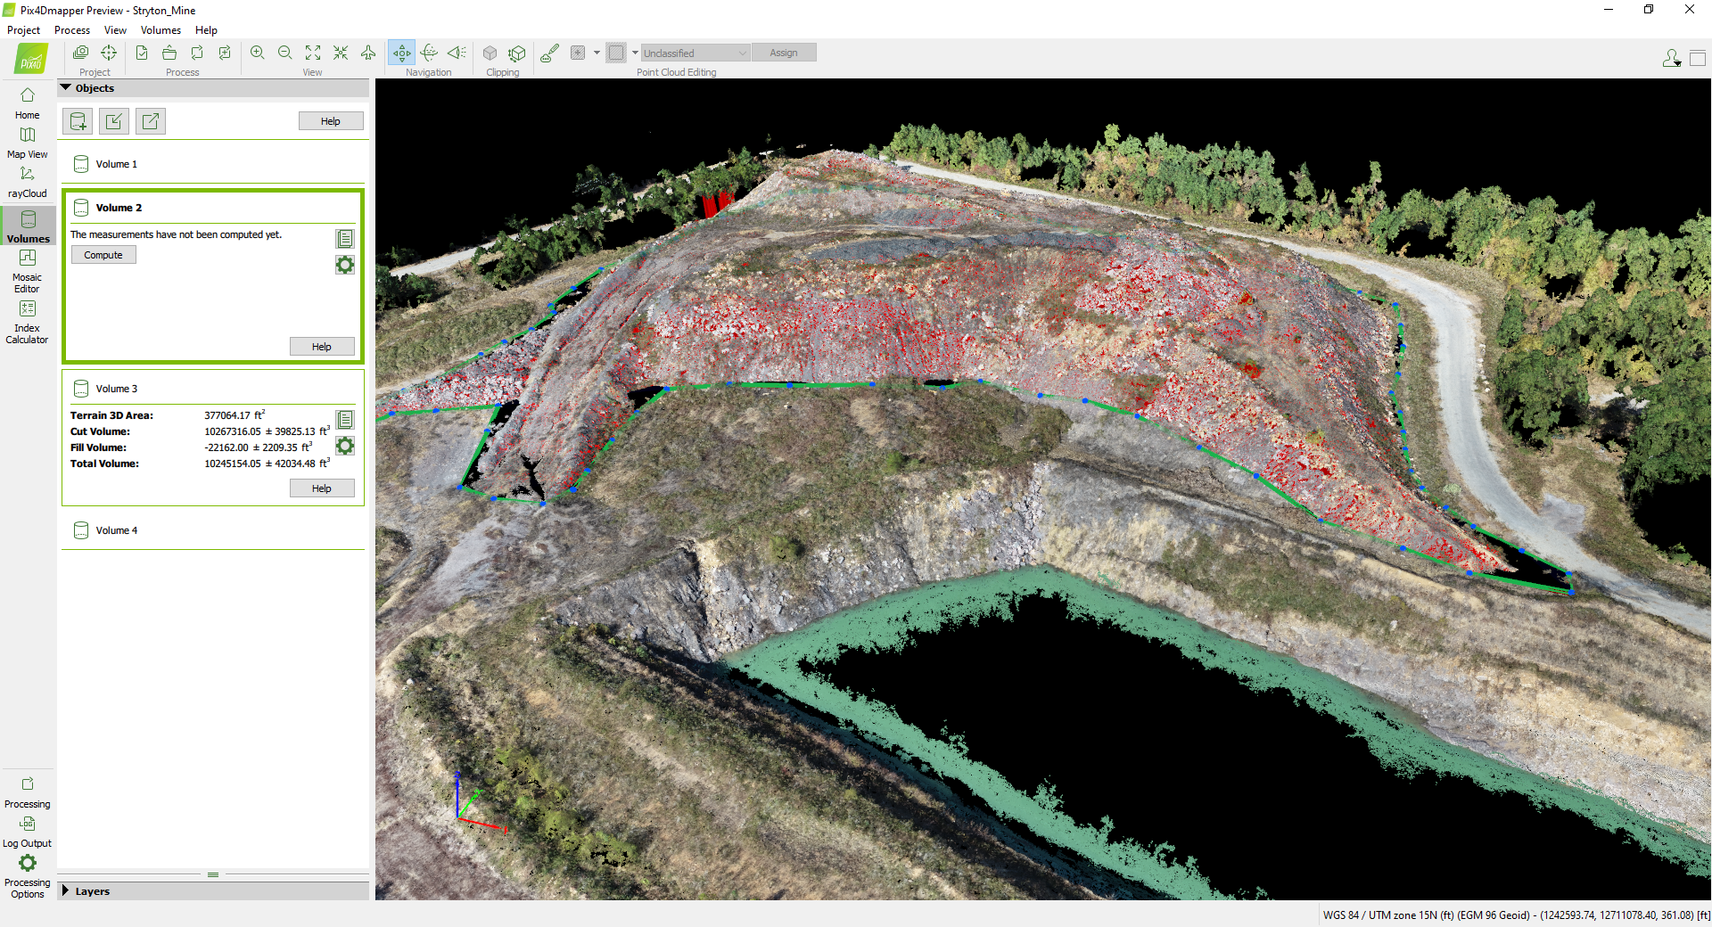
Stryton Mine Survey
Video
Mosiac
Volume

Slide 13
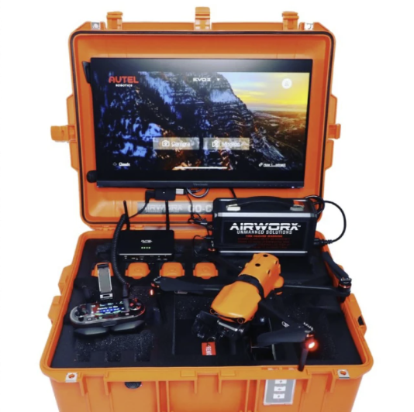
Autel EVO II
Purchased with a Go Command
Photogrammetry, Video, Photo, Thermal
Criteria for Selection
Research on Thermal capabilities for this size aircraft
Very solid, capable and stabile aircraft
Technology support of the new mission requirements
Go Command allows for rapid deployment with remote viewing capabilities

Slide 14
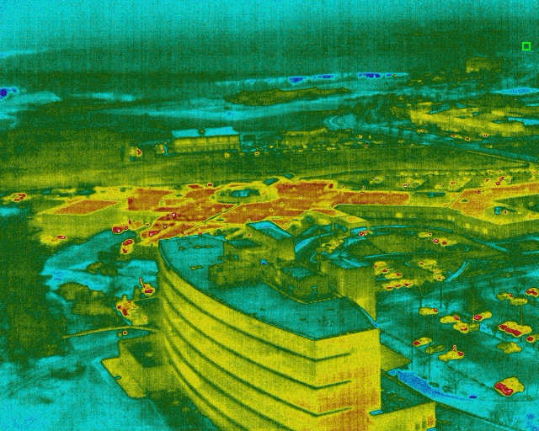
Autel EVO II Thermal

Slide 15
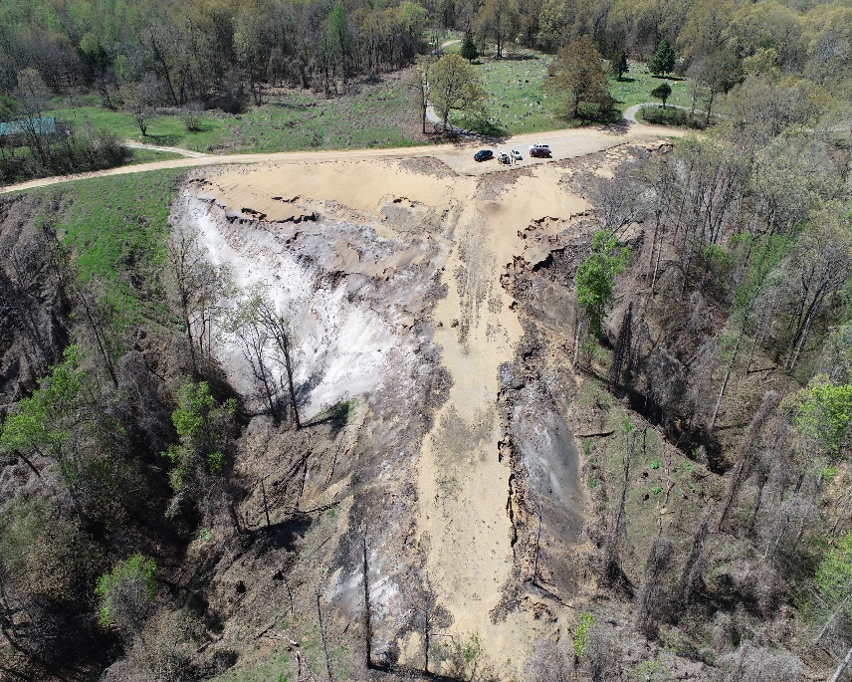
Lindley site – Rice Hull Burn
First flight with thermal imagery. Learning how to interpret the data collected.

Slide 16
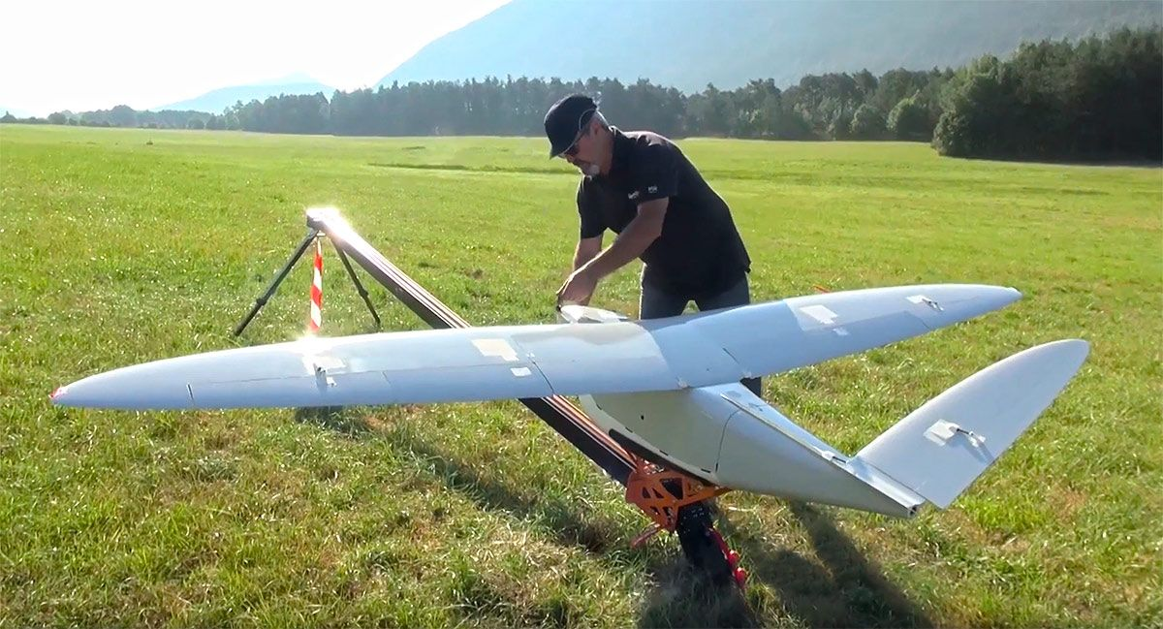
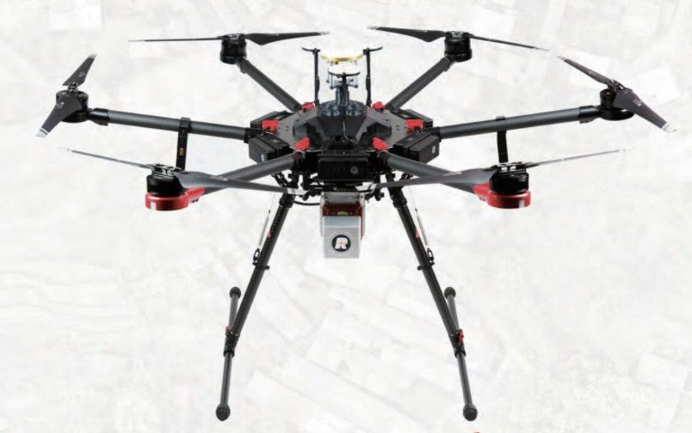
Where to Land???????
As the emerging technology of small unmanned aircraft solutions continues to build and grow, the E&E UATS team will continue to expand knowledge and professional skills.
We currently work with the VLOS (visual line of sight) restriction, however, we hope to expand to beyond line of sight.
This is sample text.

Slide 17
Challenges
Current and proficient with the air craft and the data processing tools
New and improved air craft and towable data collection technology
New FAA regulations and requirements
Mission requirements will guide the program into new technology
This is sample text.

Slide 18
Dan Pearson
UAV Program Manager
PHONE
870.677.6757
EMAIL
Dan.Pearson@aogc.state.ar.us

