Slide 1

COMPLIANCE VIOLATIONS FOUND
DURING INSPECTIONS
Office of Land Resources
Regulated Storage Tanks

Slide 2
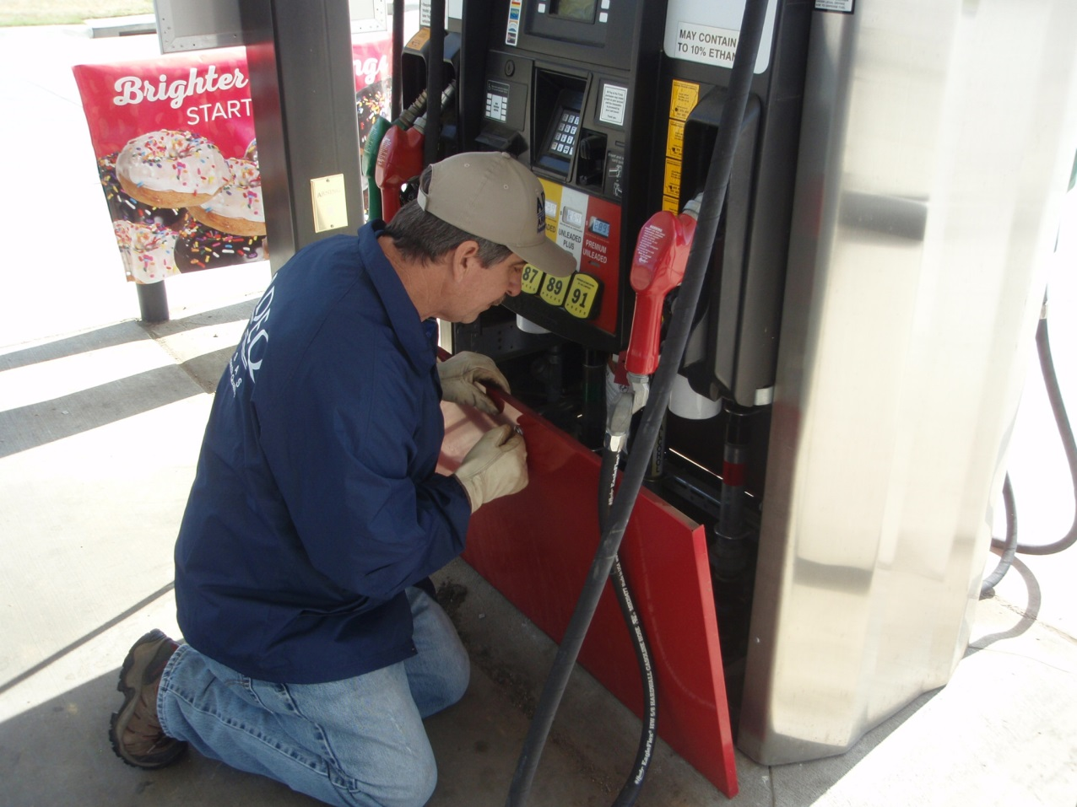
Randy Beard
District 10 Inspector
Fort Smith Field Office

Slide 3
Release Prevention
Spill Prevention
Overfill Prevention
Corrosion Protection

Slide 4
Spill Prevention
Keep spill buckets free of any liquid or debris
Repair or replace spill bucket when damaged

Slide 5
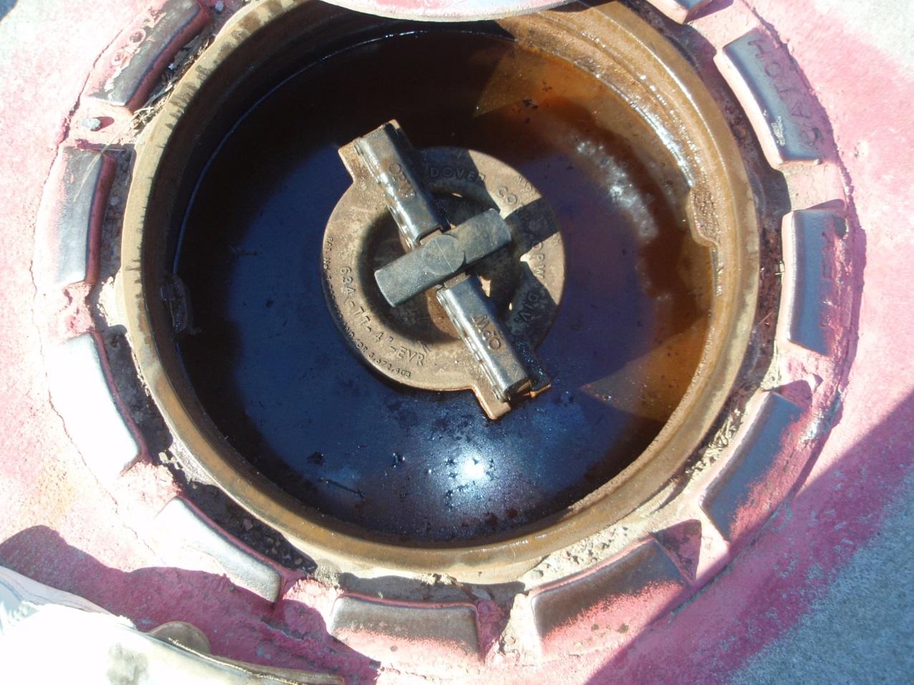
Spill bucket with liquid

Slide 6
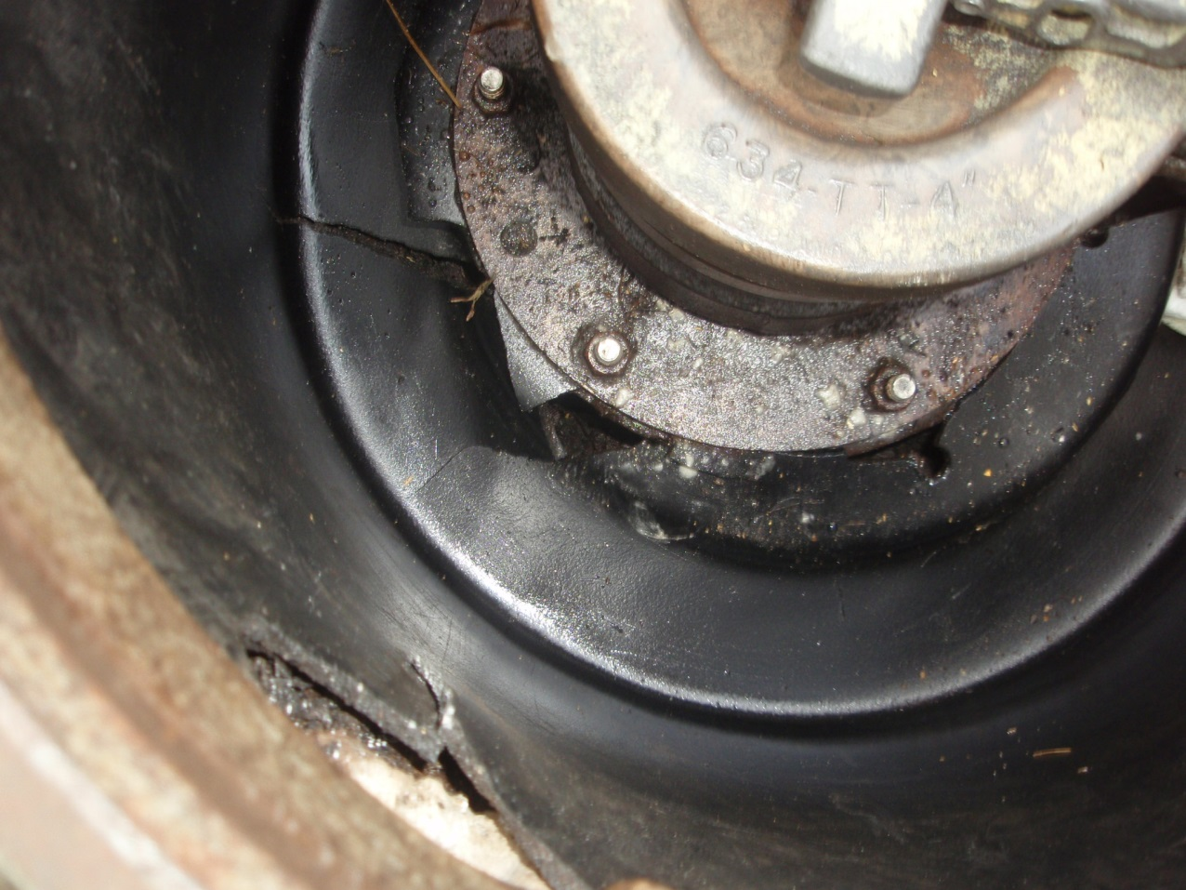
Crack in spill bucket

Slide 7
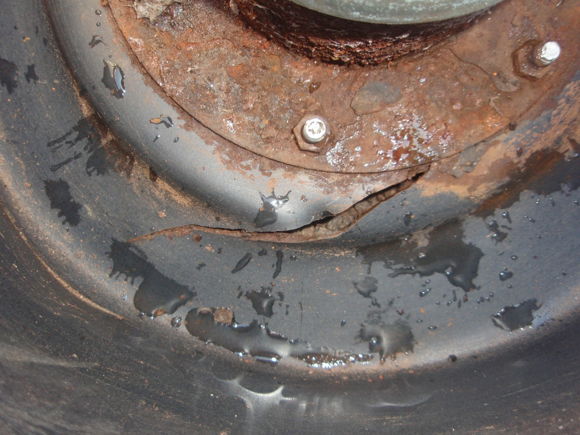
Crack in spill bucket

Slide 8
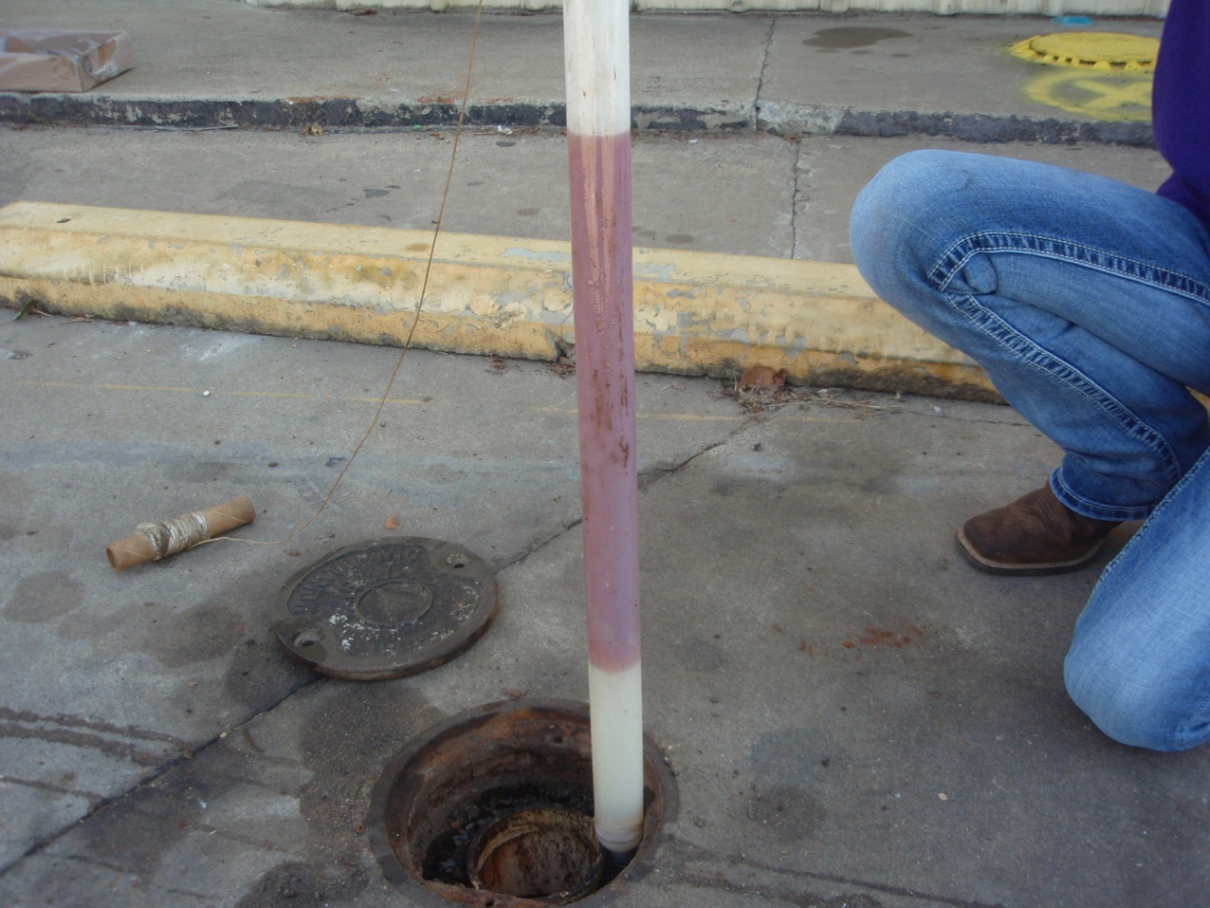
Product found in monitoring well

Slide 9
Overfill Prevention
Do not remove automatic shut-off except when testing or replacing
Maintain device as operable

Slide 10
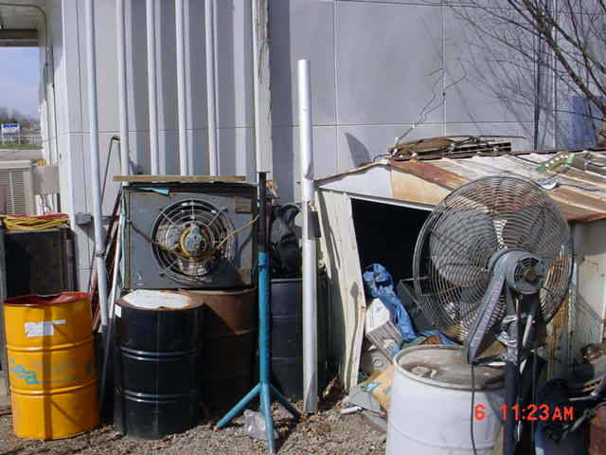
Drop tube out of tank

Slide 11
Corrosion Protection
Current three-year corrosion protection system recertification for tanks and/or piping
For flex lines, if needed
For subpump, if needed
Sixty-day rectifier check for impressed current system

Slide 12
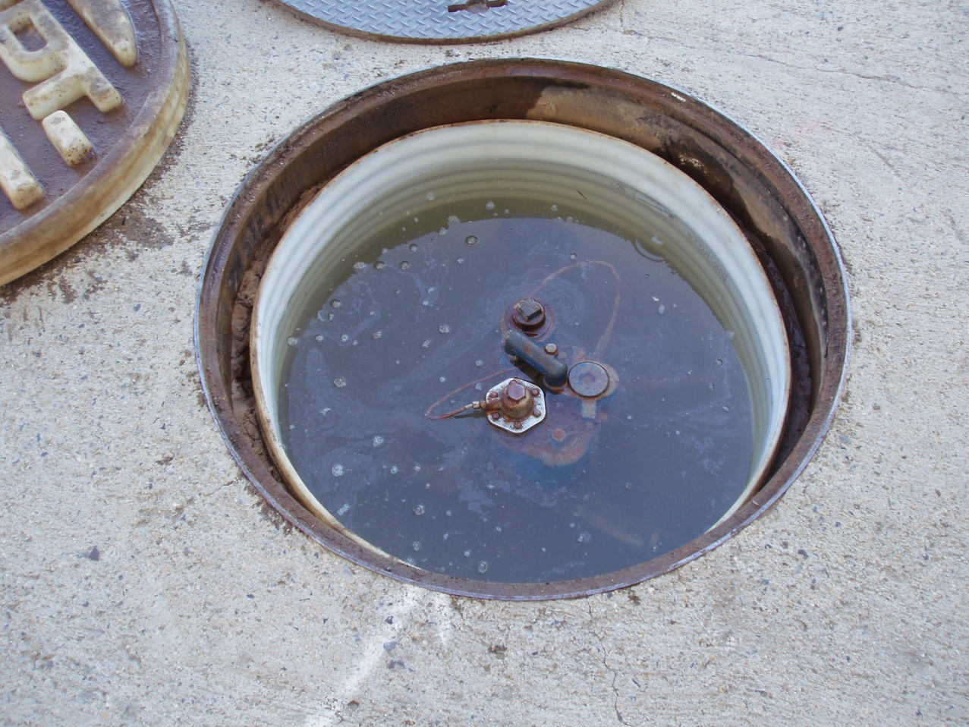
Without protection, liquid in sump will cause corrosion to metal components

Slide 13
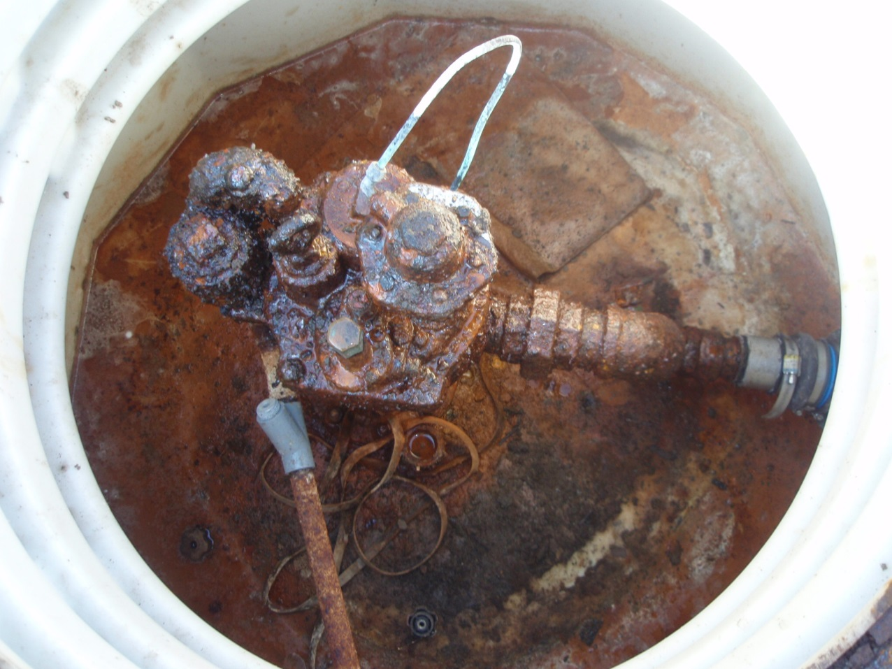
Corrosion on turbine pump

Slide 14
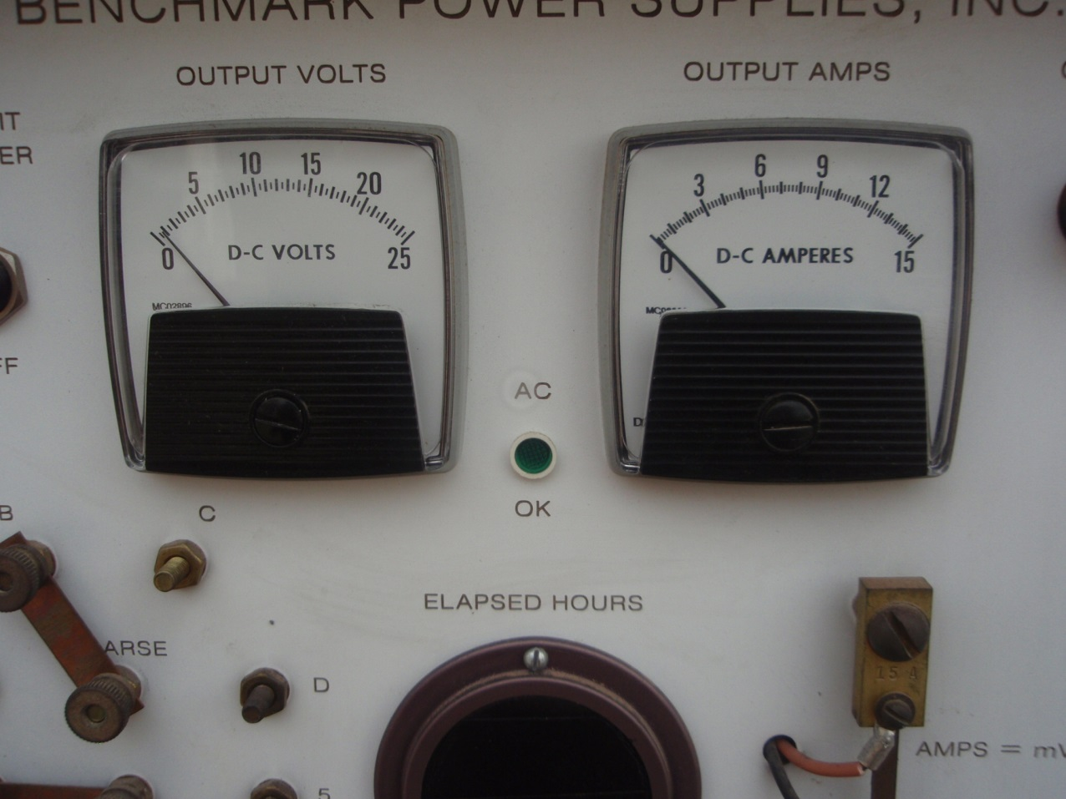
Rectifier reading zero amps

Slide 15
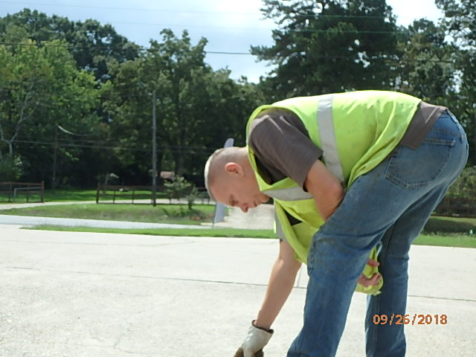
John Lamb
District 5 Inspector
El Dorado Field Office

Slide 16
Release Detection
Tanks and Piping
Monthly monitoring results documentation
Monthly ATG results
Records for the two most recent consecutive months
Records for eight of the last 12 months
(new regulations now require 10 of the last 12
months)

Slide 17
Release Detection
Tanks and Piping
Annually check function of line leak detectors
Annual line tightness test documentation
Monthly interstitial monitoring records

Slide 18
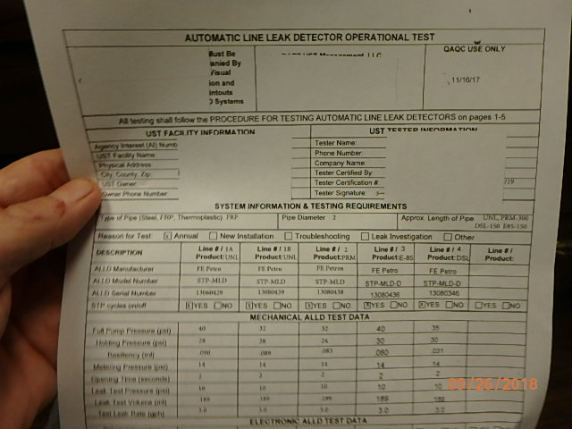
Line leak detector test

Slide 19
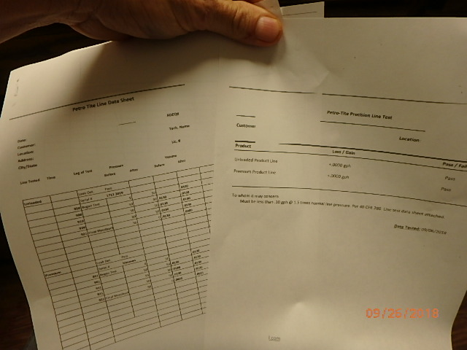
Line tightness test

Slide 20
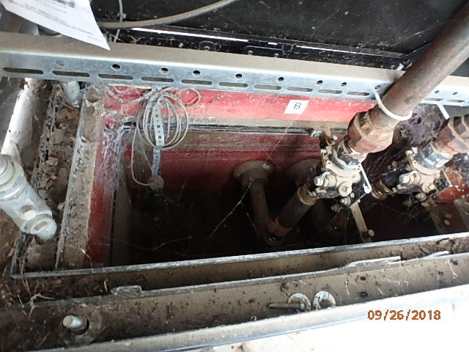
Dispenser sump with interstitial monitoring

Slide 21
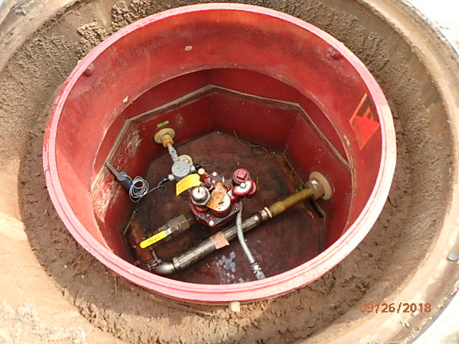
Interstitial monitoring for double-walled piping

Slide 22
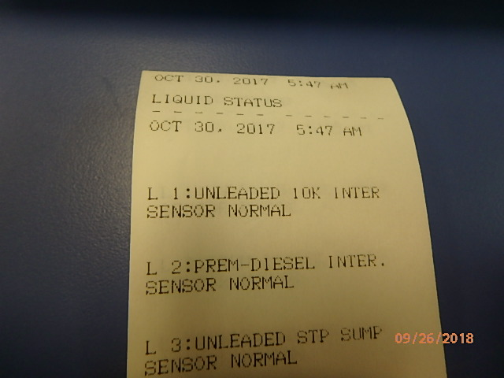
Interstitial monitoring results

Slide 23
Registration Requirements
New underground storage tanks prior to fuel delivery
Change in ownership

Slide 24
Operator Training
Trained Class C operators on all shifts
Class C operator training documented on required ADEQ forms

Slide 25
Questions

