Slide 1
Solid Waste Legislative Update
95th General Assembly
January 13 – May 5, 2025
Randy Thurman
Partner Government Solutions, LLC
rthurman@arkansaslobbying.com
501-343-4823

Slide 2
Disclaimer:
All materials, comments and presentations are strictly the opinions of the presenter and are not those of Government Solutions, LLC or its partners, staff and clients, including specifically LANXESS, ExxonMobil, Central States Water Resources, Gulf State Toyota and WM (Waste Management).

Slide 3
Legislative Overview
Arkansas House of Representatives - 100
Super Majority Vote: 75
Republicans: 81 members
Democrats: 19 members
Arkansas State Senate - 35
Super Majority Vote: 27
Republicans: 29 members
Democrats: 6 members

Slide 4
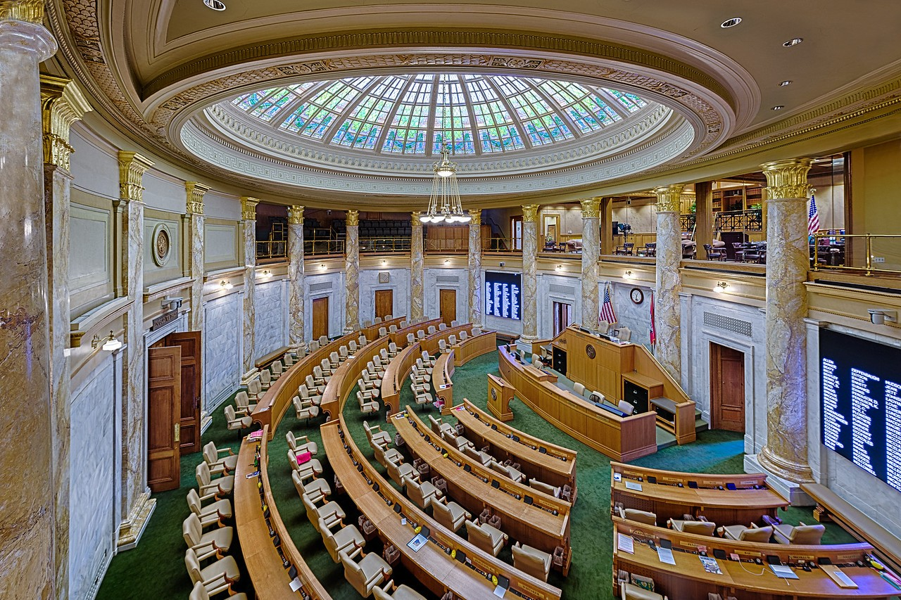

Slide 5


Solid Waste Legislation
Tires
SB8 – Payton: Immediate transfer of $5 million from General Revenue Reserve Fund to ADEQ’s Used Tire Recycling Fund. Filed 12/9/24, Died without action 5/5/25. Gov Opposed.
Governor’s Letter #36 provides $5 million to ADEQ’s current waste tire program. Filed with Jt. Budget Committee in mid-March.
SB606 – Davis: Eliminate the existing used tire program & districts, reduced fees & assessed on new tires not rims, establish manifest system & abatement program – PRIVATIZE. Governor supported this ADEQ bill. Filed 4/1/25, Killed in Sen PHC 4/7/25 voice vote.

Slide 6
Solid Waste Legislation
Tires
SB622 – Davis: Allows tire retailers to add a tire fee for hauling/disposal of waste tires (due to nonperforming Waste Tire Districts). Filed 4/3/25, Died in House PHC without hearing.
SB238 – Payton: Extended tire fees to small tires, retreads, online purchased & new car tires @ $3, large and extra-large tires @ $5. Governor opposed. File 2/27/25, Died in House PHC 4/8/25.

Slide 7
Solid Waste Legislation
Electronics
SB369 (Act 778) - Irvin: Eliminates the Computer & Electronic Recycling Fund and the fund’s support of
market research and grants for collection, transport and processing scrap electronic equipment, and support of measures to promote the recycling, donation, demanufacturing or disposal options, redistributes funds from sale of surplus electronic equipment.
Filed 3/4/25, Signed 4/17/25

Slide 8
Solid Waste Legislation
Electronics
SB185 (Act 208) - Dotson: Transfers authority from DFA
to Department of Transformation regarding pricing for
the sale of surplus computers and electronic equipment
and the establishment of statewide contracts for
recycling and demanufacturing.
Filed 2/3/25, Signed 2/27/25

Slide 9
Solid Waste Legislation
Recycling
SB460 (Act 697) - Irvin: Eliminates the Marketing
Recyclables Program of the Compliance Advisory Panel at ADEQ. Reduces Panel from 9 to 7 members.
Filed 3/13/25, Signed 4/16/25

Slide 10
Solid Waste Legislation
Landfills
HB1058 – Unger: Prohibit public employees from giving
advance notice to entities of required inspections.
Filed 12/9/24, Deferred in committee 1/28/25

Slide 11
Solid Waste Legislation
Landfills
HB1410 (Act 323) – Unger: Narrows “advance notice” to intent. File 2/5/25, Signed 3/18/25.
“…knowingly communicates information, directly or indirectly, regarding the timing, scope, or details of an upcoming inspection with the intent to:
(A) Alter or manipulate conditions to evade detection of noncompliance or violations;
(B) Provide an unfair advantage to the inspected party; or
(C) Otherwise interfere with the integrity or impartiality of
the inspection process.”

Slide 12
Solid Waste Legislation
Landfills
HB1410 (Act 323) – Unger: Also added exemptions:
“(4) Subdivision (d)(1) of this section does not prohibit:
(A) Routine scheduling disclosures required by law;
(B) Public safety notifications; or
(C) Official communications necessary for the proper administration of inspections.”

Slide 13

Solid Waste Legislation
Landfills
HB1575 (Act 376) Lundstrum: Prohibits a person that is employed or has a direct or indirect interest in an
organization that owns, operates, represents, or applies
for a solid waste license or permit from serving as a member on PCE Commission. Filed 2/5/25, Signed 3/20/25
Exemption: “…does not apply to an elected official or an employee of a city or county that is required to represent a city or county on a regional solid waste planning district or board under subsection (b) of
this section.”

Slide 14
Solid Waste Legislation
Landfills
SB265 (Act 294) Irvin: Reduces and modify the
membership of the Wastewater Licensing Committee from 8 to 5 and the Solid Waste Licensing Committee from
7 to 5. Filed 2/20/25, Signed 3/17/25.

Slide 15
Solid Waste Legislation
Landfills
HB1576 – Lundstrum: Prohibits a solid waste landfill
to be placed over a Karst topography.
File 2/25/25, Died upon Adjournment 5/5/25

Slide 16

Solid Waste Legislation
Landfills
HB1768 – (Act 815) Lundstrum: Requires a solid waste landfill contract relating to a host fee to be voted on
at a regularly scheduled meeting of a host community
in which the landfill is located.
Filed 3/12/25, Signed 4/22/25.
“…contract for a host fee shall not exceed a contract
term of four (4) years ending in December of even-numbered years.
The agreement or contract for a host fee may be renewed for an additional term not to exceed four
(4) years at the same amount of the host fee or renegotiated for a new amount of the host fee.”

Slide 17
Solid Waste Legislation
Landfills
HB1768 – (Act 815) Lundstrum:
Other Provisions
A. Does NOT limit number of renewals
B. Host Fee Agreements must have beginning and ending/renewal dates
C. “Perpetuity” provisions prohibited
D. “…agreement or contract for a host fee shall be voted on at a regularly scheduled meeting of the host community and signed by either the mayor of the city or the county judge if a municipality is not the closest governmental
unit.”

Slide 18
Solid Waste Legislation
Landfills
HB1776 – Lundstrum: Landfill CON must include a city council’s minute order or quorum court’s resolution signed by the mayor or county judge regarding the community’s decision.
Filed 3/13/25, Died in House PH upon Sine Die 5/5/25

Slide 19
Solid Waste Legislation
Facilities & Funding
SB421 (Act 578) – Hester: Authorizes Up to $500 million of General Obligation Bonds by ANRC for “WATER,
WASTE DISPOSAL, POLLUTION CONTROL, ABATEMENT & PREVENTION, DRAINAGE, IRRIGATION, FLOOD CONTROL, AND WETLANDS AND AQUATIC RESOURCES PROJECTS” with irrigation capped at $165 million, voter approval required.
“Waste” means a liquid or solid produced as an undesirable byproduct of any activity”
Filed 3/11/25, Signed 4/14/25

Slide 20
Land Use
HB1510 (Act 314) – Gonzales: Eliminates municipal extraterritorial jurisdiction over unincorporated areas of a county.
SB290 (Act 921) – B. Johnson: Prohibits moratorium on issuance of permits in watershed and other bodies of water. (Hog farming on the Buffalo) Governor opposed.

Slide 21
Land Use
SB571 (Act 1002) – Petty: Prohibits city from enforcing building & zoning regulations on county property.
SB505 (Act 595) – Bryant: Streamlines process for property owners to change their property's zoning or district designation if the requested change is consistent with the adopted land use plan.
HB1680 (Act 811) – Vaught: Forbids prohibited foreign owned companies from renting/owning ag property within 10 miles of critical infrastrure.

Slide 22
Land Use
SB290 (Act 921) – B. Johnson: Prohibits moratorium on issuance of permits in watershed and other bodies of water. (Hog farming on the Buffalo) Governor opposed.
HB1762 (Act 1009) – Hall: Requires revocation of a permit for the disposal of poultry processing plant waste in an agricultural or pastoral application for a certain number of violations. (Crawford Co. Denali Water Solutions)

Slide 23

Land Use
HB1198 – J. Moore: Prohibit wind power devices over 150’ in certain areas to protect waterfowl. Filed 1/22/25, Died in Jt. Energy 2/4/25.
SB466 – Dismang: Moratorium on wind power devices over 150’ & requires AGFC study on waterfowl impacts. Filed 3/17/25, Died in Senate Ag Comm 4/1/25.

Slide 24
Questions?
Randy Thurman
Government Solutions, LLC
rthurman@arkansaslobbying.com
501-343-4823

