Slide 1
Unresolved Reg 2 Issues and Triennial Review Preview
Raymond E. Wieda, PE
FTN Associates
2018 Arkansas Environmental Federation
Water Seminar

Slide 2
Triennial Review
Required by Clean Water Act
Water quality standards (Reg 2) must be reviewed every three years minimum
Last Triennial Review – 2014
2017 Triennial Review in progress

Slide 3
Triennial Review Process
ADEQ proposes changes to Reg 2
Reviewed by Governor’s Office and APCE Commission
Public notice and comment period
Legislative Approval
Adoption by APCE Commission
Changes submitted to EPA for review
EPA approves, disapproves or takes no action
Only approved changes take affect for CWA purposes

Slide 4
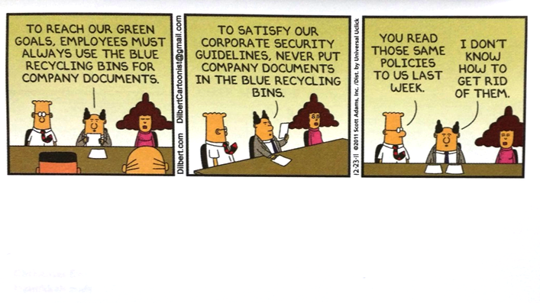
The dilemma…

Slide 5
2.104 Policy for Compliance
“…Compliance must occur at the earliest practicable time, but not to exceed three years from effective date of permit, unless the permittee is completing site specific criteria development or is under a plan approved by the Department, in accordance with Regs. 2.306, 2.308, and the State of Arkansas Continuing Planning Process.”
EPA took no action
Statement not approved for CWA purposes
Affects duration of compliance schedules

Slide 6
2.511(A) Site Specific Mineral Quality Criteria
Current Reg 2: “…The following criteria apply to the streams indicated.”
EPA Approved: “The following limits apply to the streams indicated, and represent concentrations of chloride (Cl-), sulfate (SO4=) and total dissolved solids (TDS) not to be exceeded in more than one (1) in ten (10) samples collected over a period of not less than 30 days or more than 360 days.”

Slide 7
2.511(A) Site Specific Mineral Quality Criteria (Cont’d)
Contradicts EPA Approved 2016 and Draft 2018 Assessment Methodology
  10% vs 25% allowable non-attainment
Potentially affects:
  303(d) listings
  TMDLs
  Permit limits

Slide 8
2.511(B) Ecoregion Reference Stream Minerals Values
“The following values were determined from Arkansas' least-disturbed ecoregion reference streams are considered to be the maximum naturally occurring levels. For waterbodies not listed above, any discharge which results in instream concentrations more than 1/3 higher than these values for chlorides (Cl-) and sulfates (SO4=) or more than 15 mg/L, whichever is greater, is considered to be a significant modification of the maximum naturally occurring values…The values listed in the table below are not intended nor will these values be used by the Department to evaluate attainment of the water quality standards.”

Slide 9
2.511(B) Ecoregion Reference Stream Minerals Values (Cont’d)
ECOREGION REFERENCE STREAM VALUES (mg/L)
Ecoregion | Chlorides (Cl-) | Sulfates (SO4=) | TDS
Ozark Highlands | 13 | 17 | 240
Boston Mountains | 13 | 9 | 85
Arkansas River Valley | 10 | 13 | 103
Ouachita Mountains | 6 | 15 | 128
Gulf Coastal Plains | 14 | 31 | 123
Delta | 36 | 28 | 390

Slide 10
2.511(B) Ecoregion Reference Stream Minerals Values (Cont’d)
Values vs. Criteria
Contradicts EPA Approved 2016 and Draft 2018 Assessment Methodology
  Ecoregion Values vs Secondary Drinking Water Standards (250/250/500)
Potentially affects:
  303(d) listings
  TMDLs
  Permit limits

Slide 11
Questions?

