Slide 1

ADEQ: IMPLEMENTING ENVIRONMENTAL POLICIES AND REGULATIONS
Stuart Spencer
Associate Director
Office of Air Quality

Slide 2
What We Will Cover Today
ADEQ’s authority
Regulations
Permitting
Enforcement
Notes:
Introduction
Go over agenda for today – This presentation is to discuss the ADEQ regulatory process from where we get our authority to regulate, how we implement regulations, to permitting and enforcement.

Slide 3
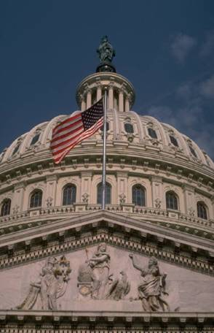

Environmental Policy
Notes:
Congress passes laws for the nation. You’re probably very aware of most of them including the Clean Air Act, Clean Water Act, and many others. Those laws are then given to the EPA to implement and enforce on a national scale.

Slide 4


From EPA to ADEQ
EPA can delegate to states:
Authority
Funding
Responsibility
Notes:
EPA realized long ago that enforcing all these regulations across the country would be very difficult. So they began delegating to states the authority and responsibility to enforce the regulations. This allowed the states to adopt regulations that were at least as stringent as the national regulations. It also gave states the authority to fund and support those programs.
The ADEQ OAQ implements all air programs delegated by Region 6 of the U.S. Environmental Protection Agency to the State of Arkansas. These programs include the Title V program for major sources of pollutants, New Source Performance Standards, National Emission Standards for Hazardous Air Pollutants, Prevention of Significant Deterioration and the State Implementation Plan.

Slide 5
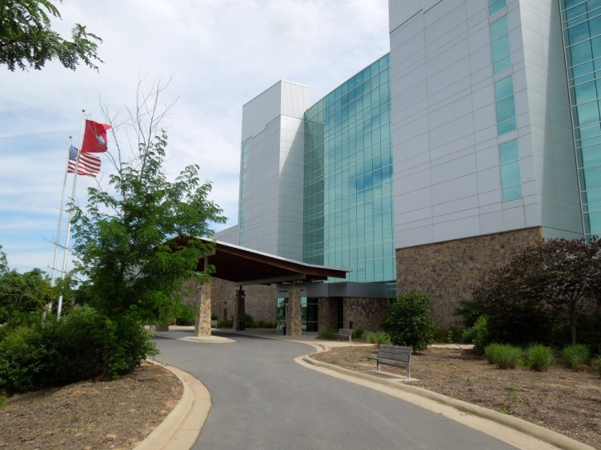
From EPA to ADEQ
Delegated states must:
Enact regulations
Enforce regulations
Fund programs
Notes:
As part of this delegation, states must enact regulations, enforce those regulations, and fund the technical and administrative support needed to administer those federally delegated programs. States are audited by the EPA periodically to make sure they are meeting the full requirements of the federal program. If not, EPA can take some or all that delegated authority back.
Why would a state want to have delegation of these rules?

Slide 6
Role of the States in
Protecting the Environment
Co-regulators with the U.S. EPA in a national system of environmental protection: “cooperative federalism”
State agencies and U.S. EPA play complementary roles in this national system
States implement 96.5% of federal programs that can be delegated to the states
Notes:
EPA and the states each play a complementary role in administering these laws. In general, EPA issues rules to implement the provisions of the law and acts as an oversight authority while the states implement the day-to-day actions needed. For example, EPA will issue rules, may set standards (although states sometimes do this), conduct research and assist states with technical matters and with funding. EPA also retains the right to supersede state actions should it find they are in conflict with federal law.
One of the basic interactions between states and EPA is the “delegation” process. “Delegation” is a term I will use to describe the process EPA uses to transfer the operation of all or part of the program implementation to the states. Delegation is sometimes called “primacy” or “assumption.” Delegation occurs once for the entire program and is updated as new rules are issued or are changed. Although states are not required to operate federal programs through delegation, most do.

Slide 7
State’s Role
State agencies conduct more than 90% of environmental inspections, enforcement, and environmental data collection, and issue a similar amount of all environmental permits
Supply most of the funding for delegated federal programs implementation (typically 80% of actual cost)
States are concerned about the increasing workload that is being asked of them coming at a time when federal funding support for states is declining
Notes:
While operating these programs, the state agencies issue permits, conduct inspections, monitor pollutants, conduct enforcement, and work on many other related matters, such as setting standards for watersheds. These activities constitute the majority of such environmental actions taken each year by any level of government.
States conduct about 96% of the inspections at regulated facilities. Pursuant to ECOS data, states conduct about 90% of the enforcement cases when violations are found.1 States are the source of about 94% of the data found in EPA’s six biggest air, water, and waste databases.
The states also review and issue nearly all of the air, water and waste permits across the nation.
The states’ implementation of the delegated programs provides benefits to government, the regulated community and our citizens. States pay for about 80% of the cost of operating these delegated programs, thereby saving the federal government millions of dollars. The operation of the environmental programs by the states also provides for more efficient and effective regulation of environmental issues. The states, having more familiarity with their regulated industries and being located in closer proximity thereto, generally provide timelier compliance assistance and response to citizen concerns and complaints. In addition, states are generally able to provide a quicker turnaround on permit issuance, renewal and modification.

Slide 8
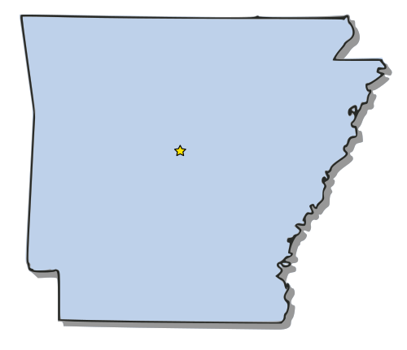
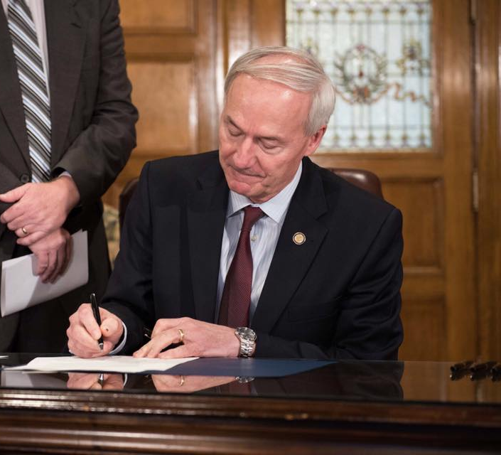

Local Control
Notes:
The main reason that states want delegation of these regulations is because it gives them greater control over how the federal programs are implemented and enforced locally. States want to be able to make decisions on regulations, permitting, and enforcement. They don’t want those decisions made in Washington D.C. or by an EPA regional office.
In effect, the governor of Arkansas has a very important role in setting the environmental policy of the state. The governor appoints the director of the state environmental agency. It is the Director’s role to make sure ADEQ is adequately fulfilling our role of protecting, enhancing, and restoring the environment of Arkansas for the benefit of all Arkansans.
The governor also appoints the members of the Pollution Control & Ecology Commission.

Slide 9



Program Delegation in Arkansas
Hazardous Waste (HW)
ADEQ’s Office of Land Resources has received delegated authority of the federal RCRA HW management program
State and federal HW management regulations and requirements are merged into a single reference document, APC&E Commission Regulation 23
RCRA’s Cradle-to-Grave
Hazardous Waste Management System
Hazardous Waste Generation
Hazardous Waste Transportation
Hazardous Waste Disposal

Slide 10
Program Delegation in Arkansas
Clean Water Act
ADEQ’s Office of Water Quality’s delegated authority includes:
National Pollution Discharge Elimination System (NPDES)
Pretreatment standards
Notes:
National Pollution Discharge Elimination System (NPDES)
Permit required for any discharges of pollutants from a point source into navigable waters of the US. EPA or the states must set limits on the amount of pollutants that facilities may discharge into a waterbody.
The thresholds are established according to national technology-based standards, and the conditions of the waters that receive the discharge based on state water quality standards.
Indirect discharges from non-point sources are not subject to NPDES requirements, but they are regulated by pretreatment standards.

Slide 11
Program Delegation in Arkansas
Clean Water Act
NPDES (National Pollution Discharge Elimination System)
An NPDES permit is required for any discharges of pollutants from a point source into navigable waters of the US.
EPA or the states must set limits on the amount of pollutants that facilities may discharge into a waterbody.
The thresholds are established according to national technology-based standards, and the conditions of the waters that receive the discharge based on state water quality standards. Indirect discharges from non-point sources are not subject to NPDES requirements, but they are regulated by pretreatment standards.
Notes:
National Pollution Discharge Elimination System (NPDES)
Permit required for any discharges of pollutants from a point source into navigable waters of the US. EPA or the states must set limits on the amount of pollutants that facilities may discharge into a waterbody.
The thresholds are established according to national technology-based standards, and the conditions of the waters that receive the discharge based on state water quality standards.
Indirect discharges from non-point sources are not subject to NPDES requirements, but they are regulated by pretreatment standards.

Slide 12
Program Delegation in Arkansas
Clean Water Act
Pretreatment
Publicly Owned Treatment Works (POTWs) required to develop pretreatment programs and impose pretreatment standards for discharges from non-point sources

Slide 13
Program Delegation in Arkansas
Air
ADEQ’s Office of Air Quality has received all delegable air programs, including the Title V program for major sources of pollutants, from Region 6 of the U.S. EPA.

Slide 14
Program Delegation in Arkansas
Air
Office of Air Quality programs include:
New Source Performance Standards (NSPS)
National Emission Standards for Hazardous Air Pollutants (NESHAP)
Prevention of Significant Deterioration (PSD)
State Implementation Plan (SIP)

Slide 15
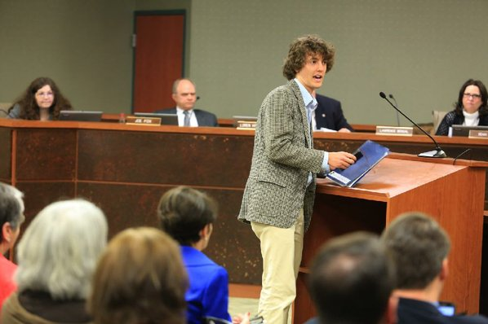
APC&E Commission
Environmental policy-making body for Arkansas
Thirteen members
  Six from state agencies
  Seven Governor appointees
Approves regulations
Appellate body for ADEQ decisions
Notes:
Explain about the makeup of the commission and how it represents the head of six state agencies and also appointees from all areas of the state.
Explain about the role of the commission in guiding the work of ADEQ – Approving regulations & settling disputes between ADEQ and the regulated community.

Slide 16
How ADEQ works
ADEQ Regulations
Permit/registration
  Inspection
    Enforcement
Notes:
Discuss that this slide shows a simple chart on how ADEQ functions.
ADEQ implements regulations to protect the environment
Those regulations will usually require a permit or registration to help us track and identify the regulated community
We send out inspectors to check on compliance with permits and regulations
Enforcement is taken against those found to be violating their permits or environmental regulations in order to bring them into compliance
Let’s take a look at each of those steps in a little bit more detail...

Slide 17
Environmental Regulation
National legislation
U.S. EPA rulemaking
State legislation
APC&EC rulemaking (initiated by ADEQ)
Third-party rulemaking
Notes:
Environmental regulations in Arkansas can come from a number of sources. As we discussed a few minutes ago, many of our broad environmental regulations are brought about to mirror the national regulations administered by the EPA. In addition, our own Arkansas Legislature can pass environmental acts that require ADEQ to develop regulations to implement and enforce the state laws. Recent examples of this type of legislation include issues like mercury switch removal in scrap automobiles and meth lab cleanups. Also, Arkansas law enables “third parties” to initiate rulemaking on their own behalf to make changes to our regulations.

Slide 18
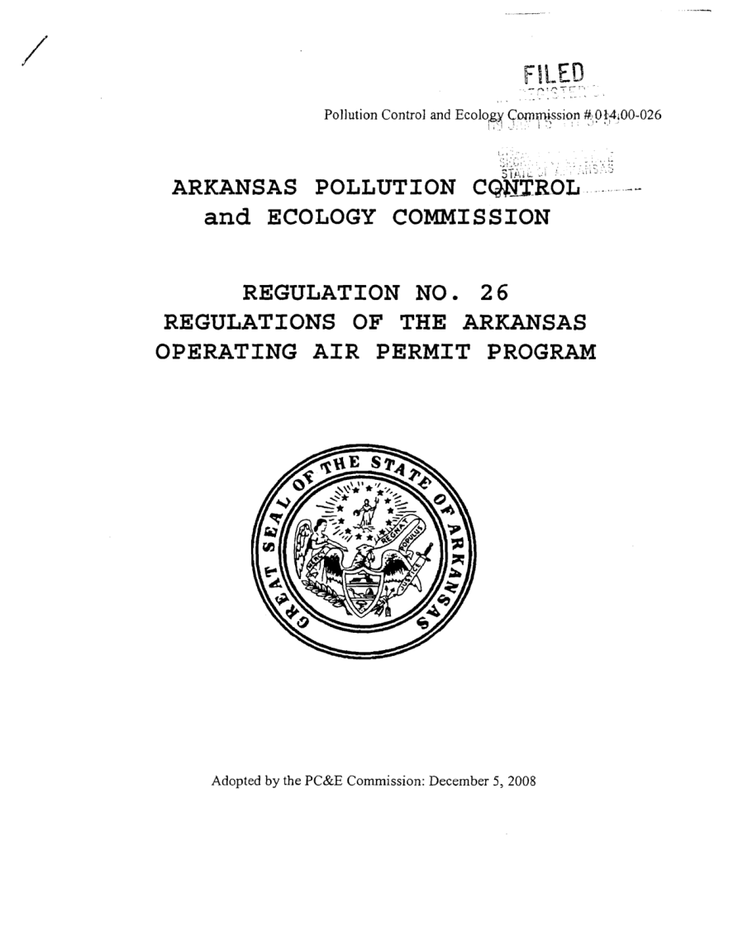
Implementing Regulations
Permits/
  registrations/
  ID number
Identifying & monitoring
General vs. Individual
Notes:
Many of our regulations place requirements on the operating processes of Arkansas manufacturers and businesses. As a means of implementing these regulations, we require those businesses affected to obtain a permit, registration, or ID number to make them aware of their requirements and responsibilities under the regulations. It also enables ADEQ to gather data on these facilities so that we can better understand where they are located and what effect they may have on the environment.
These permits can be either general or individual. General permits will apply to broad groups and make regulating them easier. Instead of writing multiple permits for each individual facility, we write one permit that covers most, if not all, facilities in a certain sector. Examples of General Permits in Arkansas include our storm water permits, asphalt plant air permits, and Car Wash Water Permits.
Individual permits, on the other hand, are specifically tailored for one location. These permits are required when a general permit isn’t feasible or a facility doesn’t fall under the requirements of a general permit. Individual permits take longer to issue as they require more work by our staff.
Both individual and general permits follow the same path to getting approved and issued. General permits are written by ADEQ staff and then are sent through the permitting process. Once they are approved, applicants simply file an application of their intent to be covered by the permit. As long as they meet the criteria of the permit, they can be covered. Individual permit applications are submitted by the applicant and must go through a complete approval process to ensure the permit meets all regulatory requirements.

Slide 19
Permitting
Public notice
Draft permit
Public comment
Public hearings (if requested)
  Comments
  Response to comments
Notes:
Explain the permitting process from initial notification of the permit through the public comment and hearing process. It might be good to explain exactly what we do during the comment period to differentiate between what kind of changes can be made and what can’t be done. (substantive comments vs. complaints)
Timeframes:
Permit Application:
Public notice of an administratively complete application for a new permit is published in a newspaper of general circulation (Arkansas Dem/Gaz). Reg. 8 §2.1.4.
An interested person may request a public hearing on the proposed permit by giving the Department a written request within 10 business days of the publication of the notice. Reg. 8 §2.1.4. Notice must follow the requirements in Reg. 8. Discretion to hold a hearing remains with the Director.
Draft Permitting Decision:
Notice of a draft permitting decision is published in newspaper of general circulation stating among other things, that public comments will be accepted during the public comment period which is 30 calendar days from the date of publication of the notice. A.C.A. § 8-4-203(c)(1)(B), Reg. 8, §2.1.6 & 2.1.7.
After receiving public comments, within Director’s discretion to hold public hearing. If hearing held, notice mailed to applicant and all persons who submitted comments and published in newspaper. Reg. 8, §2.1.8.
Oral comments are received at hearing. Presiding officer (usually a Commissioner) my grant at the hearing, an extension of time for filing written comments up to 20 days after the hearing. Reg. 8, §2.1.8.
Public Meetings may also be held to exchange information with the public on permitting decisions.
Response Time: No time frames are set by regulation for responding to comments and completing the draft permit. Response and completion times will vary depending on number of comments received and complexity of the permit.
Final Permit Decision: Will be in writing and include a response to each issue raised in public comments received during the public comment period. (Similar Comments may be combined and one response to those comments may be given.)

Slide 20
Inspections
Permit/registration
Complaint
Random
Notes:
Discuss the inspection process. Stress that the bulk of our inspections are programmed inspections of those facilities holding permits or registrations with ADEQ. This is our means of checking compliance with those documents. ADEQ also investigates all complaints that are filed with us by phone, letter, or e-mail. This allows us to use the citizens of Arkansas as an extra set of eyes to help us find those businesses causing problems. Also note that we sometimes do random inspections that could be based on certain regulations or industry sectors as part of our enforcement strategy.

Slide 21
Inspections
What to Expect
Discuss compliance
Tour facility
Examine records
Notes:
Discuss that inspections seek to find all relevant information on a facility to determine compliance or non-compliance. During an inspection, ADEQ inspectors will meet with a facility representative to discuss their compliance with regulations. They will tour the facility to visually inspect operating processes and procedures. They will also go over any relevant documents needed for the inspector to be able to make an accurate determination of their compliance.

Slide 22
No Violations
Inspector writes report
Report routed up chain of command
Report sent to facility
Notes:
The inspector will review all information received during the audit and write up a report of his/her findings. That report will then be routed through the chain-of-command to be reviewed for accuracy and approval. Assuming that no violations were found during the inspection, the report is sent to the facility and no further action is required.

Slide 23
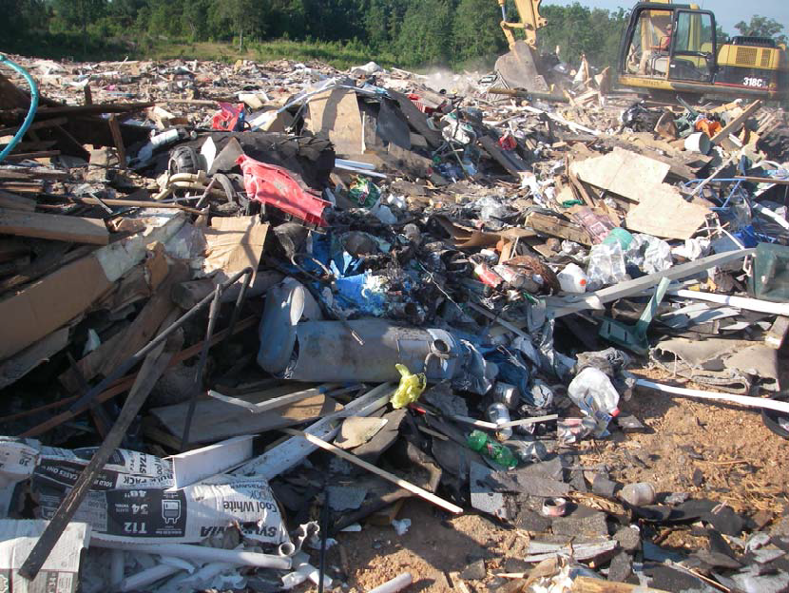
Facility Violations
Inspector writes report
Report routed up chain of command
Referred to Enforcement
Notes:
If violations are found during the inspection, a similar process is followed but the report is also referred to Enforcement for further action. The enforcement administrators must review the report to gauge the severity and impact of the violations.

Slide 24
Enforcement
Consent Administrative Order (CAO)
Notice of Violation (NOV)
Direct action in Civil Court
Notes:
One option for enforcement is a Consent Administrative Order (CAO). A CAO lists the alleged violations and includes required corrective measures and a proposed penalty. Once approved by the Director, the CAO is sent to the facility for review.
A CAO is a negotiable agreement proposed by ADEQ to address the violations. The facility has the option of signing the CAO or requesting that the CAO be modified to reflect additional information that the facility feels is relevant to the issue. The facility also has the option of not signing the CAO. (This will lead to one of the next two types of action)
Another option for enforcement is a Notice of Violation (NOV) which is a a written notification to a person of alleged violations. The Notice of Violation initiates an administrative enforcement action.
Reg 8 on NOVs:
“2.3.2 Issuance of Notice of Violation
(a) Except as otherwise provided in Section 2.4, the Director shall not issue an order, except by consent, to any person for violation of the laws, permits, or regulations administered by the Department unless and until the person has been served with a Notice of Violation and has had the opportunity to request an adjudicatory hearing in accordance with Subsection 2.3.3.
(b) Whenever the Director determines that reasonable grounds exist to believe that a violation has occurred which should be addressed by the issuance of a Notice of Violation, the Director shall cause such notice to be served upon all persons alleged to be in violation. The notice shall state:
(1) All alleged violations of which the person is accused;
(2) The civil penalty, if any, proposed by the Director to be assessed for each violation;
(3) Corrective actions, including time frames, which in the Director's judgment must be undertaken to remedy the violations or to otherwise
abate or contain any situation causing pollution or the threat thereof;
(4) Any other measure, such as permit suspension or revocation, proposed by the Director to be taken against the alleged violator;
(5) That the alleged violator must file a written response to the Notice of Violation with the Secretary within twenty (20) days of its receipt, or otherwise the allegations therein will be deemed proven and the Director may thereafter issue a Default Administrative Order affirming the allegations as findings of fact, affirming the assessment of civil penalties, and ordering the corrective actions and other matters, as stated in
the Notice of Violation; and
(6) That upon filing a written response within the time provided, the alleged violator will be entitled to a Commission review and adjudicatory
hearing upon the allegations and other matters stated in the Notice of Violation.

Slide 25
Powers of ADEQ
Criminal penalties
Civil action
Civil penalties
  $10,000 per day per violation of any rules, regulations, permits, or plans
Notes:
2.3.3 Response to Notice of Violation
Any person served with a Notice of Violation shall file a written response thereto with the Secretary within twenty (20) days of its receipt. If this person fails to respond within this period of time, the allegations contained in the Notice of Violation will be deemed proven and the Director may thereafter issue a Default Administrative Order affirming the allegations as findings of fact, affirming the assessment of civil penalties, and ordering the corrective actions and other matters, as stated in the Notice of Violation.
(b) A written response to a Notice of Violation shall provide the caption of the action and the docket number assigned to the matter. The response may be in the form of a general denial or may admit one or more of the allegations and deny others, and may contest the proposed civil penalties, if any, or the corrective actions or other matters stated in the Notice of Violation.
(c) A written response to a Notice of Violation shall initiate a review by the Commission in accordance with Section 2.5 unless the matter is resolved by stipulation or settlement of the parties.
2.3.4 Finality of Default Administrative Order A Default Administrative Order is a final order of the Director. Except as provided in Subsection 2.3.5, such order may not be reviewed on its merits by the Commission unless the person to whom the order was issued files a Request for Commission Review and Adjudicatory Hearing and proves that his failure to respond to the Notice of Violation was due to excusable neglect. Only then will the person be allowed an adjudicatory hearing on the merits.”
NOVs are published on the 10th day of each month. Notice contains statement that written comments will be accepted by the Department. Reg. 8 §2.3.6.
Failure to respond to an NOV within 20 days will result in the issuance of a Default Administrative Order (DAO). DAO will be filed as complaints in circuit court to obtain enforceable judgments.

Slide 26
Emergency Orders
Necessary to meet an emergency or situation of imminent hazard
May be issued verbally or in writing
Effective upon issuance
Request for hearing may be filed in writing within ten business days
Notes:
Director has discretion to issue EO when it is necessary to meet an emergency or situation of imminent hazard. Order may be issued verbally or in writing and is effective upon issuance. A.C.A. §8-4-220 & Reg. 8, §2.4.2.
Any person to whom an EO is issued may file a written request for hearing within 10 business days of the issuance of the order. The hearing will be held within 10 days of the request. Id.
ADEQ may also take a direct action in Civil Court to compel compliance. There is no requirement to file an administrative action first.
ADEQ follows APC&EC Regulation No. 8 – not the Administrative Procedures Act.
May want to discuss what factors are used to calculate penalties.

Slide 27
“Informal” Enforcement
Department seeks compliance through cooperation
Affords suspected violators an opportunity to resolve problems prior to initiation of administrative enforcement proceedings
Notes:
Work with the inspectors and enforcement officials in the Divisions to try to resolve issues before it gets to Legal.

Slide 28
Administrative Enforcement
NOV received
20 days
Don’t Respond
Respond
Notes:
What if I don’t file an answer w/ 20 days?
Director will issue a Default Administrative Order (“DAO”) which affirms:
The findings of fact
The assessment of civil penalties and
Ordering Corrective Actions
A complaint will then be filed by the Dept. in Circuit Court to enforce the DAO, additional penalties may be assessed.

Slide 29
Administrative Enforcement
You file an Answer, now what?
Administrative Hearing Officer (AHO) sets a hearing and schedule
Schedule includes discovery deadlines, motion deadlines, and briefing schedules
AHO may issue subpoenas
Notes:
Timeline is more compressed than typically what is experienced in circuit court. APC&EC Reg.8.614(A) provides that in the appeal of a permitting decision, the Administrative Hearing Officer shall schedule the hearing and other proceedings so that the matter will be submitted to the Commission for final Commission action within one hundred twenty (120) calendar days after the preliminary hearing. Regulation also provides for the parties to mutually agree to longer period of time or for the AHO to establish a longer period of time for just cause.

Slide 30
Administrative Enforcement
Within 20 days of entry of recommended decision, a party has right to request hearing before the full Commission.
Commission’s decision may be appealed to circuit court
Notes:
The Commission’s review is de novo of the record compiled. Generally, just arguments of counsel are heard – can vote to consider add’l evidence.
When the Commission’s decision is appealed to circuit court, the review of the court is confined review of the record. The Commission is represented by the AG and the Department gets involved only if we intervene.

Slide 31
Who can Appeal to the Commission?
Permittee or permit applicant
Person named in an NOV
Commenter of record
Notes:
Right of Permit Applicant and Alleged Violator to appeal is self evident.
Permit Appeals by Other Parties:
Only persons who submitted comments on the record have standing to petition for permissive intervention in a permit appeal. A.C.A. §8-4-205(b)(1) & §8-4-203(3), Reg. 8, §2.1.13 & §2.5.3.
However, if no public comment period is provided, any person who reasonably considers himself injured in his person, business or property by the decision shall have standing to petition for intervention. Reg. 8, §2.1.13.
If the permit applicant does not appeal a permitting decision, any person who submitted comments has the right to file a Third-Party Request for Commission Review and Adjudicatory Hearing within 30 days of the date of issuance of the permitting decision. Reg. 8, §2.5.3(b).
NOV Appeals:
Any person who submitted written comments during the public comment period, discussed above, is given notice of any adjudicatory hearing to be held and has a right to intervene upon a timely filing of a Petition for Intervention.
As with permit appeals, if no comment period is provided, any person who reasonably considers himself injured in his person, business or property by the NOV shall have standing to file a petition for intervention. Reg. 8, §2.3.7.
If the alleged violator does not appeal an NOV, no Third-Party right to request Commission review exists in Reg. 8.

Slide 32
Appeal to the Commission
Request adjudicatory hearing
  NOV: within 20 days
  Permits: within 30 days
Hearing officer’s recommended decision
Commission review
  Oral arguments
  Additional evidence
Circuit court appeal
Notes:
NOVs: The alleged violator must file a response to the NOV with the Commission Secretary within 20 days of its receipt.
Permits: Only permit applicant or person who submitted comments on the record have standing to file a permit appeal. A.C.A. §8-4-205(b)(1) & Reg. 8 §2.1.13.
Permit Appeals must be filed within 30 days of the date of issuance of the final permitting decision. Note: Time begins running when decision is placed in the mail to the permittee or applicant – not when he or she receives it. Reg. 8, §2.1.10(b).
During the pendency of the appeal: The denial of a permit shall stand; the issuance modification or revocation of a permit or that part of a permit which is the subject of the appeal shall be stayed. A party may apply to have stay imposed, modified or lifted to avoid substantial prejudice. A.C.A. §8-4-205(c)(6).
If the request meets Regulation 8 conditions, then an adjudicatory hearing will be set. The appeal is conduct much like any other lawsuit. The ALJ will set discovery schedules, motion deadlines, etc. At the hearing, both sides will present their witnesses and evidence in a trial-like setting. The ALJ will subsequently make a recommended decision.
The recommended decision will be presented to the full Commission. Prior to the Commission’s vote they may hear oral arguments or additional evidence as per Reg 8.
“2.5.19 Oral Argument Before the Commission
(a) Request for Oral Argument
(1) Any party of record may request oral argument on a Recommended Decision before the Commission by filing a written request with the
Secretary no later than twenty (20) days after the Recommended Decision has been mailed to all parties.
(2) The request must contain the factual objections and legal issues to be addressed and the relief sought from the Commission.”
“2.5.20 Additional Evidence
(a) If a party of record requests an opportunity to supplement the record with additional evidence and is able to satisfactorily demonstrate to a majority of the Commission that the evidence is material to the issues and was unavailable at the time of the adjudicatory hearing despite the best efforts of the party to procure the evidence, then the Commission may remand the matter to the Administrative Hearing Officer to take further
testimony and evidence in the matter or direct that the Director reconsider the matter based on the additional evidence before the matter is considered by the Commission.
(b) The requesting party shall file an affidavit with the Secretary describing the circumstances as to why the additional evidence was not available at the time of the adjudicatory hearing and why the information is material to the issues. A copy of the affidavit shall be furnished to all parties of record at least ten (10) business days prior to the date the Commission meets to consider the request.”
The decision of the Commission upon review of a matter shall be by majority vote of the Commissioners present; shall be issued in the form of a "Minute Order"; and shall either affirm, modify or reverse, in whole or in part, the Recommended Decision of the Administrative Hearing Officer. Alternatively, the Commission may, by Minute Order, remand the matter with directions to the Administrative Hearing Officer or Director for further proceedings. The Secretary shall serve a copy of the Minute Order upon all parties of record to the proceeding no later than ten (10) business days after the Minute Order is executed by the Commission.
The Commission's vote to affirm or reverse the Recommended Decision shall constitute final Commission action for the purposes of appeal.
The Commission’s review of the Director’s decision is de novo.
The Commission’s decision may be appealed to Circuit Court, Ark. Code Ann. 8-4-222-8-4-229. The Circuit Court’s review is confined to the record of the Commission.

Slide 33
Administrative Recap
NOV
Respond
Don’t Respond
Discovery
DAO
Hearing - AHO
Full Commission
Circuit Court
Enforcement

Slide 34
Supplemental Environmental Project (SEP)
An in-kind service or cash contribution to a project designed to advance environmental interests and which a Person agrees to perform in partial settlement of an enforcement action, but which the Person is not otherwise legally required to perform, and retains no monetary benefit.
Notes:
An in-kind service or cash contribution to a project designed to advance environmental interests and which a “Person” (meaning a state agency, any municipality, governmental subdivision of the state or the United States, public or private corporation, individual, partnership, association or other entity) agrees to perform in partial settlement of an enforcement action, but which the Person is not otherwise legally required to perform, and retains no monetary benefit.
A Person's willingness to make voluntary in-kind service or cash contributions to such projects may be considered by Arkansas Department of Environmental Quality (ADEQ) enforcement staff in the partial settlement of enforcement actions. The specific project must be approved by the Director in consultation with the Enforcement Manager assigned to the matter under the guidelines described herein and in accordance to A.C.A. §§ 8-4-103 (f)(3), 8-6-204 (e)(3), or 8-7-204 (e). This guideline does not create any rights on behalf of the Person.
The final administrative penalty amount (without considering the amount approved for any SEPs) must be sufficient: (1) to have a deterrent effect on the individual violator and on other violators in similar positions, and (2) to the extent possible, recapture the economic benefits of noncompliance plus some appreciable portion of the gravity component of the penalty computation.
In general, a SEP will not justify more than a thirty-five percent (35%) reduction of the recommended administrative penalty, however, the Director has the final authority to establish the level of partial mitigation of a statutory penalty.

Slide 35
State Government Clerkships
ADEQ usually has a clerkship offered in the fall and spring semesters
Clerkships are coordinated through the law school’s externship program
(Kelly Terry)

Slide 36
State Government Clerkship
Benefits of clerking:
Usually one-on-one mentor with attorney
Included in staff and client meetings
Diverse assignments
Feedback on work product
Hours
Holidays
Rarely “billing”
Public Service Loan Forgiveness as
part of College Cost Reduction and Access Act of 2007

Slide 37

Questions?
Stuart Spencer
Office of Air Quality
501.682.0750
spencer@adeq.state.ar.us
Notes:
That was a quick summary of the ADEQ regulatory process from regulations to permitting to enforcement. Keep in mind some very important steps that are common in all of these processes:
There are many opportunities for the public and concerned parties to be involved in the process
This process is conducted openly and all documentation and meetings are open to outside review
There are different levels of appeal for the regulated community
The APC&E Commission provides an extra degree of oversight during all of these processes to ensure the needs of the citizens and environment of Arkansas are represented
Thank hosts – Mention contact information – Take questions

