Slide 1

Landfill Post-Closure Trust Fund

Slide 2
Landfill Post-Closure Trust Fund
What is it?
  The post-closure trust fund was established by Act 747 of 1991.
  Amended by Act 1037 of 2015 - include closure of waste tire processing facilities or disposal sites owned or operated by RSWMDs.
  Amended by Act 624 of 2017 - repealed §8-6-612 and removed the $25 million dollar cap.
  Used to perform corrective action at a site that is causing groundwater or other type of contamination.

Slide 3
How the Fund is Financially Supported?
Disposal Fees
  Collected and paid on a quarterly basis by permitted landfills in AR (except private industrial landfills 3Ns)
  Fees - $1.00/ton $0.15/uncompacted cy $0.30/compacted cy

Slide 4
C & L Landfill
Washington County

Slide 6
Selected Corrective Action
  Construct proper landfill cap.
  The intent is to reduce the amount of contaminants from seeps and reduce impacts to surface waters and groundwater.
  Expenditures to date: $5,567,160

Slide 7
Nabors landfill
Baxter County

Slide 8
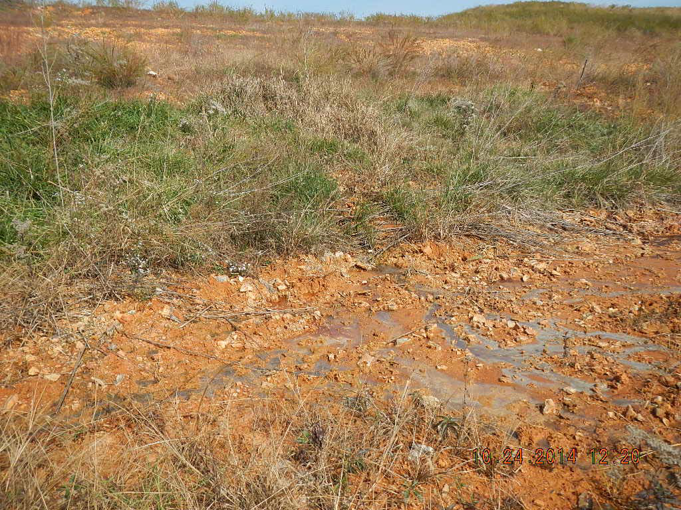

Slide 9
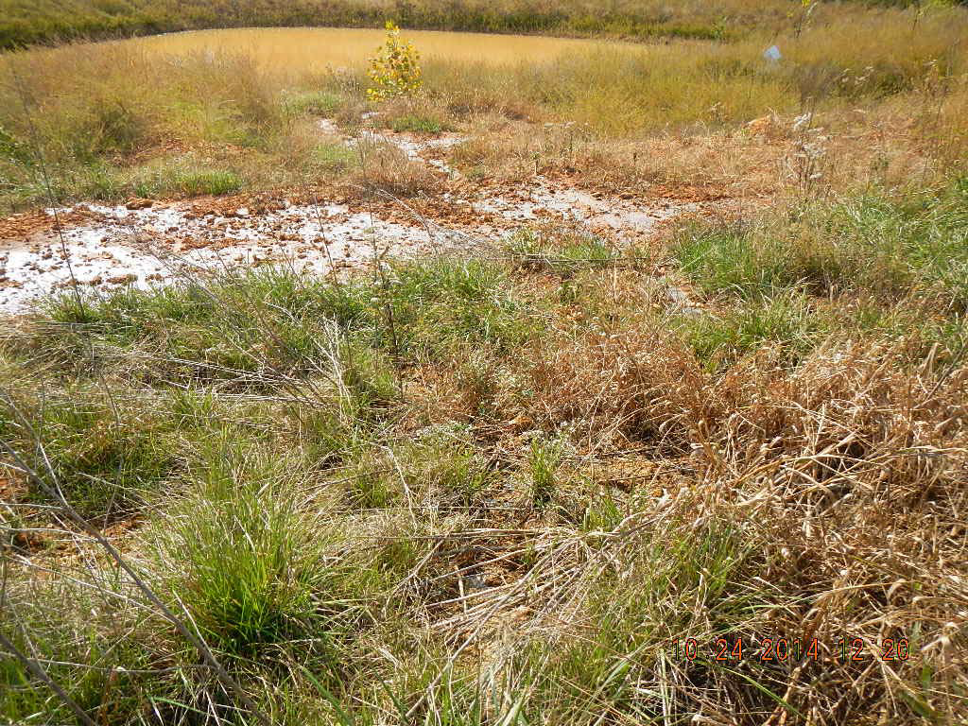

Slide 10
Selected Corrective Action
Remove overfill and correct slopes
Install common leachate collection system
Install closure turf
Install passive gas system
Expenditures to date:
  FA Forfeiture - $2,438,622.84
  PCTF - $10,295,401.79

Slide 11
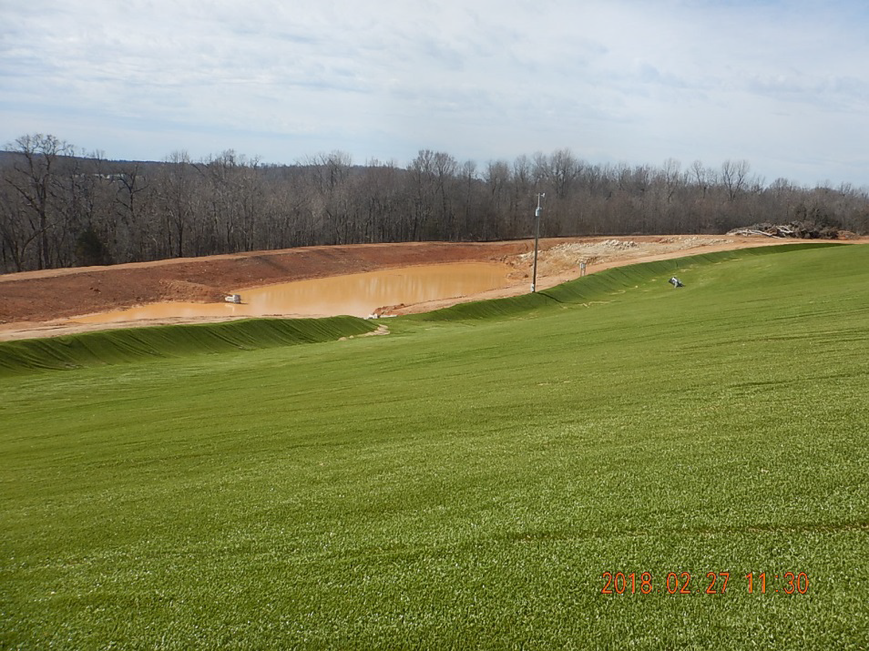

Slide 12
Damco waste tire site
Baxter County

Slide 13
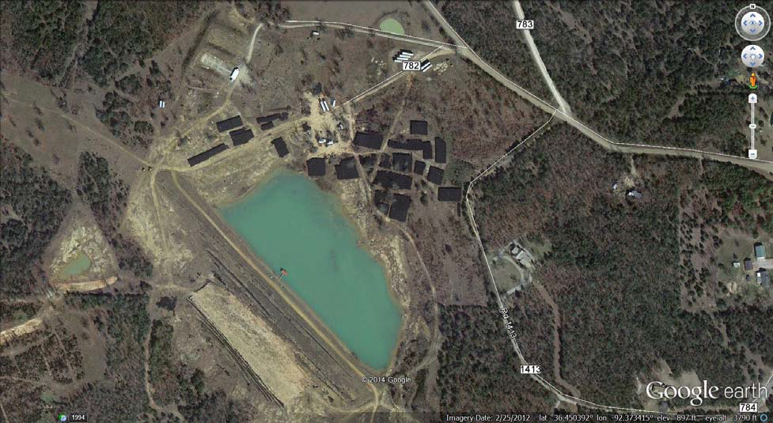

Slide 14
Selected Corrective Action
Remedial Design
Rock excavation
Tire baling/re-banding
Tire bale placement
Temporary/final cover
Expenditures to date:
  F.A. Forfeiture - $75,071.71
  PCTF - $1,232,512.68

Slide 15
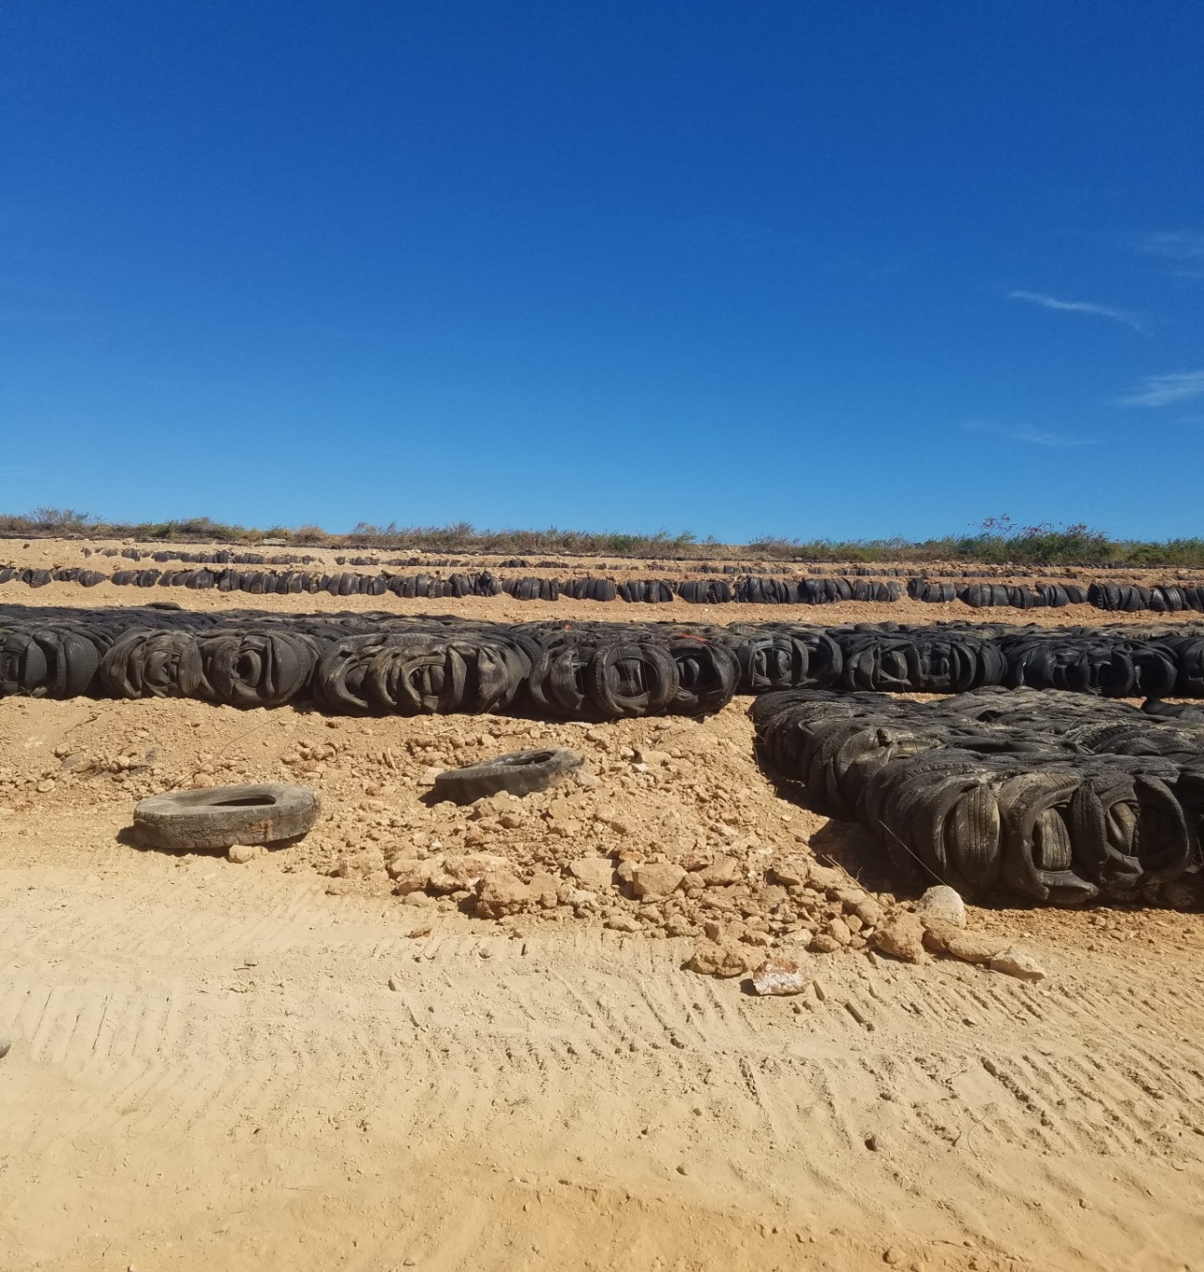

Slide 16
Contact Information
Susan Speake
Trust Fund Manager
Remediation & Assessment / OLR
Phone: (501) 682-0594
speake@adeq.state.ar.us

