Slide 1

APC&EC Regulation No. 36
Tire Accountability Program
Arkansas Environmental Federation
April 17, 2018

Slide 2
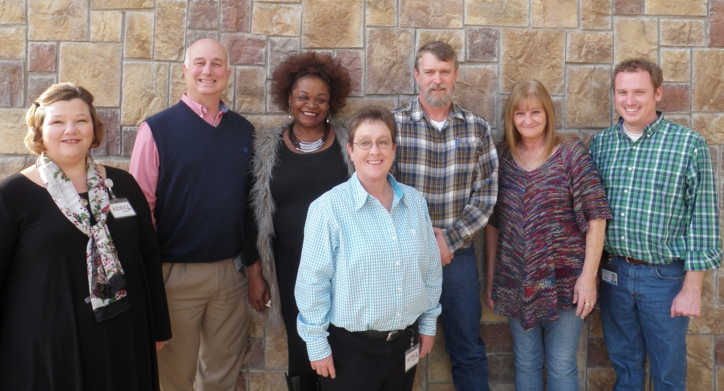
Meet the Tire Accountability Program Team Members

Slide 3
Tire Accountability Program
Tire Accountability Program
Senior Manager:
Tammie Hynum
Admin Analyst:
K. Johnson
Generators & Transporters Manager:
Daniel Marks
Processors & Waste Tire Sites Manager:
Scott McWilliams
Business Planning Manager:
Everette Hatcher
Admin Analyst:
C. Kent
Admin Analyst:
M. Womble

Slide 4
Rules and Regulations
APC&EC
Regulation No. 36

Slide 5
General Provisions and Definitions
Act 317 of 2017
Regulation 36
Primary goal of the program is to ensure Districts recycle or put to beneficial use as many used tires as possible
Reg. 36: Chapters 1 and 2

Slide 6
Used Tire Programs
Used Tire Programs (UTPs) are defined as Solid Waste Management Districts or Inter-District programs that collect and manage used tires.
Must obtain an identification number for using the e-manifest system. √
Submit Business Plan for review and approval. √
Develop & Submit a Used Tire Management Plan: √
  Name and address of all waste tire sites;
  Quantity of tires at each waste tire site;
  Owner and Operator of each waste tire site; and
  Schedule of implementation to abate each site.
Reg. 36: Chapter 3

Slide 7
Performance & Efficiency Evaluations
Performance indicators used by the Department in evaluating the Business Plans included:
  Quantity of recyclable tires
  Quantity of waste tires disposed in a landfill
  Number of waste tire sites in the district
  Administrative, facility, and Transportation expenses
  Revenue sources
  Number, type, and location of tire collection centers
  Recycling rates
Reg. 36: Chapter 4 and 5

Slide 8
E-Manifest System
Purpose:
  Provide accountability
  Provide sustainability
How is this done?
  Requiring the use of e-manifest system for UTPs and paper manifest for tire generators.
Why an e-manifest system?
  Provides ADEQ with an accurate reporting of all information related to collection, transportation, distribution, recycling, and disposal of recyclable tires, waste tires, and used tires culled for resale.
Reg. 36: Chapter 6

Slide 9
Tire Generators
Register with DFA
Types of Tire Generators:
  Tire retailer
  Tire transporter
  Tire wholesaler
  Tire manufacturer
  Manufacturer of retreaded tires
  New or used car dealers
  Auto repair shop
  Salvage yard
Reg. 36: Chapter 7

Slide 10
Ark. Code § 8-9-401(15)(A)
“Tire generator” means a person who:
  (i) Removes tires from rims for disposal or resale; or
  (ii) Stores used tires on or in property owned, leased, or otherwise controlled by that person.
Reg. 36: Chapter 7

Slide 11
Tire Transporter
“Tire transporter” is defined as a person who is in the business of or receives compensation for transferring used tires from one (1) location to another location for collection, storage, processing, recycling, disposal, reuse, or resale.
Reg. 36: Chapter 7

Slide 12
What is required of Transporters?
8-9-411(a)
On or after January 1, 2018, a tire transporter shall meet the following requirements:
  Obtain for each vehicle a tire transporter license and receive a tire transporter number
  Provide proof that each vehicle has passed an annual safety inspection
  Provide proof of insurance for each vehicle and authorized driver
  Provide a bond in the amount of ten thousand dollars ($10,000.00)
  Establish that each authorized driver has completed training for the used tire manifest
  Pay a fee of fifty dollars ($50.00) for each vehicle to be licensed
Reg. 36: Chapter 7

Slide 13
Rim Removal Fees
Starting January 1, 2018, rim removal fees are imposed upon the transaction of removing a tire from a rim that is related to the sale of a replacement tire by a tire retailer.
The tire retailer will impose a rim removal fee to any person who purchases:
  A replacement tire for a rim that involves the removal of a different tire from the same rim; or
  The service of removal of a tire from a rim and replacement with a tire not purchased from the tire retailer (only if person making purchase cannot show proof of rim removal fee payment for replacement tire).
Reg. 36: Chapter 8

Slide 14
Rim Removal Fees
$3.00 for each new tire that replaces a tire removed from a rim
$1.00 for each used tire that replaces a tire removed from a rim
Each tire generator must:
  Register with DFA and ADEQ
  Collect fees from the purchaser
  Pay DFA monthly (keep 5% for administrative costs)
  Use the paper manifest form
Reg. 36: Chapter 8

Slide 15
Commercial Generators and Fees
Starting January 1, 2018, commercial generator fees will be imposed upon the transaction of a commercial generator selling or delivering a new tire as part of a fleet service.
The commercial generator fee shall be charged by the commercial generator to a person who in the ordinary course of business is an end user that removes used tires from the rim and replaces them with new tires.
Reg. 36: Chapter 9

Slide 16
Commercial Generators and Fees
Commercial generator fee is paid to DFA:
  $3.00 for each new tire sold or delivered to an end user
The commercial generator who collects the fee may retain 5% for administrative costs.
Reg. 36: Chapter 9

Slide 17
Importers and Import Fees
Starting January 1, 2018, import fees are imposed at a rate of $1.00 for each used tire that is imported into AR.
Importers must:
  Be registered with DFA and ADEQ
  Pay monthly fees to DFA
  Use the paper manifest
Reg. 36: Chapter 10

Slide 18
Disbursements
Reimburse UTPs for used tire recycling and disposal costs
Provide incentives for recycling used tires collected under this regulation
Provide accountability for the disbursement of moneys to UTPs
Improve the sustainability of UTPs
Reg. 36: Chapter 11

Slide 19
Disbursements
Disbursements are:
  Based on moneys available in the funds
  According to established rates in the approved business plan specific for each UTP
  According to funding priorities
    Level One
    Level Two
    Level Three
Reg. 36: Chapter 11

Slide 20
Beneficial Use
Requires written approval by both the used tire programs and ADEQ
Regulation 36.1202 contains the Project Proposal requirements
Exemptions:
  Project involving <500 tires for soil erosion
  Tire chips as leachate collection media
  Road construction
  Daily cover
Reg. 36: Chapter 12

Slide 21
Waste Tire Sites
Waste tire sites are prohibited
Within a 30-day written notification from ADEQ, a person must:
  Provide information of the waste site including the location, size, and amount of tires
  Submit a written plan describing a method and time schedule for removal
Reg. 36: Chapter 13

Slide 22
Tire Collection Centers
Districts must have at least one center in each county (75 minimum state-wide)
Access-controlled
General Permit (Form TAP-6)
Annual Report (Form TAP-5)
Initial Permit Fee of $200.00
Annual Permit Fee of $50.00
General Permit good for 5 years
Reg. 36: Chapter 15

Slide 23
Tire Processing Facilities
Site-specific permit (Form TAP-4)
Initial Permit Fee of $250.00
Annual Permit Fee of $250.00
If less than 500 tires in a 30-day period are processed, the owner/operator may obtain a general permit for mobile processing equipment.
  Initial Permit Fee of $200.00
  Annual Permit Fee of $50.00
Reg. 36: Chapter 16

Slide 24

QUESTIONS
Fact Sheets
Checklist
Forms
TAP Webpage
https://www.adeq.state.ar.us/tap/

